Slide 1
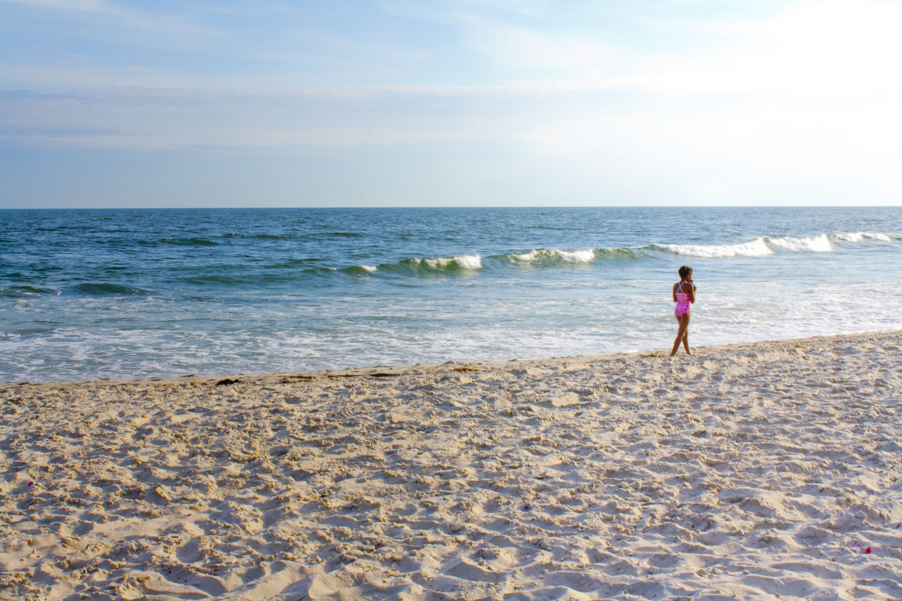
Yan Zhang (Arena)

Slide 2
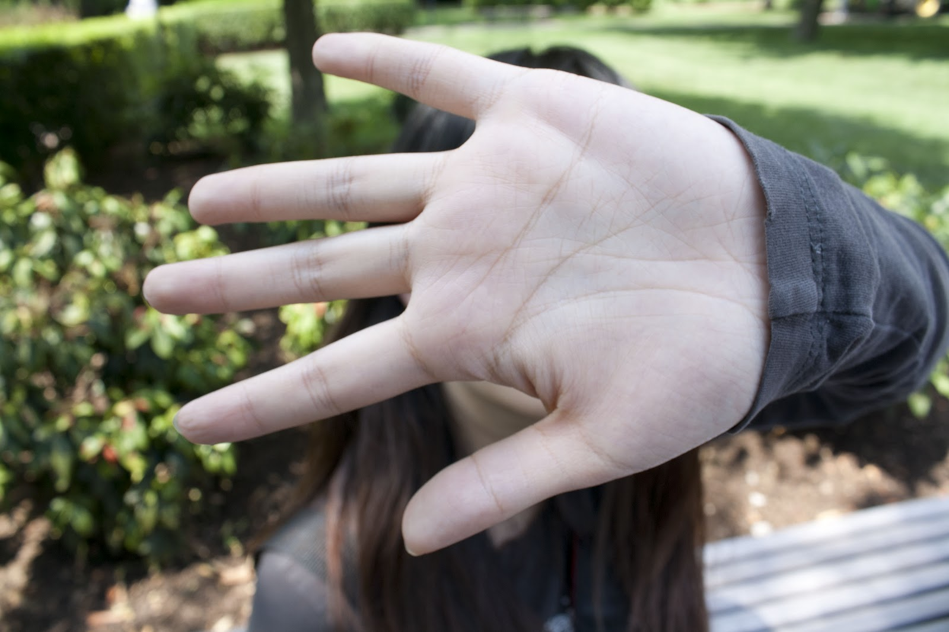
Scavenger Images 1
Go away!!!
PAPARAZI

Slide 3
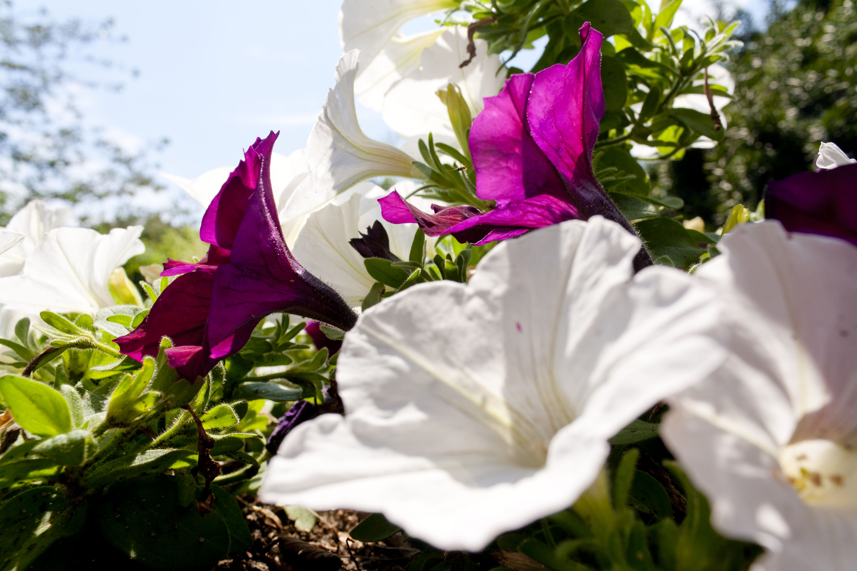
Scavenger Images 2

Slide 4
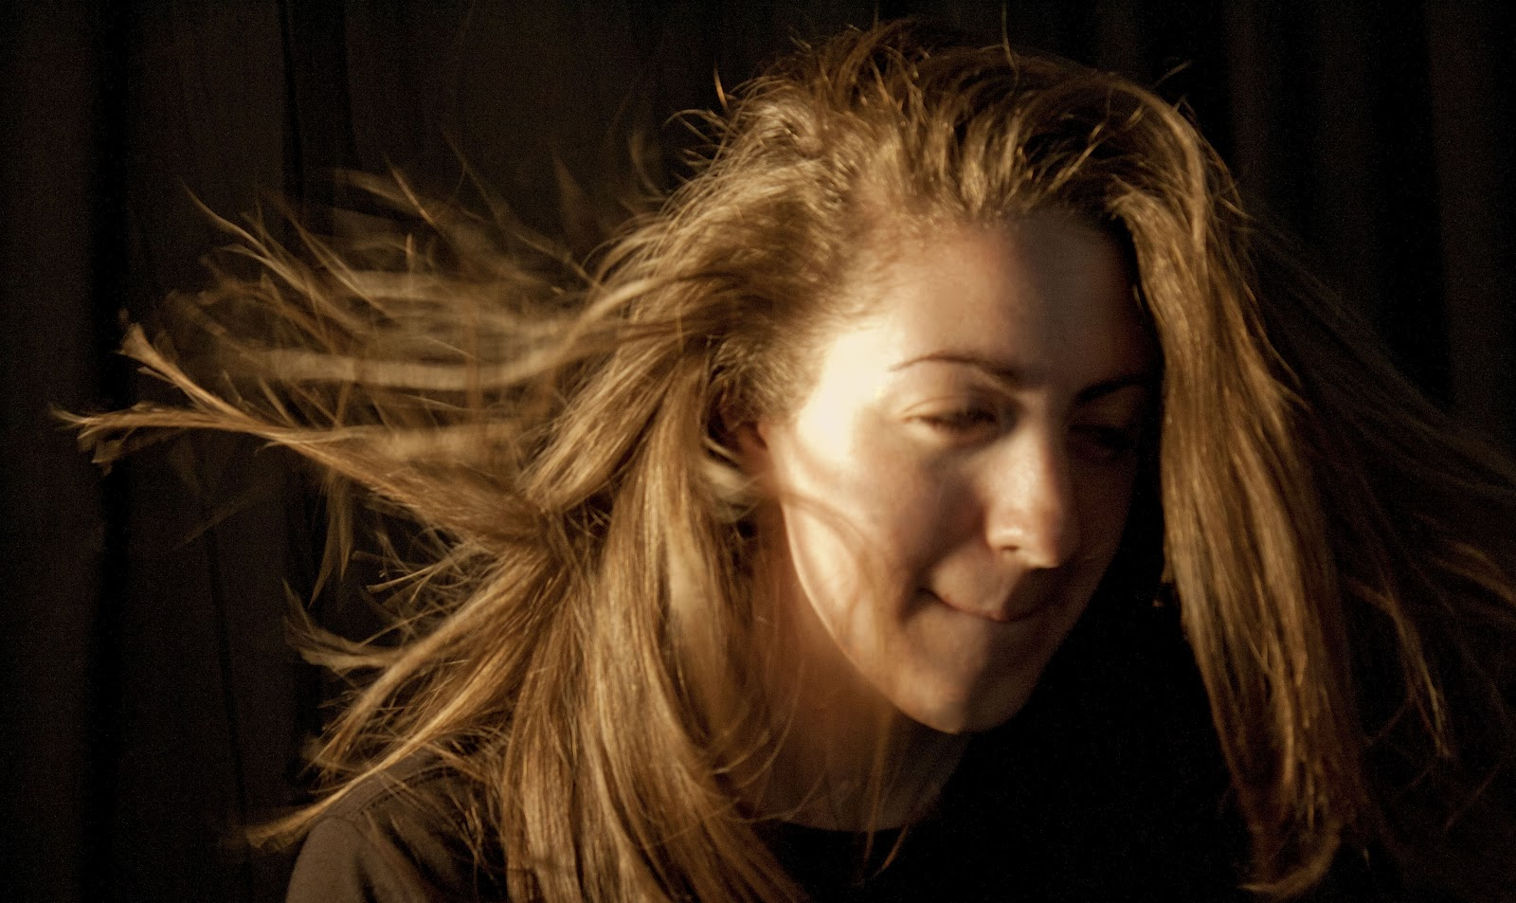
Studio Images : 1

Slide 5
Studio Images: 2

Slide 6
Panoramic 1

Slide 7
Panoramic 2

Slide 8
Light Images 1

Slide 9
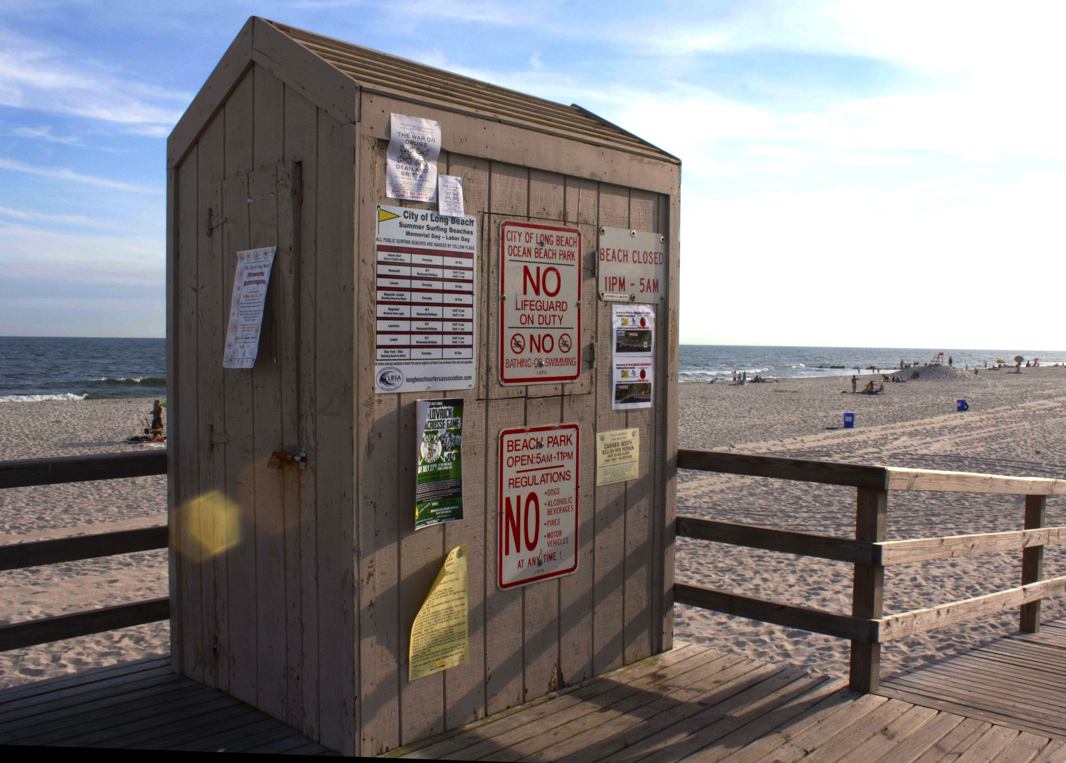
Light Images 2

Slide 10
Light Images 3

Slide 11
Abstraction Images 1

Slide 12
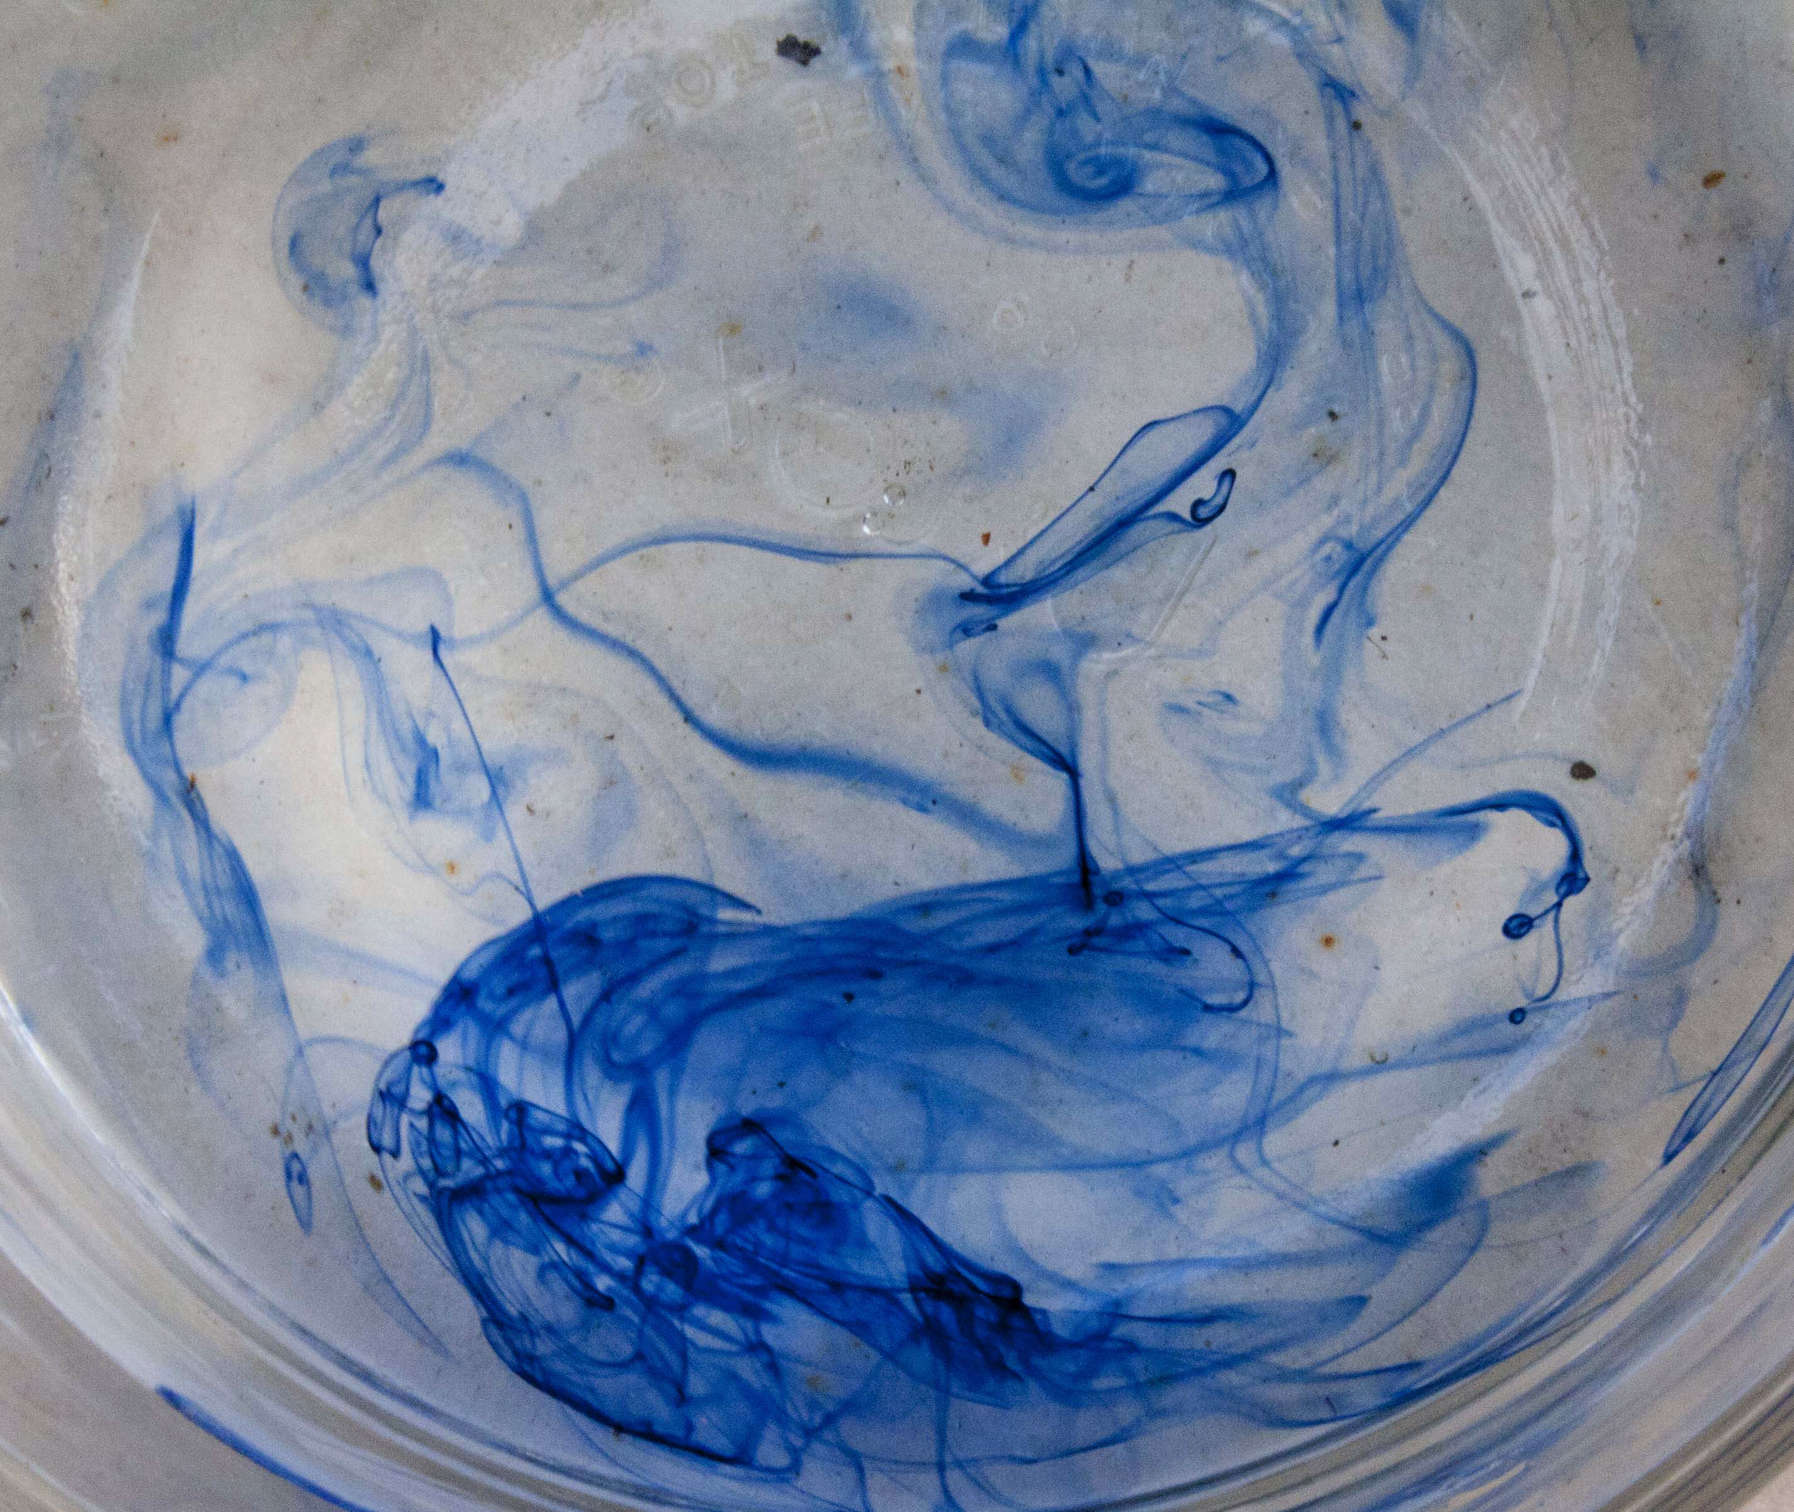
Abstraction Images 2

Slide 13
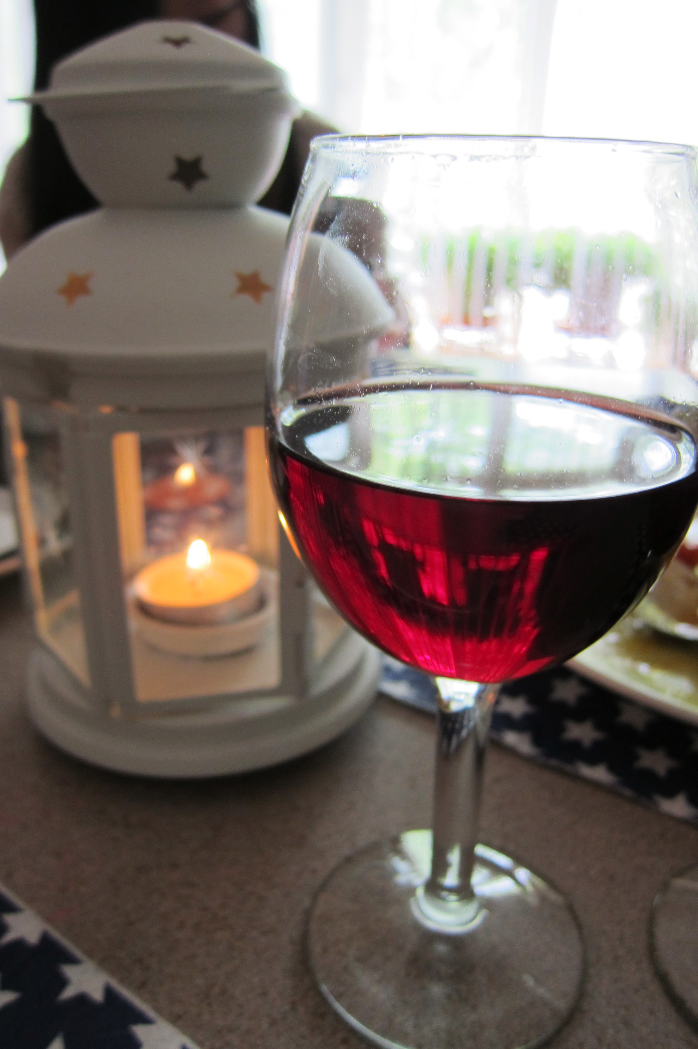
Family

Slide 14
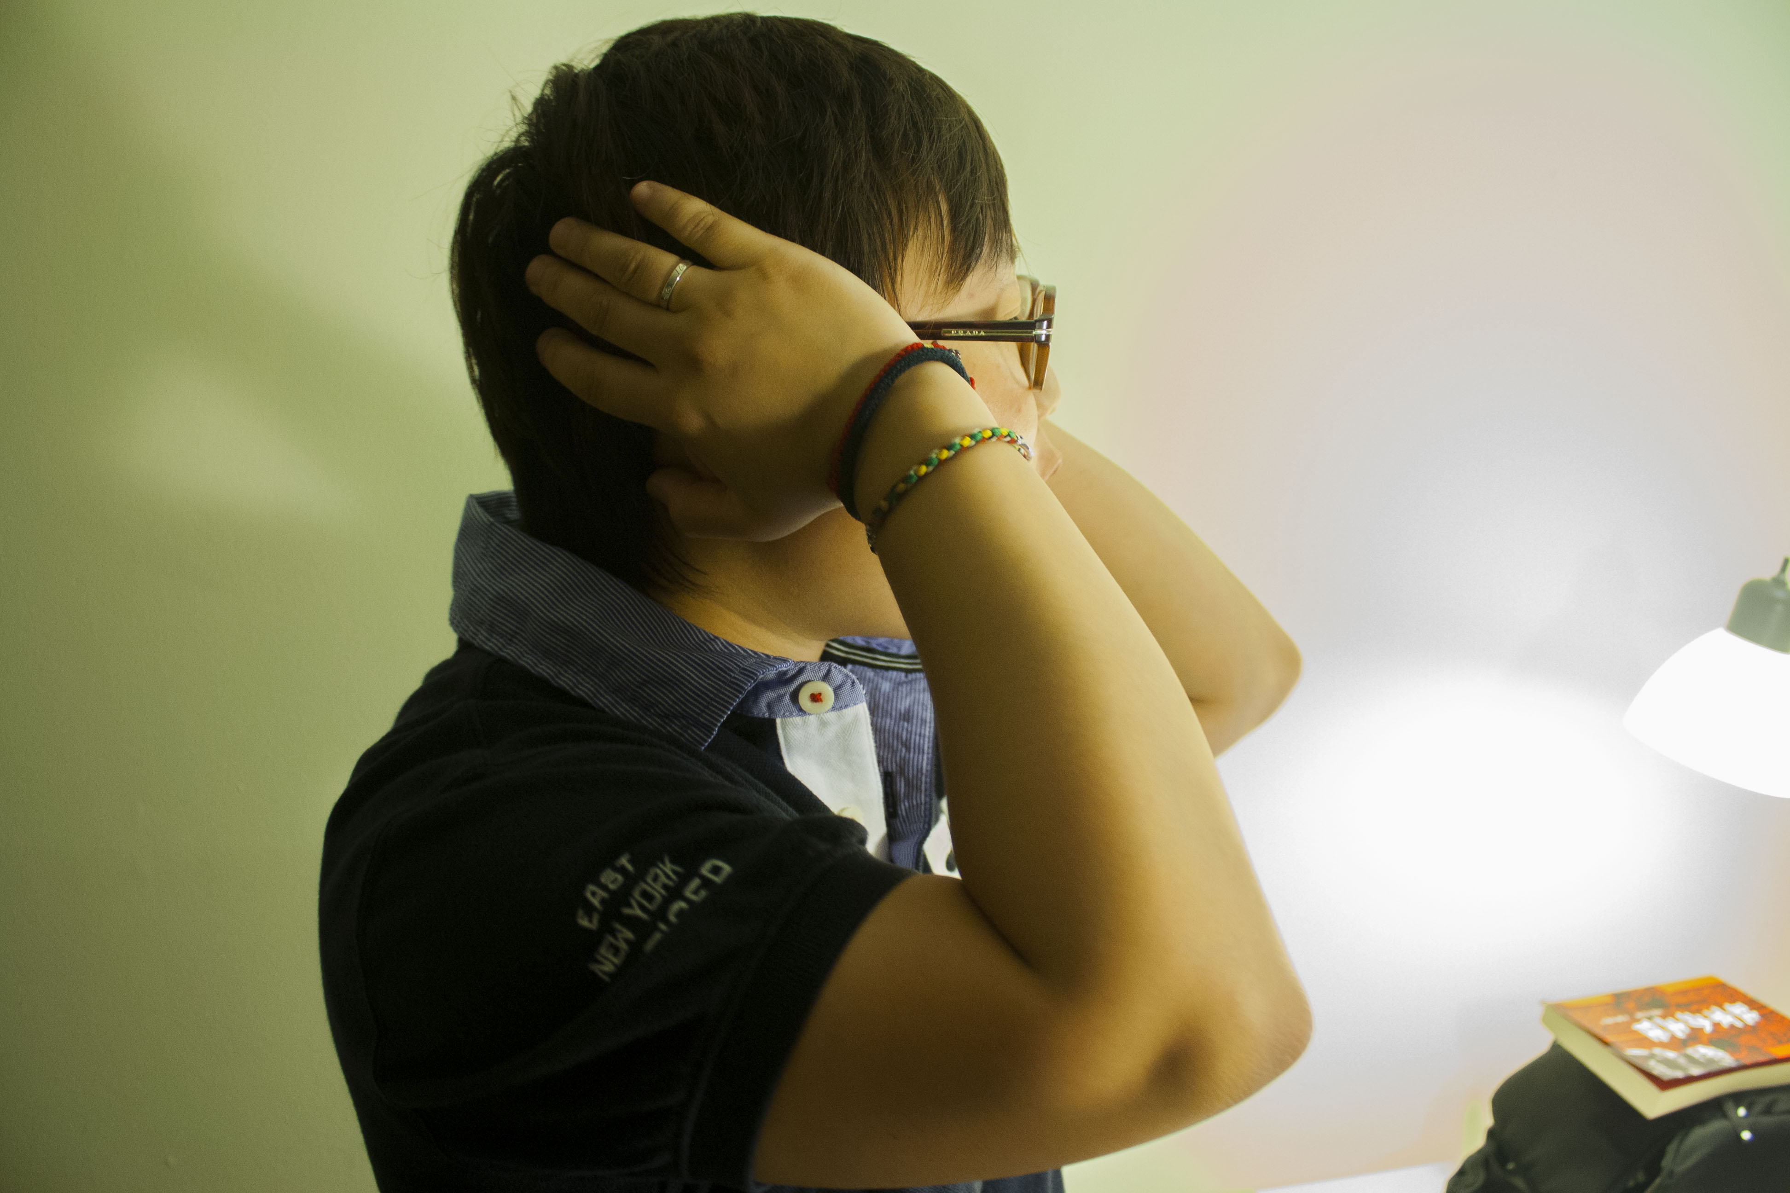
Impatient

Slide 15
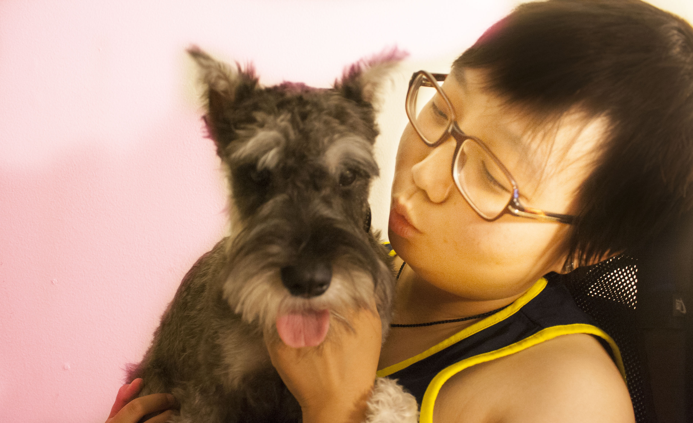
Patient

Slide 16
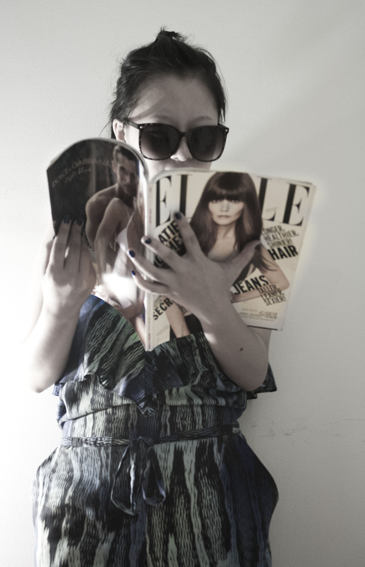
Love
Fashion

Slide 17
Love
Study

Slide 18
Sad

Slide 19
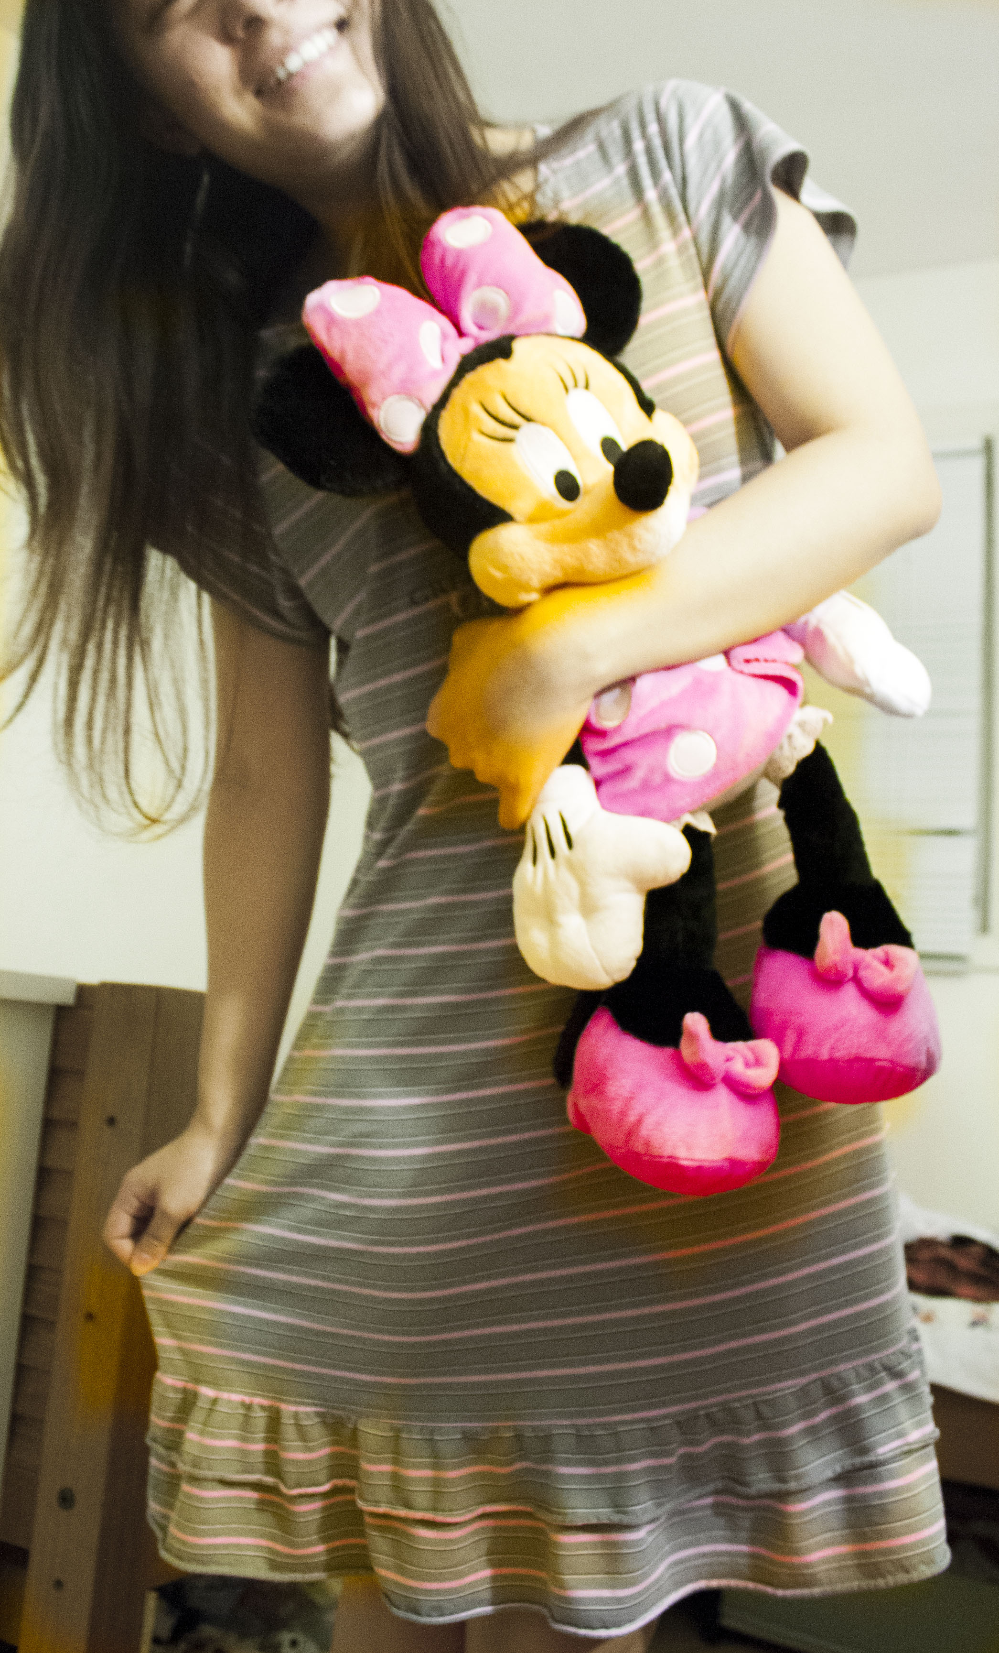
Happy！

Slide 20
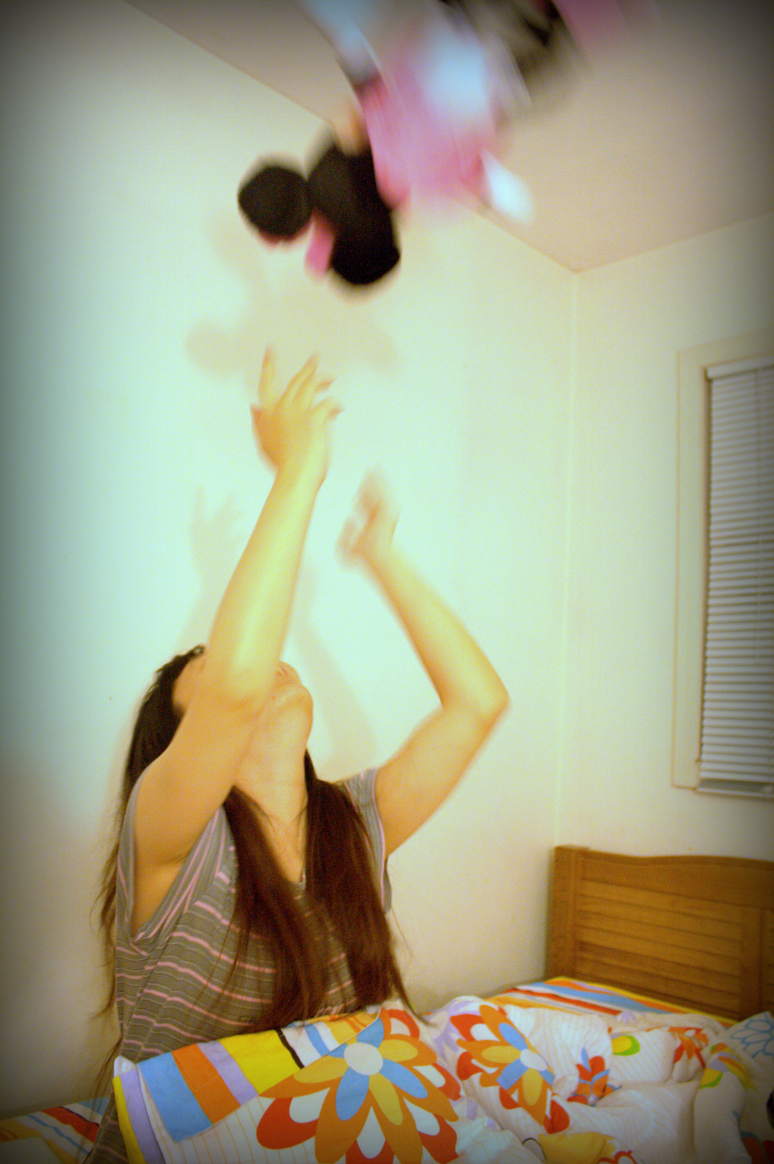
Fun~

Slide 21
Thanks For Watching!!!
Have a great summer!!!

