Slide 1
Air Jordans
Tammy Abreu
Notes:
1

Slide 2
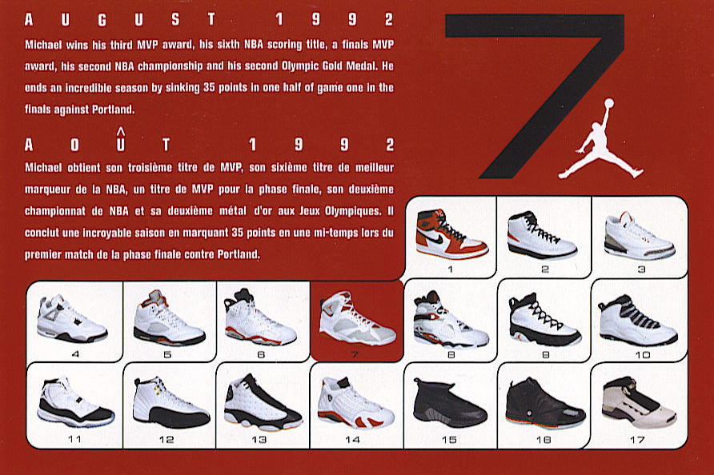
All Air Jordans
All Jordans range from:$69.99 to $180.72. It depends on the size you choose.
I will be showing my favorite Jordans.
They are the 4’s, 5’s, 7’s, 8’s and 13’s.
Notes:
2

Slide 3
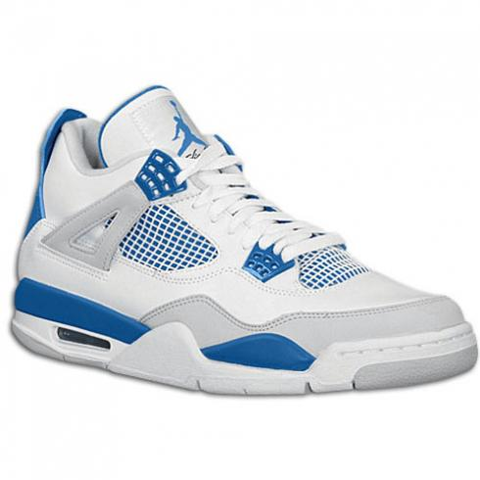
Air Jordans 4
Notes:
3

Slide 4
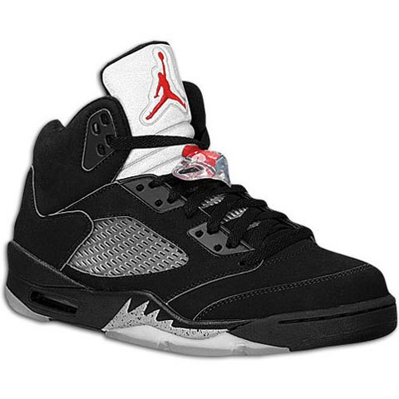
Air Jordans 5
Notes:
4

Slide 5
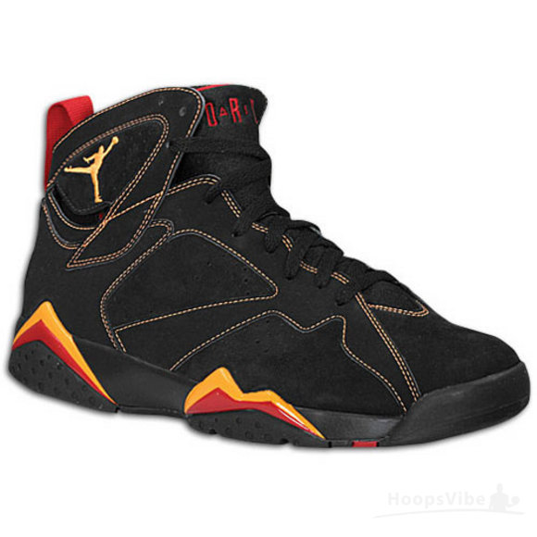
Air Jordans 7
Notes:
5

Slide 6
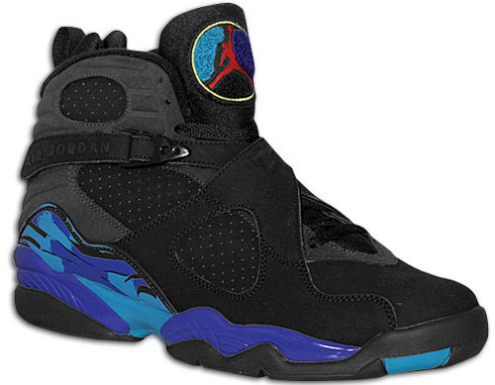
Air Jordans 8
Notes:
6

Slide 7
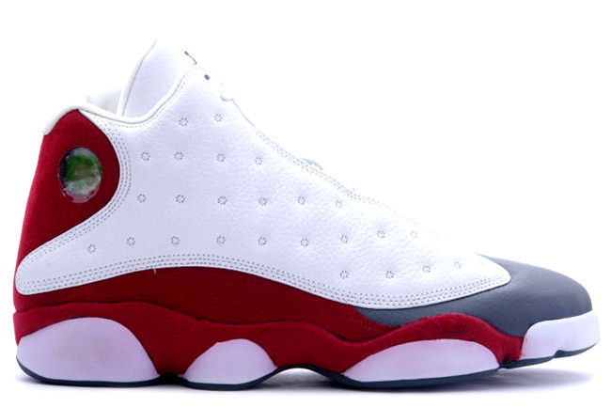
Air Jordans 13
Notes:
7

