Slide 1
Funny Demi Moments

Slide 2
Demi Trips!
Watch Demi trip onstage in multiple instances!

Slide 3
Demi is hilarious!
Click to watch clips of Demi being silly!
Click to watch this hilarious music video featuring Demi Lovato and the Jonas Brothers!

Slide 4
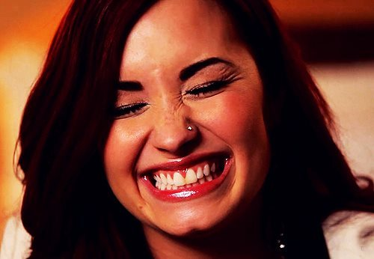
Through it all, Demi always has a smile on her face!

Slide 5
THE END
Return to Demi Lovato Fan Page

