Slide 1
Character Menu
Ignite your mind

Slide 2
How to write good characters
Characterization 101: How to Create Memorable Characters
Character Development
How to Build a Character
Character Questionnaires

Slide 3
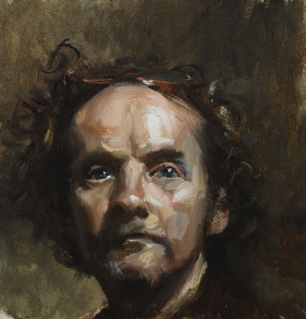

Slide 4
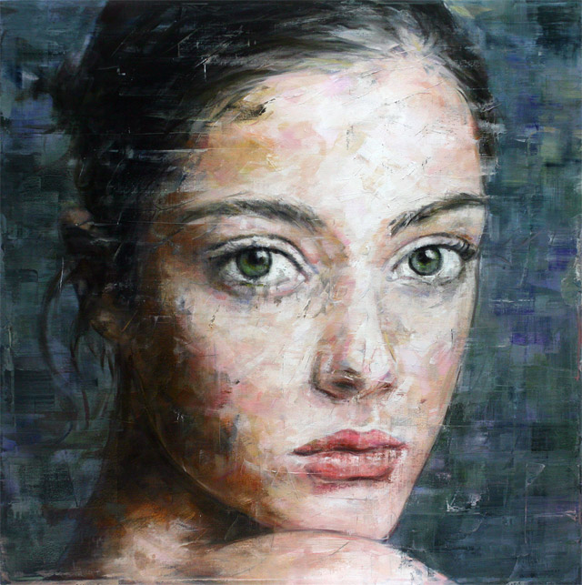

Slide 5
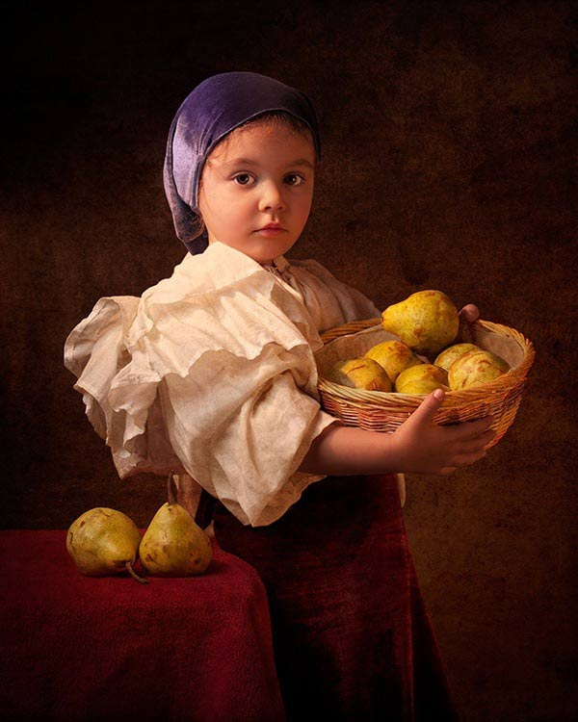

Slide 6
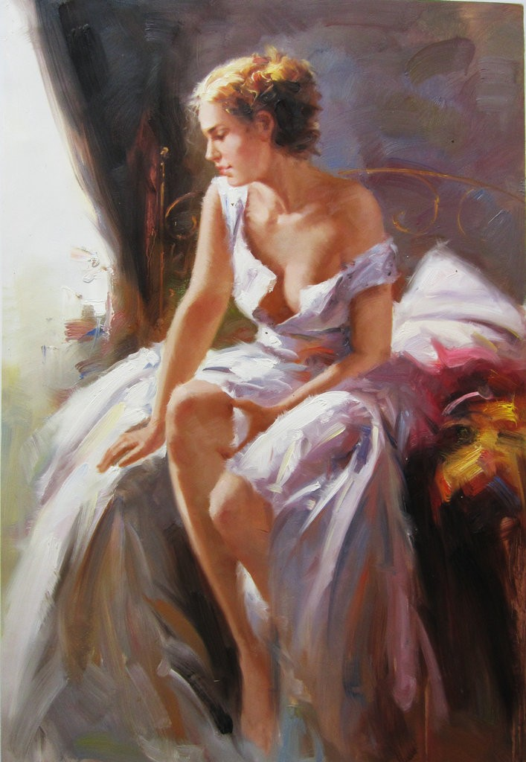

Slide 7
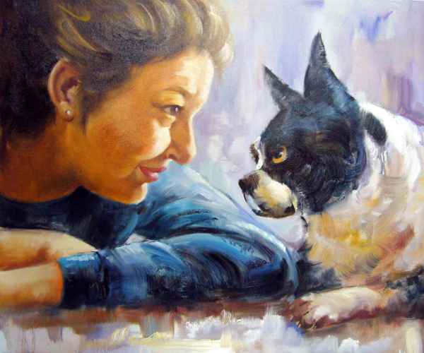

Slide 8
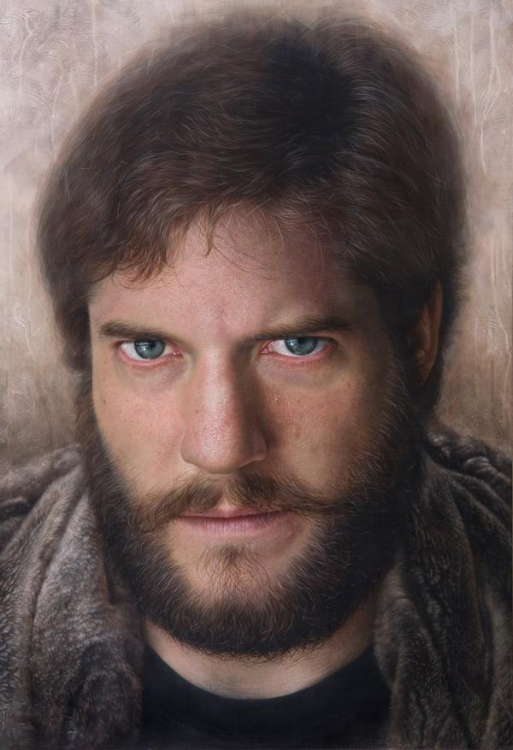

Slide 9
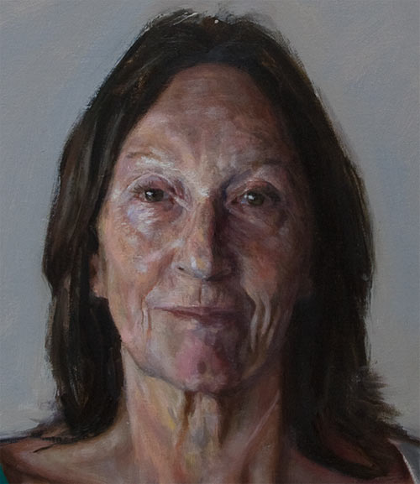

Slide 10
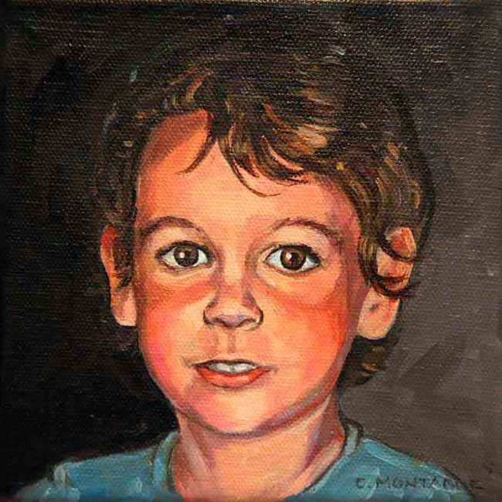

Slide 11
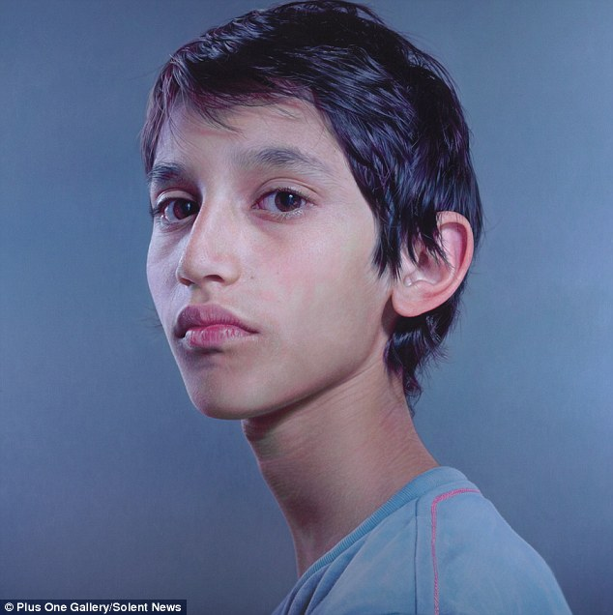

Slide 12
Return to Start

