Slide 1
Adelphi Women’s Soccer Team
Samantha Lanza

Slide 2
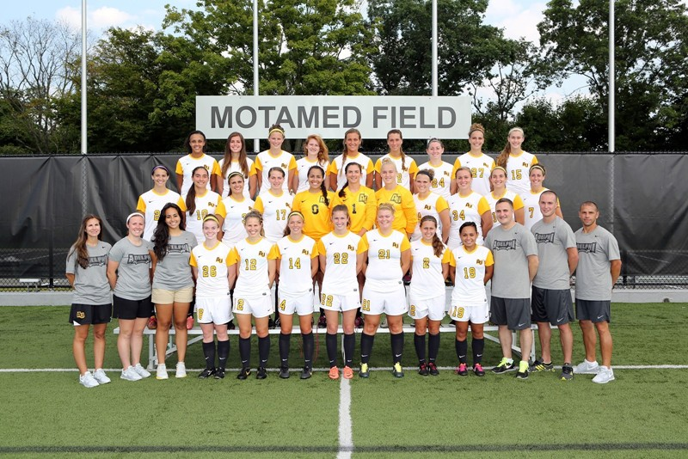
Go back to first page
Adelphi Women’s Soccer 2013-2014
Wome’s Soccer Facebook

