Slide 1
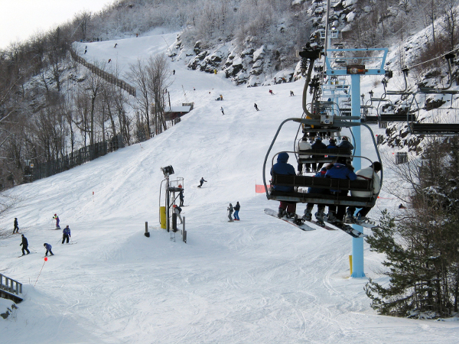
Ski Slopes in the Catskills

Slide 2
Windham Mountain
Click here for more info!

Slide 3
Hunter Mountain
Click here for more info!

Slide 4
Belleayre Mountain
Click here for more info!

