Slide 1
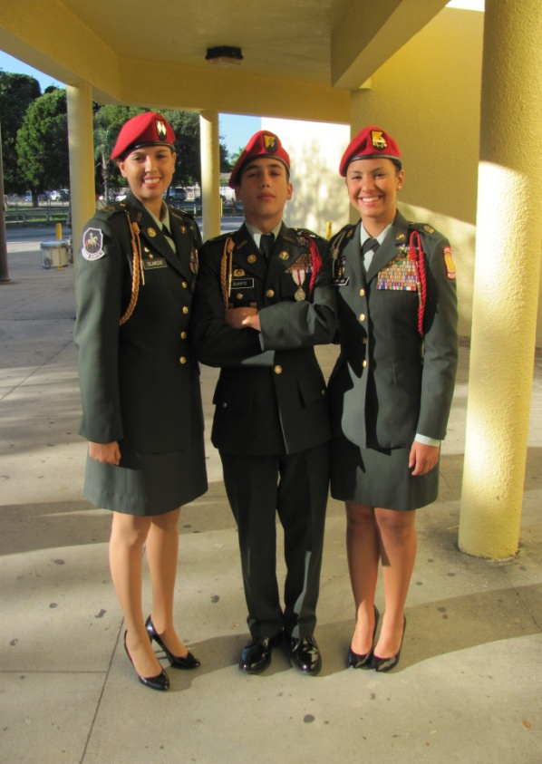
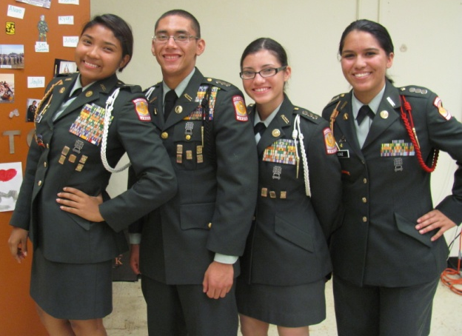
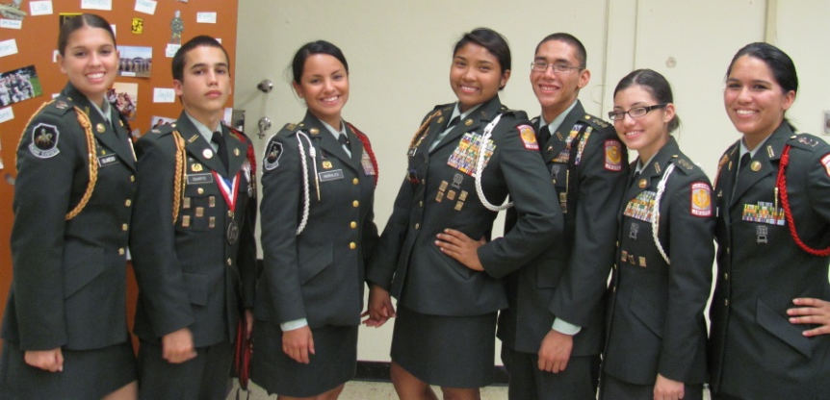
Junior Reserve Officers’ Training Corps (JROTC)
Miami Sunset Silver Knights JROTC Battalion
Click here to go to the JROTC Home Page
Notes:
(There are 136 National Standards. The Army JROTC curriculum directly supports 74 of them: 0 - Fine Arts, 0 - Foreign Language, 12 out of 12 Language Arts/Literature, 4 out of 14 Math, 14 out of 14 PE/Health, 1 out of 7 Science, 38 out of 49 Social Science and 5 out of 6 Technology)

Slide 2
Junior Reserve Officers’ Training Corps – Leadership
A Confidence and Character-Building program that offers
Rappel & Rock Wall
Swim, Canoe, Archery
Drug Free Life
Leadership Camp
Land Navigation
Confidence Course
Drill Team /Honor Guard / Raiders Team
Self-Confidence
Leadership
Values
Patriotism
Physical Fitness
Believe in Yourself

Slide 3
Silver Knight Battalion Staff
SY 2010-2011
C/LTC Rebecca Olmedo
BN CDR
C/MAJ Hiram Duarte
BXO
C/CSM Patricia Morales
CMD SGT MAJ
C/CPT Ana Luna Adjutant Officer
S1
C/CPT Alexander Zuniga Security Officer
S2
C/CPT Ops/Training Officer
S3
C/CPT Dianelis Olazabal Supply Officer
S4
C/CPT Carolina Ugaz Public Affairs Officer
S5
C/CPT Bryan Puckett
A/ CO CDR
C/CPT Juan Gonzalez
B/CO CDR
C/MAJ Ryan Paredes
C/CO CDR
C/CPT John Stansel
D/CO CDR
C/CPT Jaylis Solivan
E/CO CDR
C/CPT Julian Acosta
F/CO CDR
C/1SG Alvaro Pulido
C/1SG Richard Duran
C/1SG Pedro Cerrate
C/1SG Juan Fernandez
C/1SG
C/1SG
C/CPT
G/CO CDR
C/1SG Jose
Calil

Slide 4
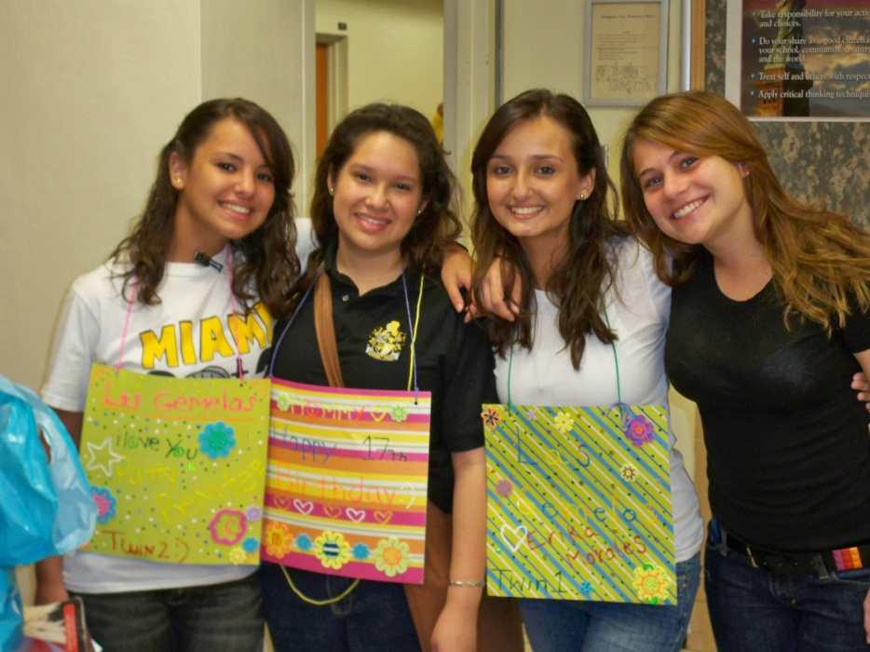
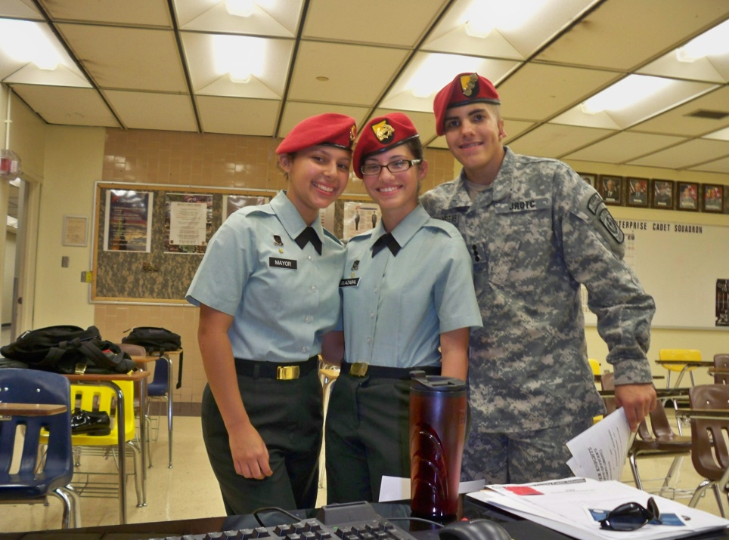
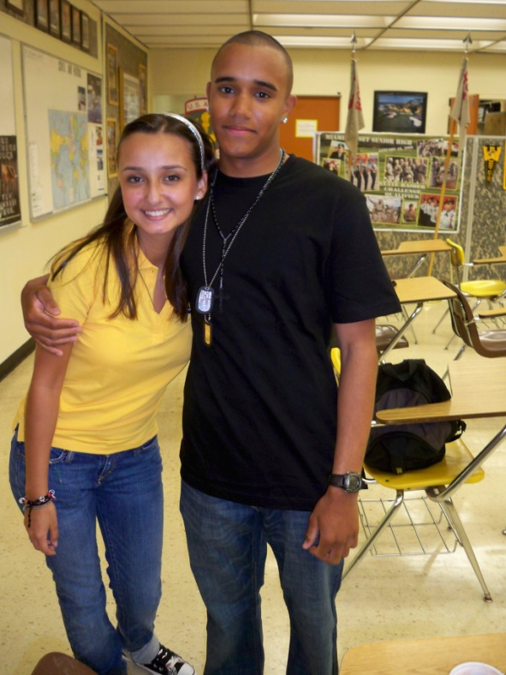
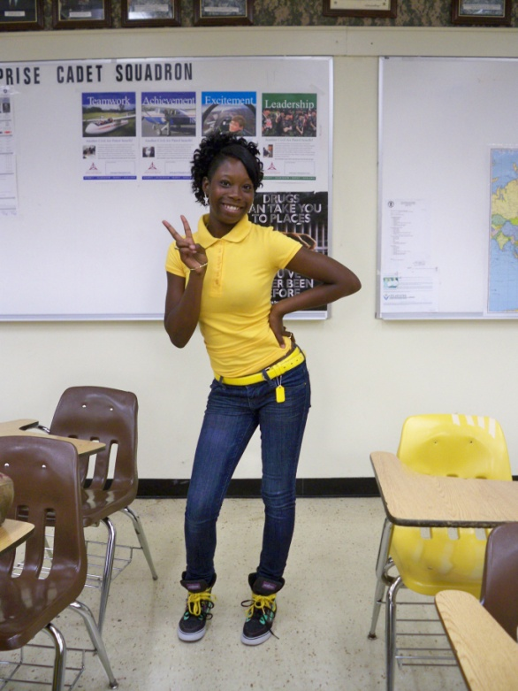
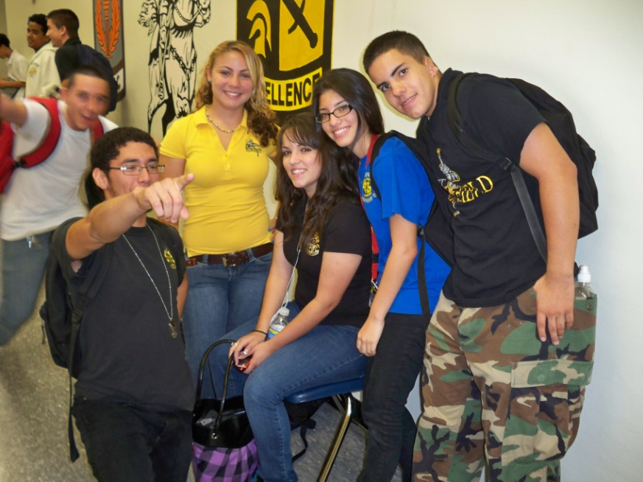
Silver Knights JROTC 2010-2011

Slide 5
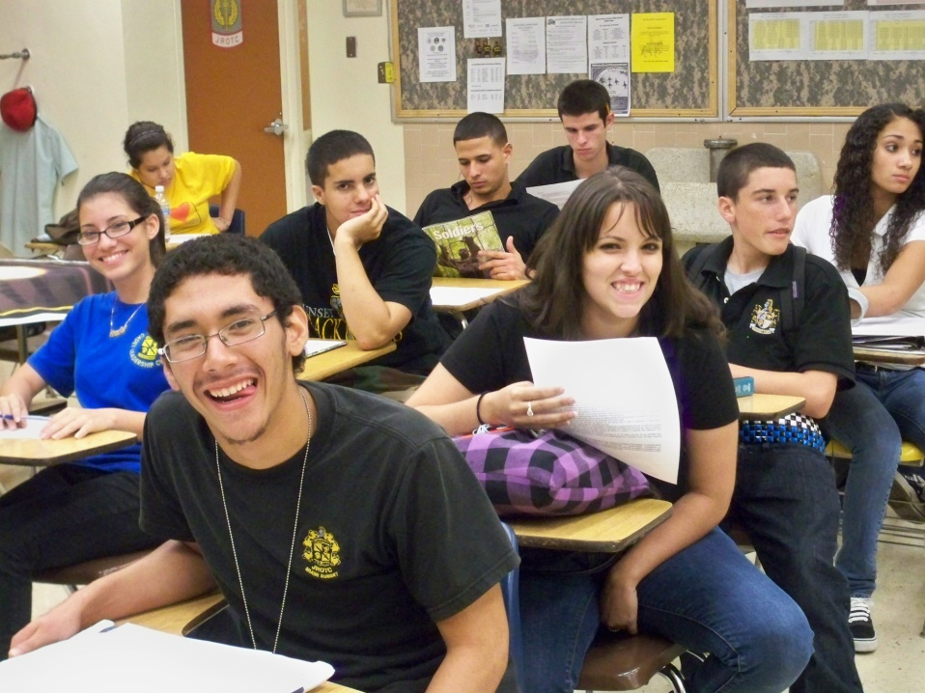
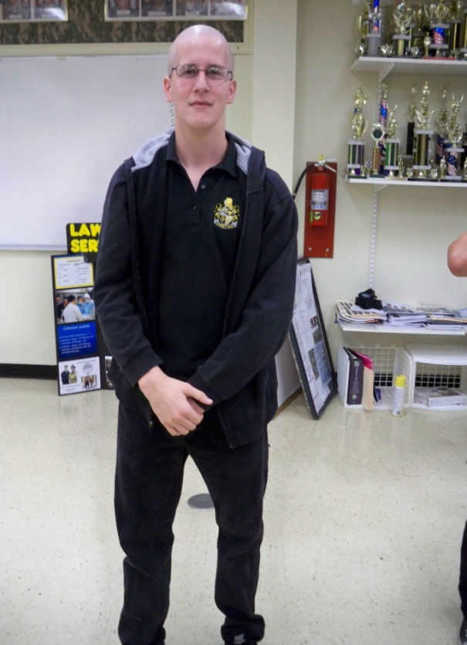
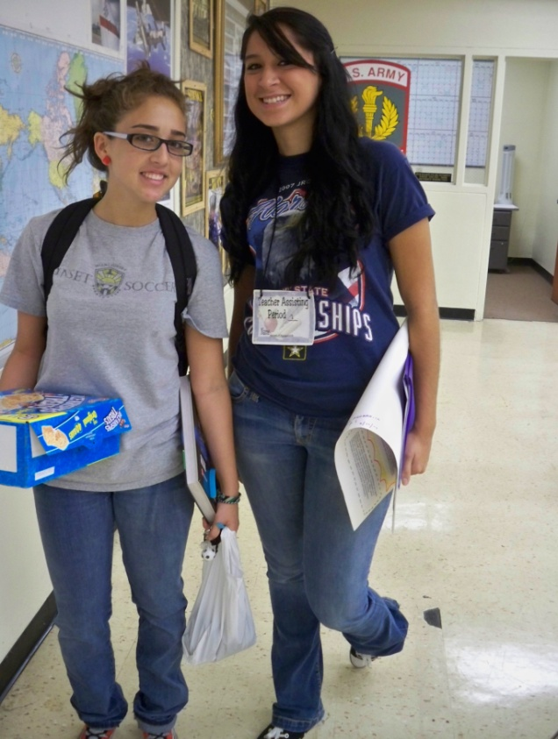
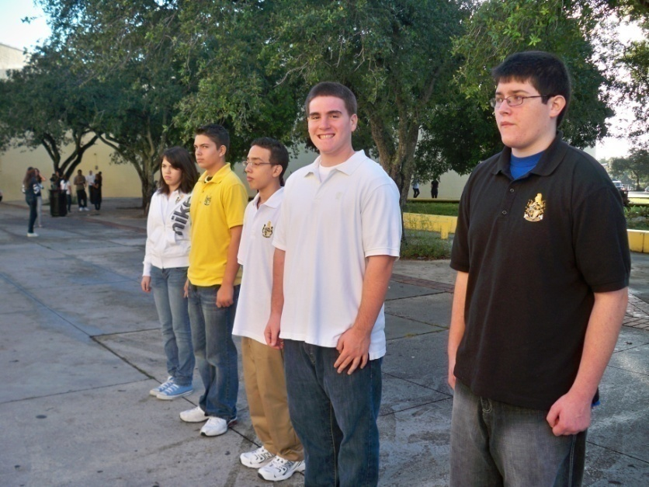
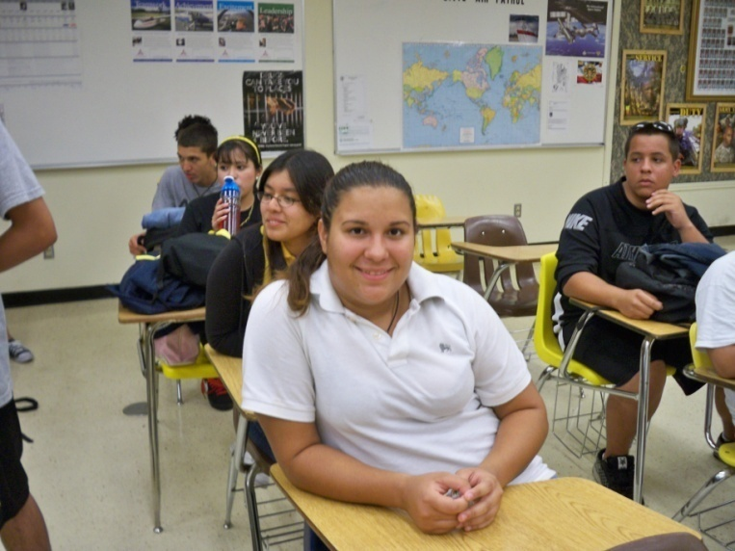
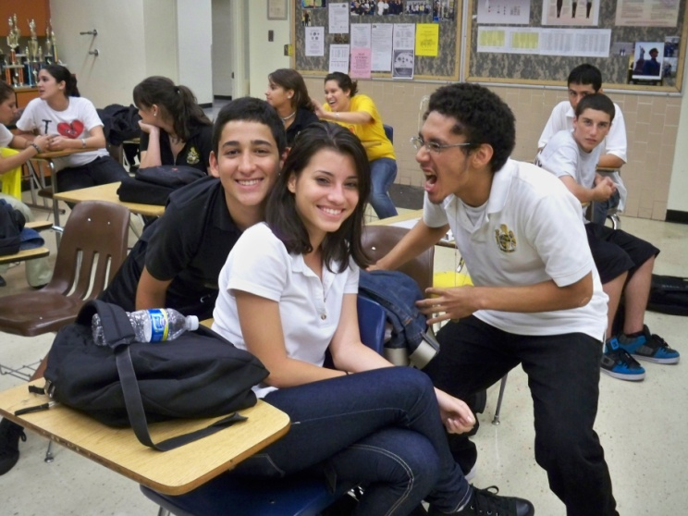
Silver Knights JROTC

Slide 6
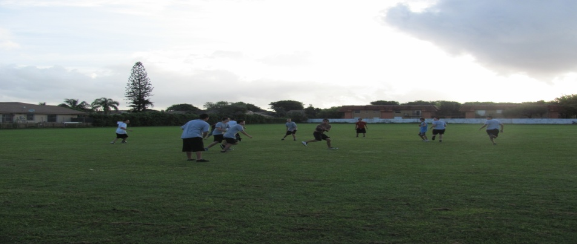
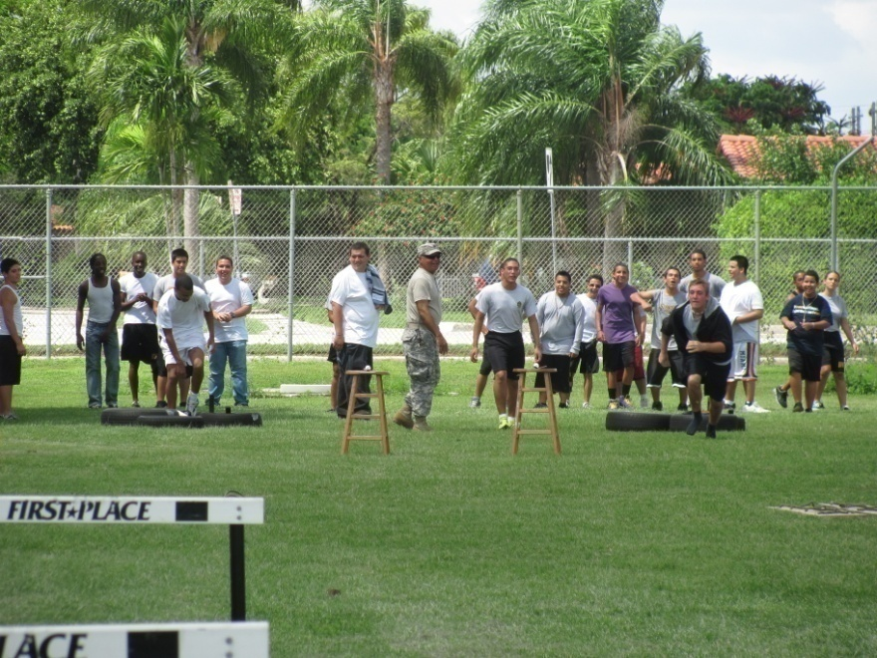
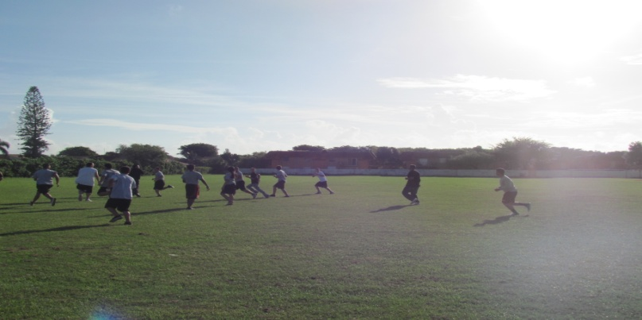
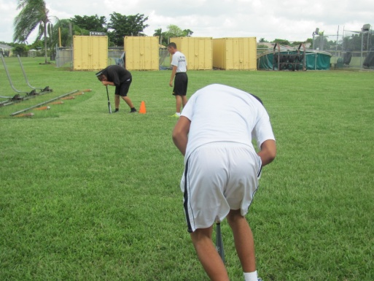
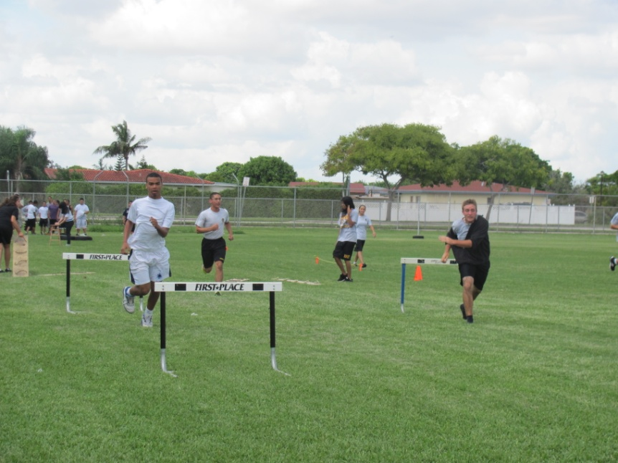
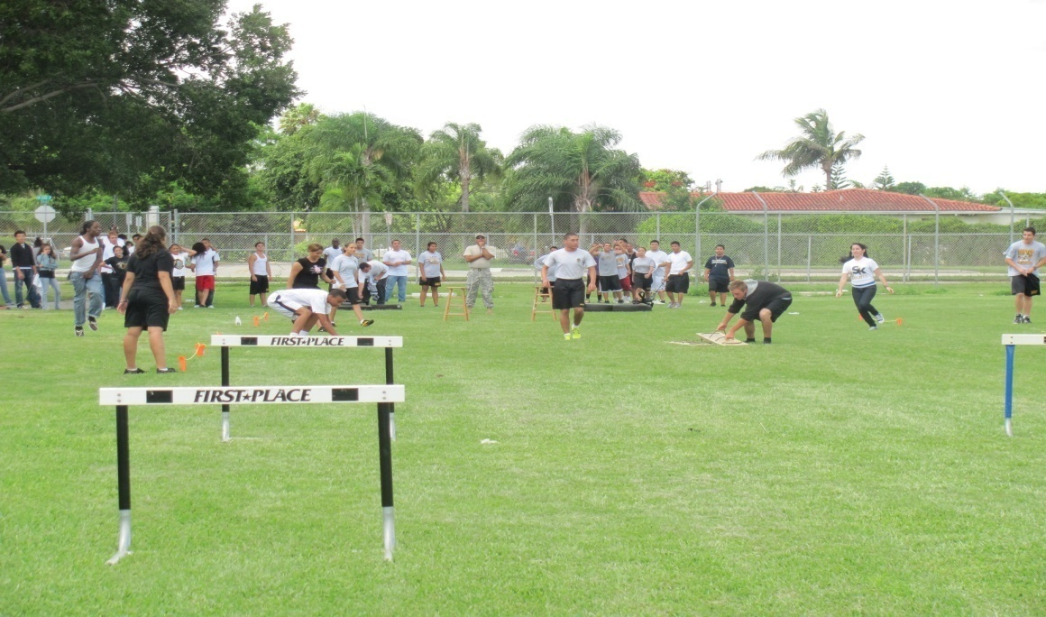
JROTC having fun indoors and outdoors

Slide 7
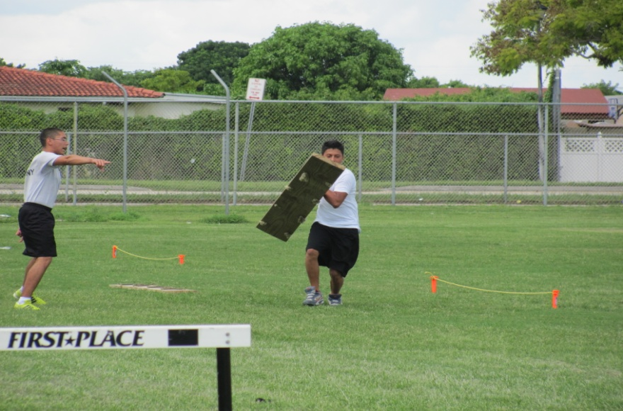
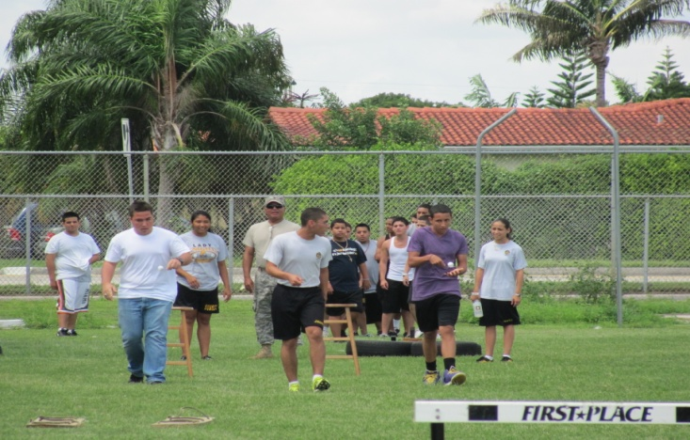
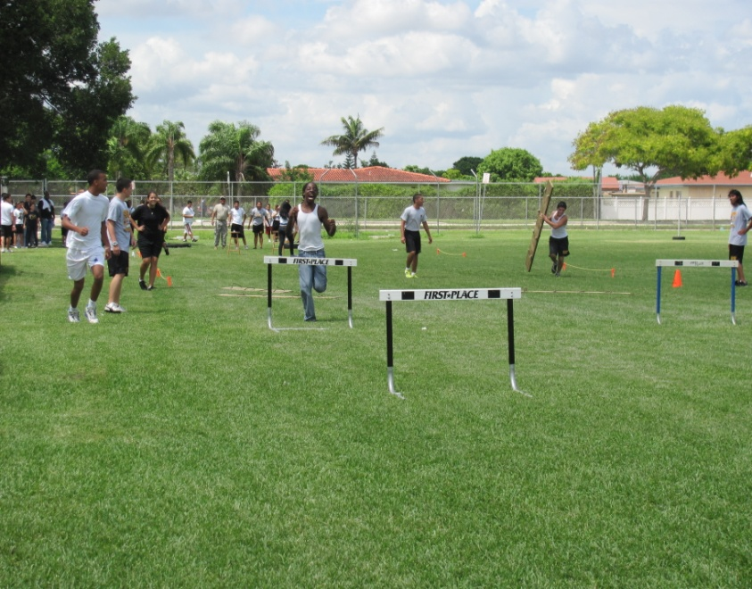
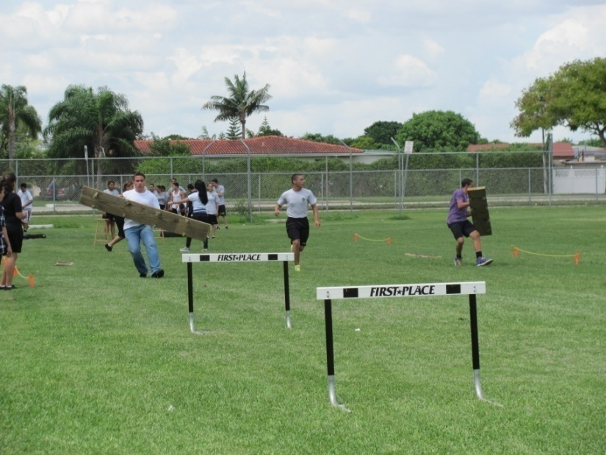
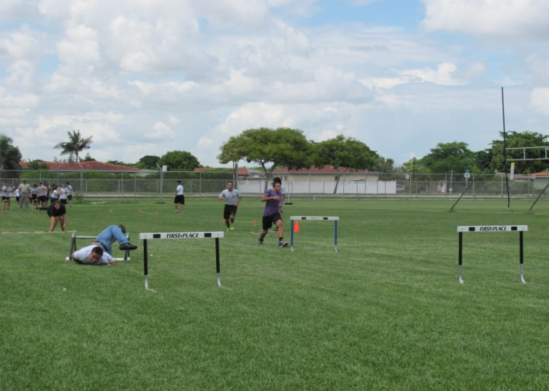
JROTC having fun indoors and outdoors

Slide 8
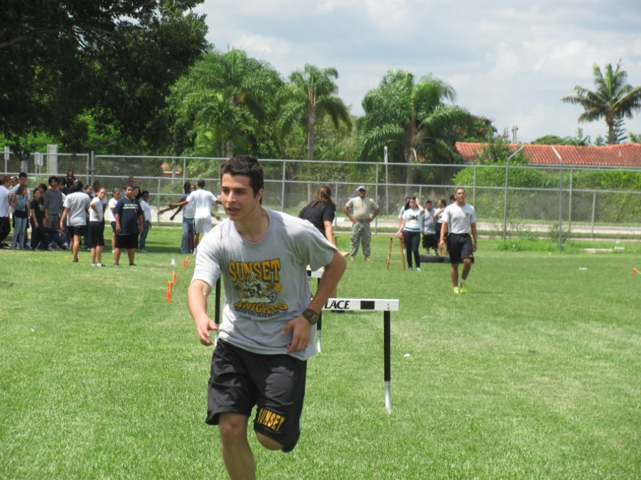
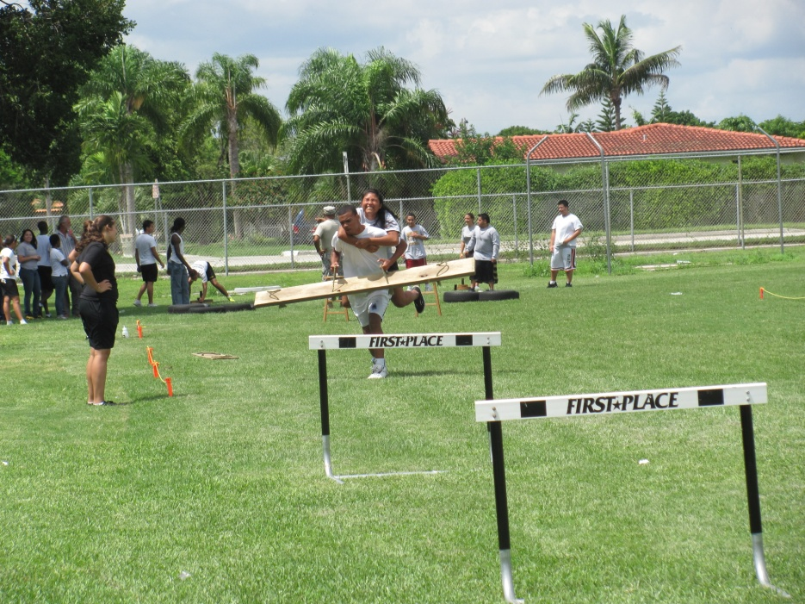
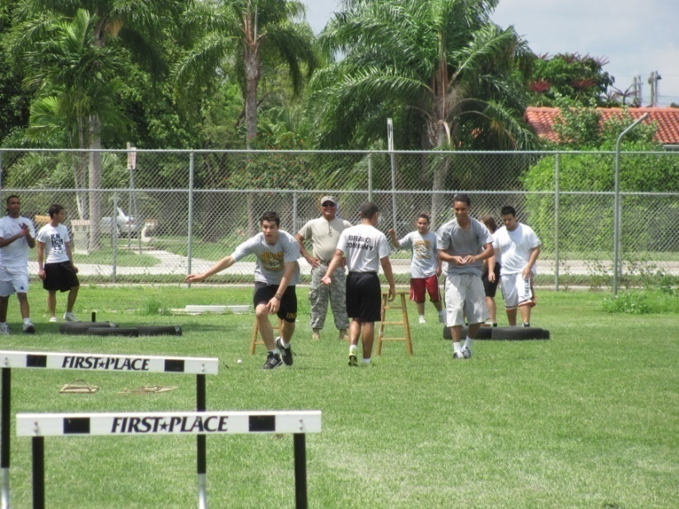
JROTC having fun indoors and outdoors

Slide 9
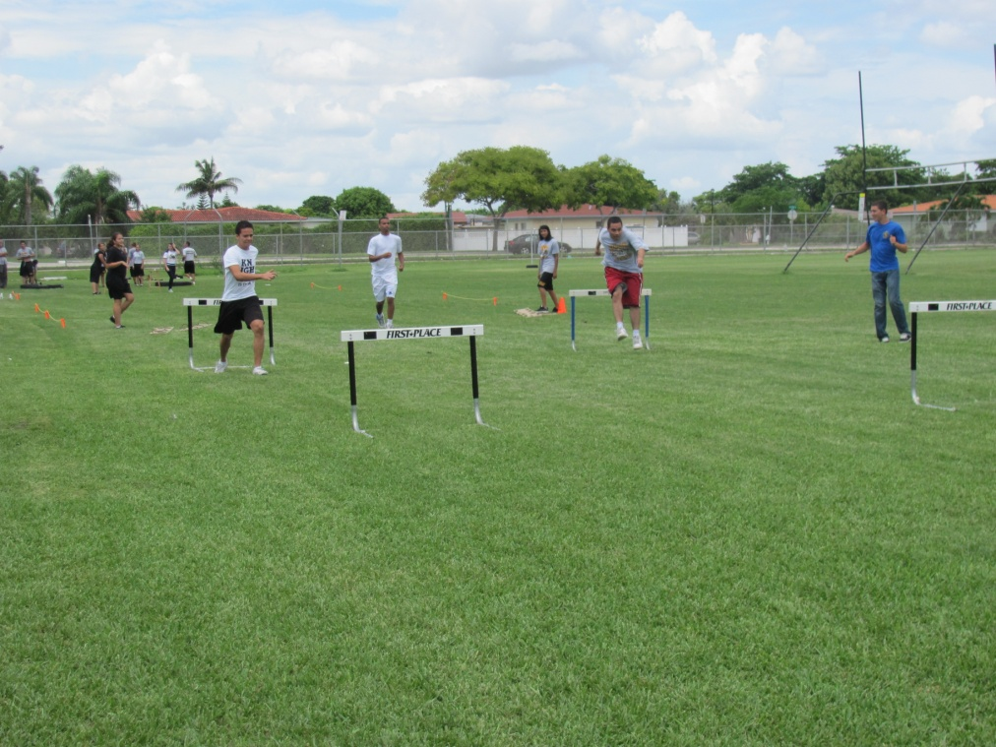
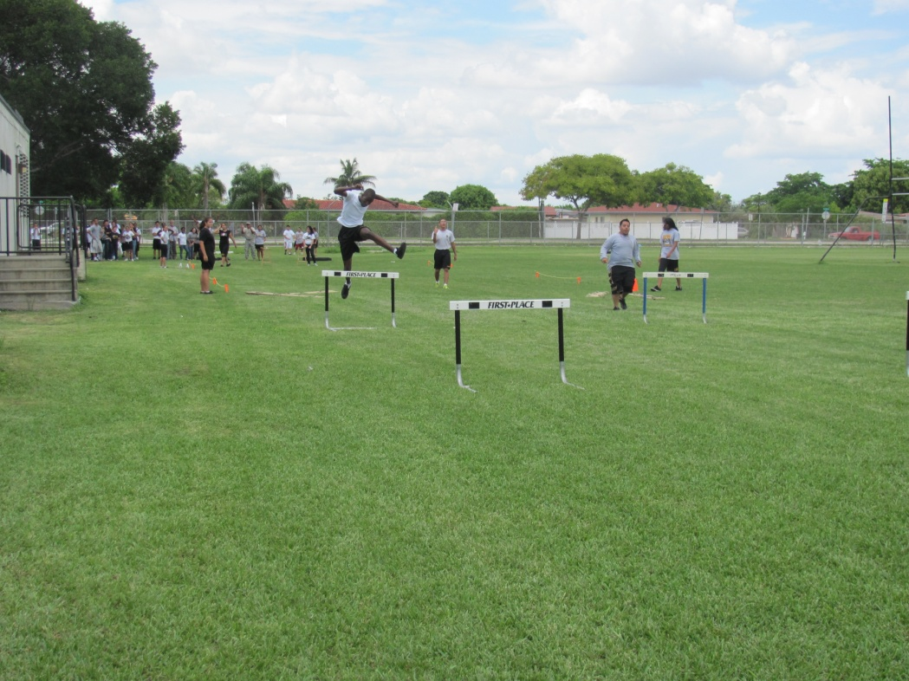
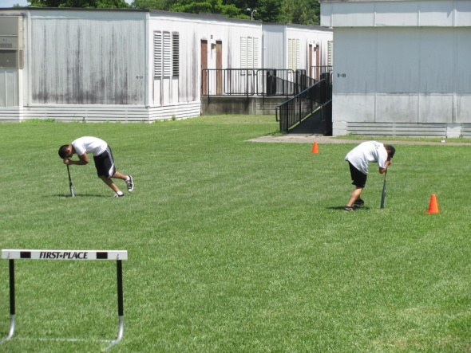
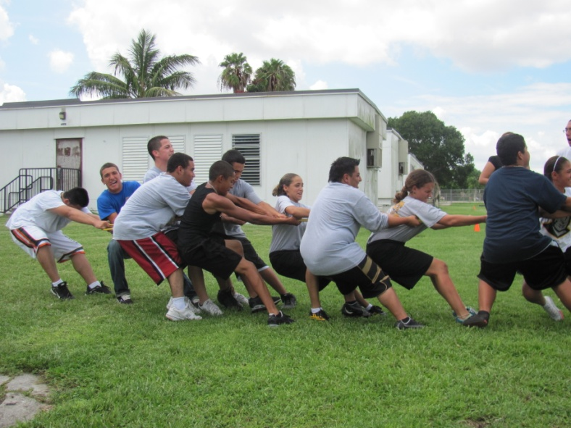
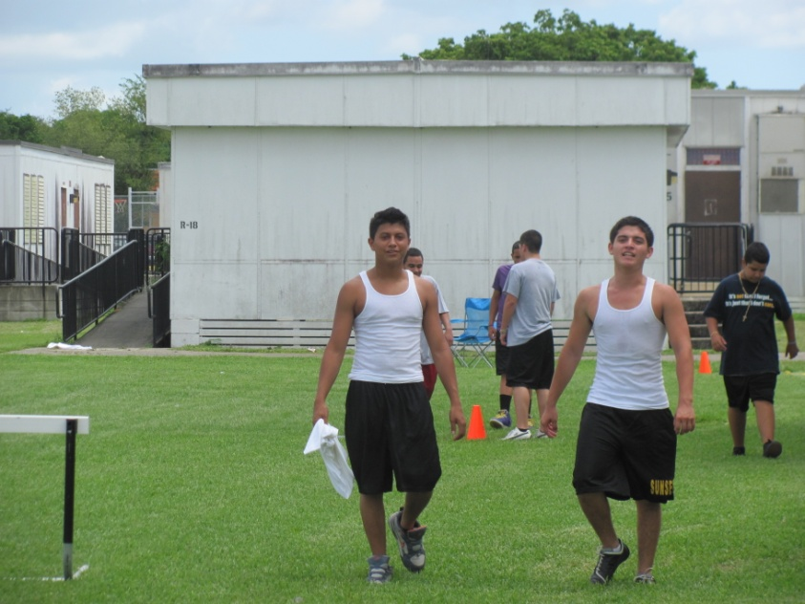
JROTC having fun indoors and outdoors

Slide 10
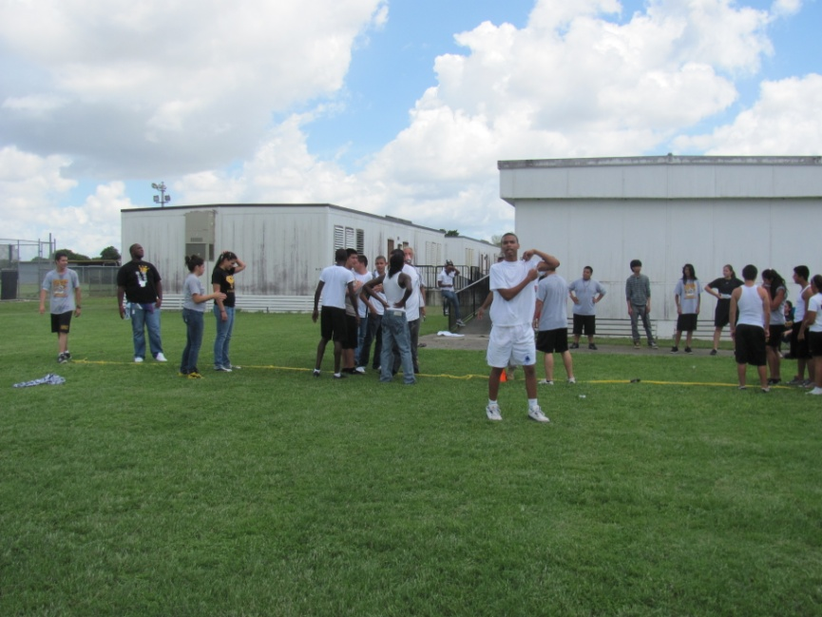
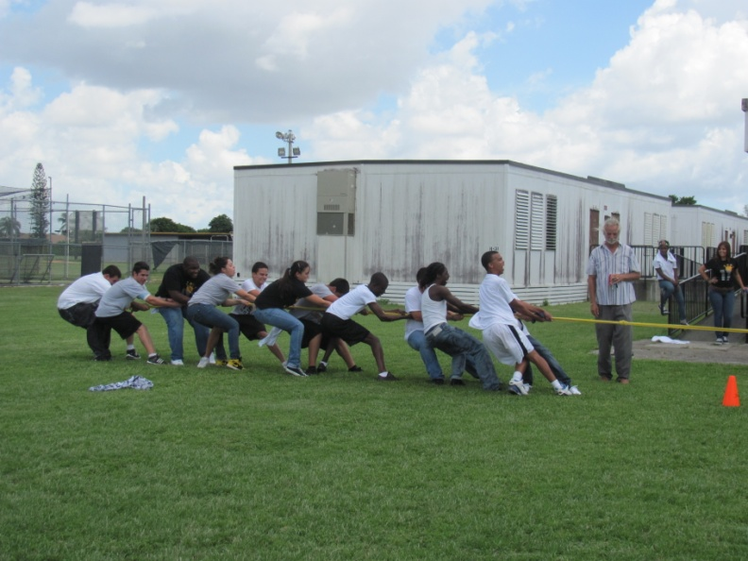
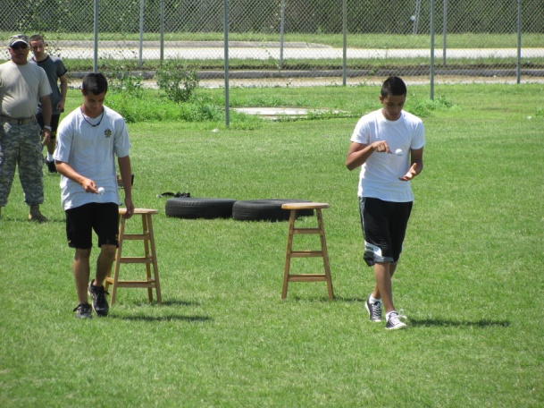
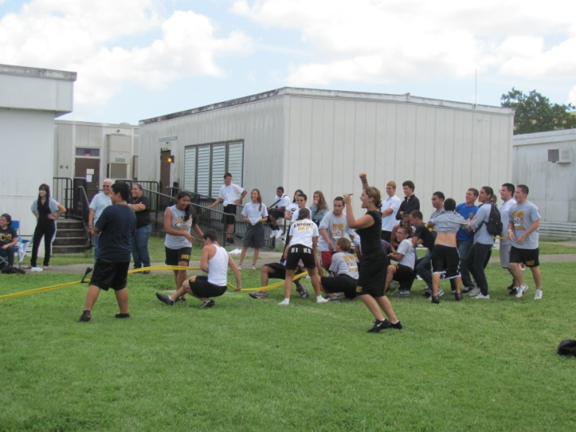
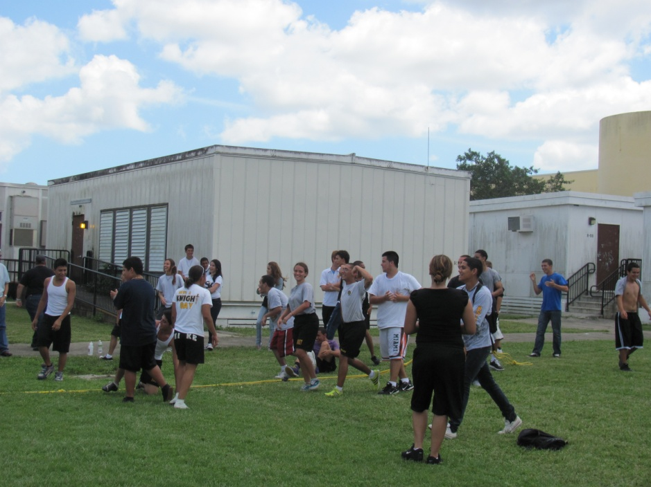
JROTC having fun indoors and outdoors

Slide 11
JROTC having fun indoors and outdoors
Click the videos

Slide 12
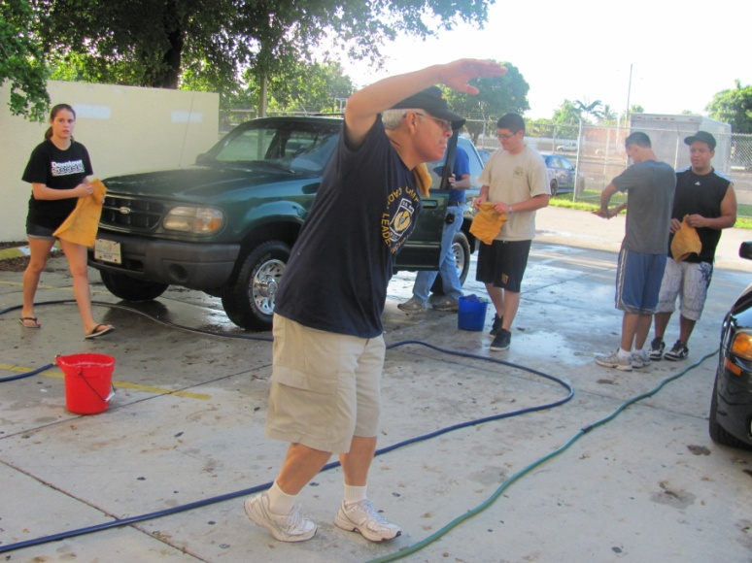
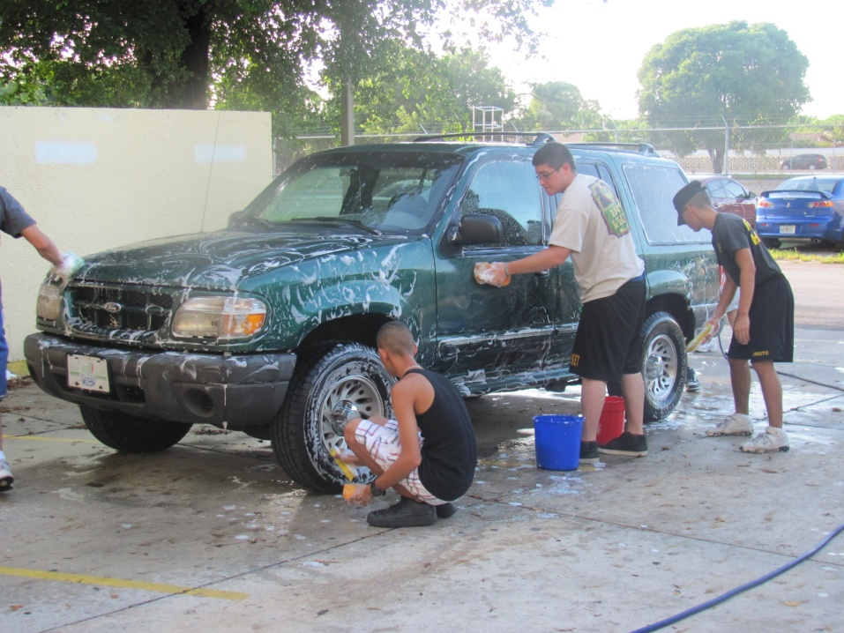
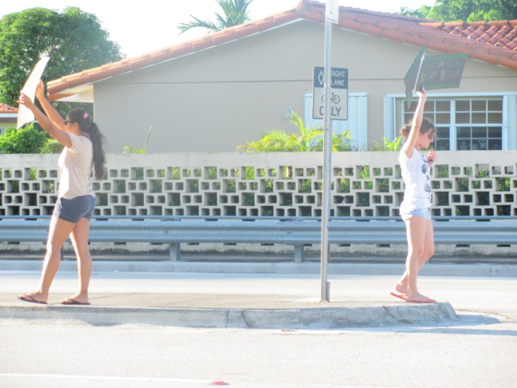
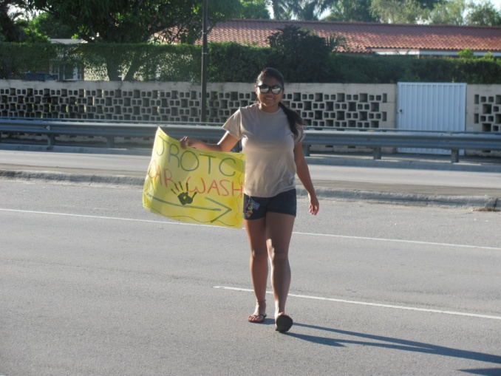
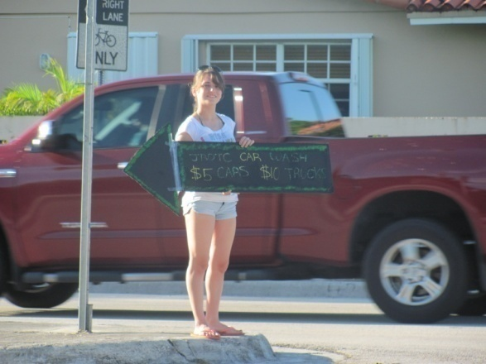
JROTC having fun indoors and outdoors

Slide 13
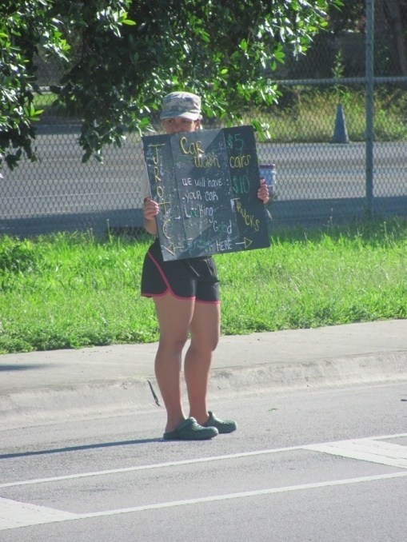
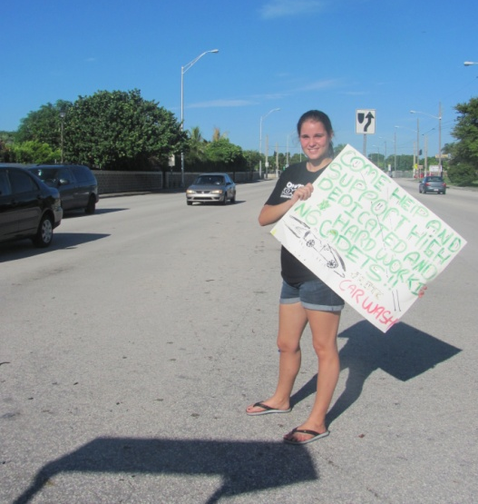
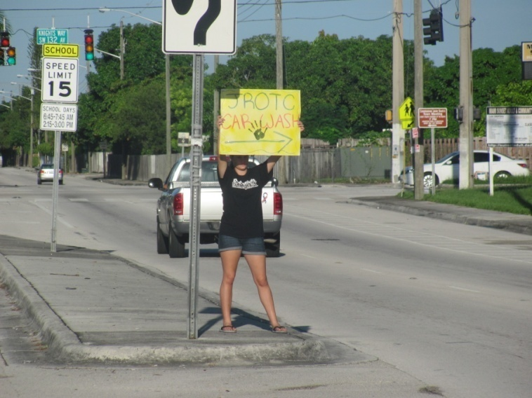
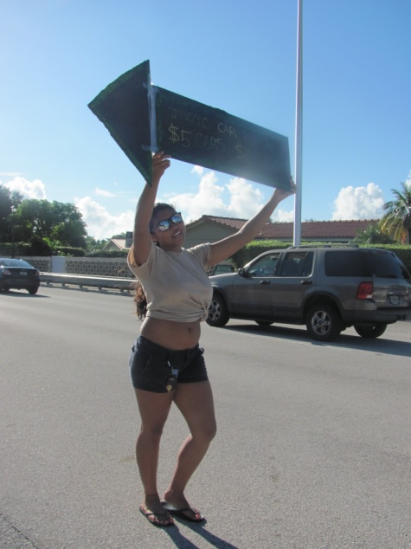
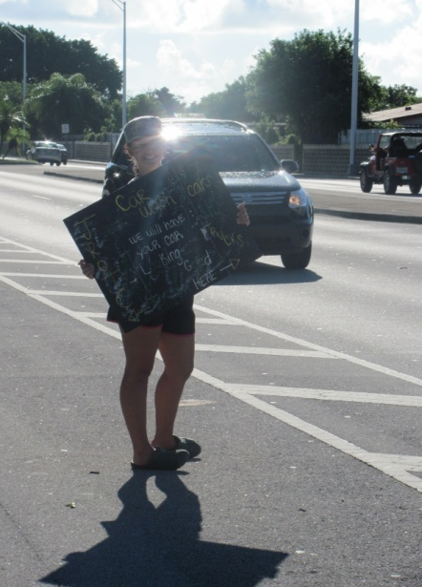
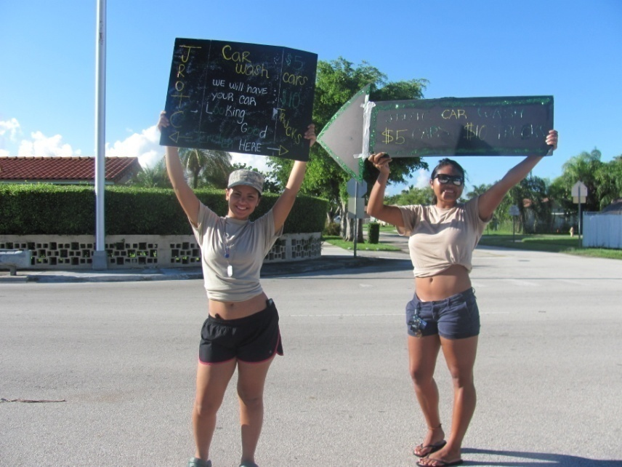
JROTC having fun indoors and outdoors

Slide 14
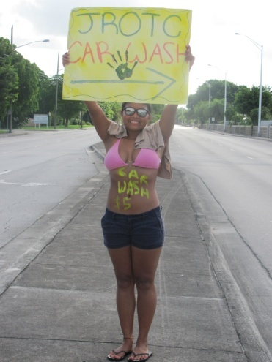
JROTC having fun indoors and outdoors

Slide 15
JROTC having fun indoors and outdoors

Slide 16
JROTC having fun indoors and outdoors

Slide 17
JROTC having fun indoors and outdoors

Slide 18
Our Highly Motivated Cadets

Slide 19
Our Highly Motivated Cadets

Slide 20
Raiders in Action

Slide 21
Raiders in Action

Slide 22
Raiders in Action

Slide 23
Raiders in Action

Slide 24
Raiders in Action

Slide 25
Raiders in Action

Slide 26
Raiders in Action

Slide 27
Raiders in Action

Slide 28
Raiders in Action

Slide 29
Raiders in Action

Slide 30
Drill Team in Action

Slide 31
Drill Team in Action

Slide 32
Drill Team in Action

Slide 33
Drill Team in Action

Slide 34
Drill Team in Action

Slide 35
Veteran’s Day Ceremony

Slide 36
Veteran’s Day Ceremony

Slide 37
Speedway

Slide 38
Speedway

Slide 39
Speedway

Slide 40
Speedway

Slide 41
Speedway

Slide 42
Speedway

Slide 43
Speedway

Slide 44
Speedway

Slide 45
Zoo Miami

Slide 46
Zoo Miami

