Slide 1
Computer Science Careers
Adjunct Professor Kris Pepper

Slide 2
Programming
Logic Sharpener
New Technology Challenges
Team work
Deadline pressure

Slide 3
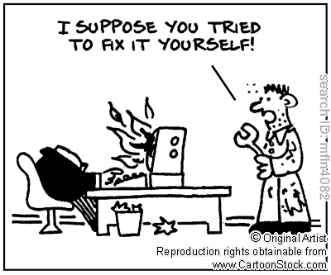
Help Desk Support Analyst
Interact with people
Patience
Up and moving
Expertise

Slide 4
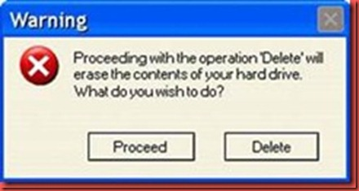
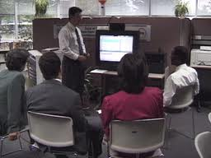
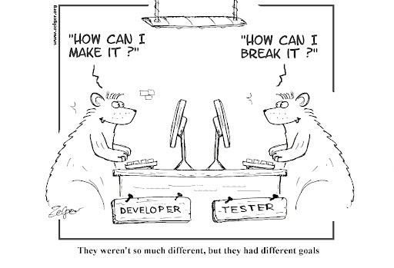
Training & Testing
Break holes in software
Application Expertise
Testing tools
Design input
Training users

Slide 5
Networking
Adding the latest device
Moving and Building
Mission critical
Trouble shooting

Slide 6
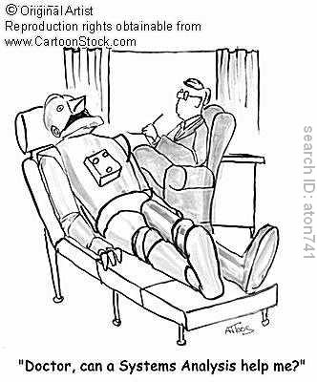
Systems Analyst
Communication
Specifications
Logic puzzles
Problem resolution

Slide 7
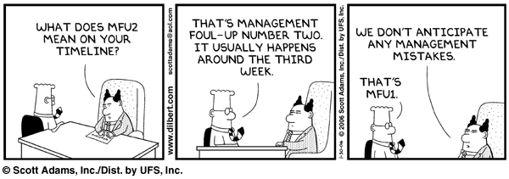
Project Manager
Map out resources
A man is a resource
Customer relations
Motivation
On Time

Slide 8
What Type of Company?
All Industries
Small start up comp co.
Huge comp co.
IT department
Independent
A mix of all 3

Slide 9
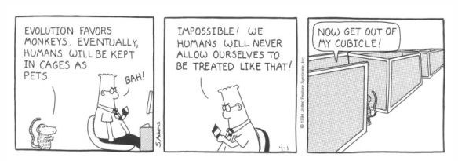
Work Location
Cubicles…
Customer Sites
Your Car
Planes
International

Slide 10
Opportunities
Tech Unemployment 4%*
Cross Industry Unemployment 9%
Small Business Start Ups
* Caruso, Jeff. "IT Job Search: An Expert Guide." Network World. International Data Group, 26 Sept. 2011. Web. 06 Feb. 2012.

Slide 11
Growth
Computer systems design and related services:
4th largest projected wage and salary employment growth
3.9% Annual Salary Growth
*"Table 3. The 20 Industries with the Largest Projected Wage and Salary Employment Growth, 2010-20." U.S. Bureau of Labor Statistics. 1 Feb. 2012. Web. 06 Feb. 2012. <http://www.bls.gov/news.release/ecopro.t03.htm>.

Slide 12
Opportunities
Bureau of Labor Occupational Handbook:
Computer and mathematical science occupations: “expected to grow more than twice as fast as the average for all occupations in the economy” from 2008 - 2012
"Overview of the 2008-18 Projections." U.S. Bureau of Labor Statistics. Web. 06 Feb. 2012. <http://www.bls.gov/oco/oco2003.htm>.

