Slide 1
The Holy Trinity of YouTube
By: Morgan McCurdy

Slide 2
Grace Helbig
Creator of It’sGrace
Star in Camp Takota
Over one million subscribers
Creator of DailyGrace
Seen on MTV

Slide 3
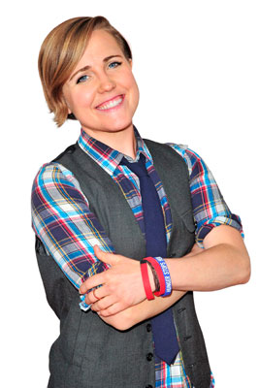
Hannah Hart
Creator of MyHarto
Completed community service tour around the world
Co-star in Camp Takota

Slide 4
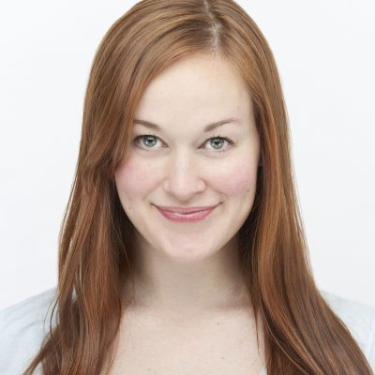
Mamrie Hart
Creator of Mametown
Seen on MTV
Wrote screenplay for Camp Takota
Co-star in Camp Takota

Slide 5
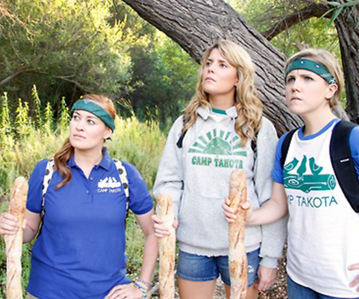

Slide 6
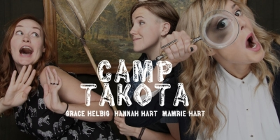
Grace Helbig
Hannah Hart
Mamrie Hart

