Slide 1
Introducing the Class of 2013
Play this while watching this slideshow

Slide 2
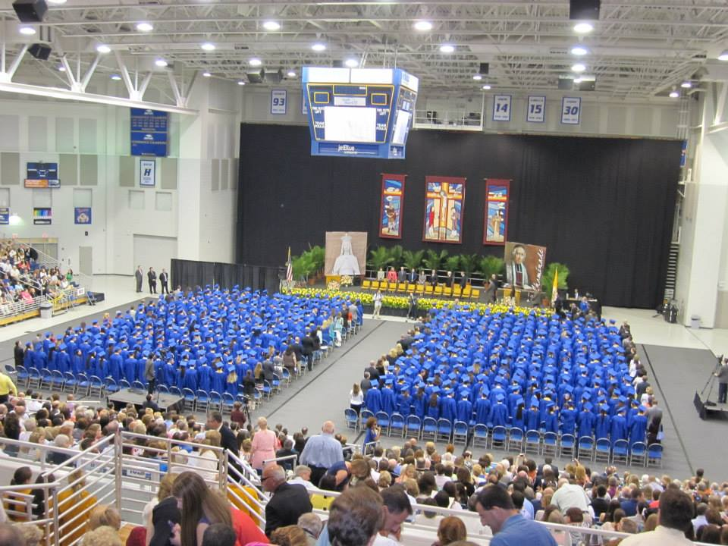
Go to Homepage

