Slide 1
Lightning’s Photo Album
2013-2014
Click to go back to our Lightning Website

Slide 2
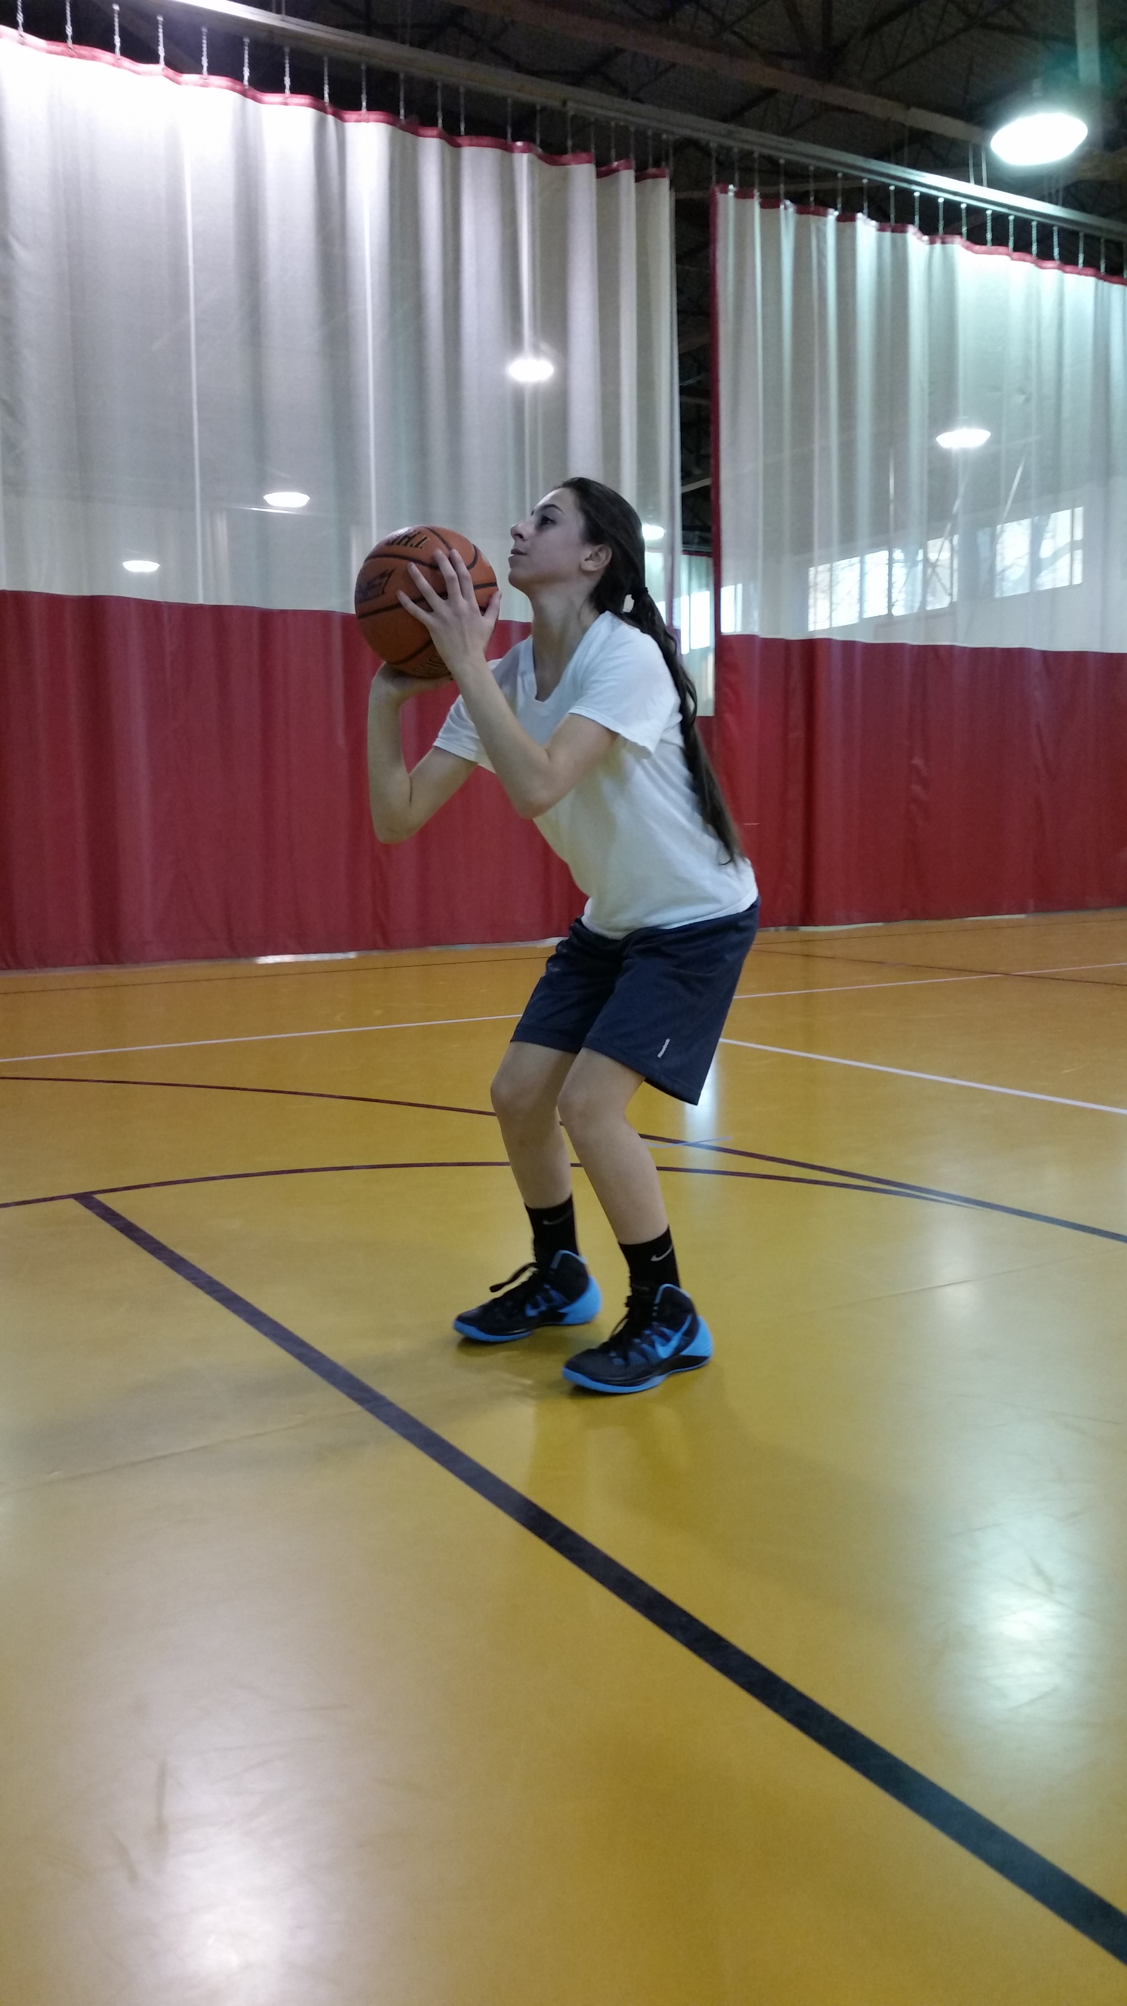
Lightning’s Photo Album

Slide 3
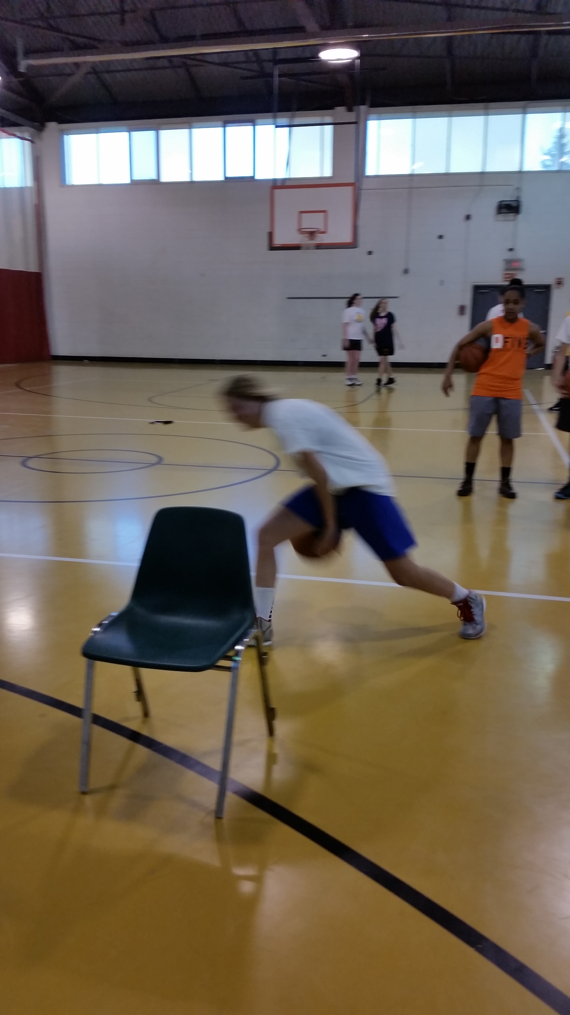
Lightning’s Photo Album

Slide 4
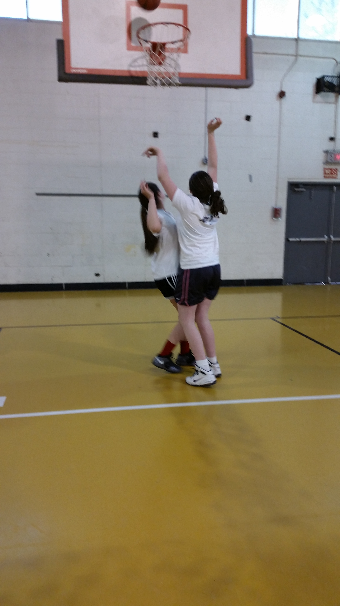
Lightning’s Photo Album

Slide 5
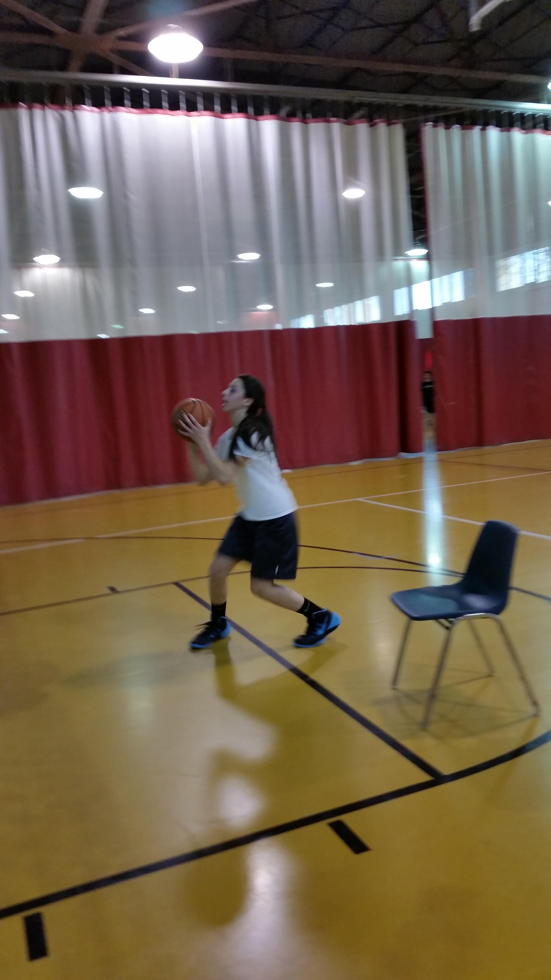
Lightning’s Photo Album

Slide 6
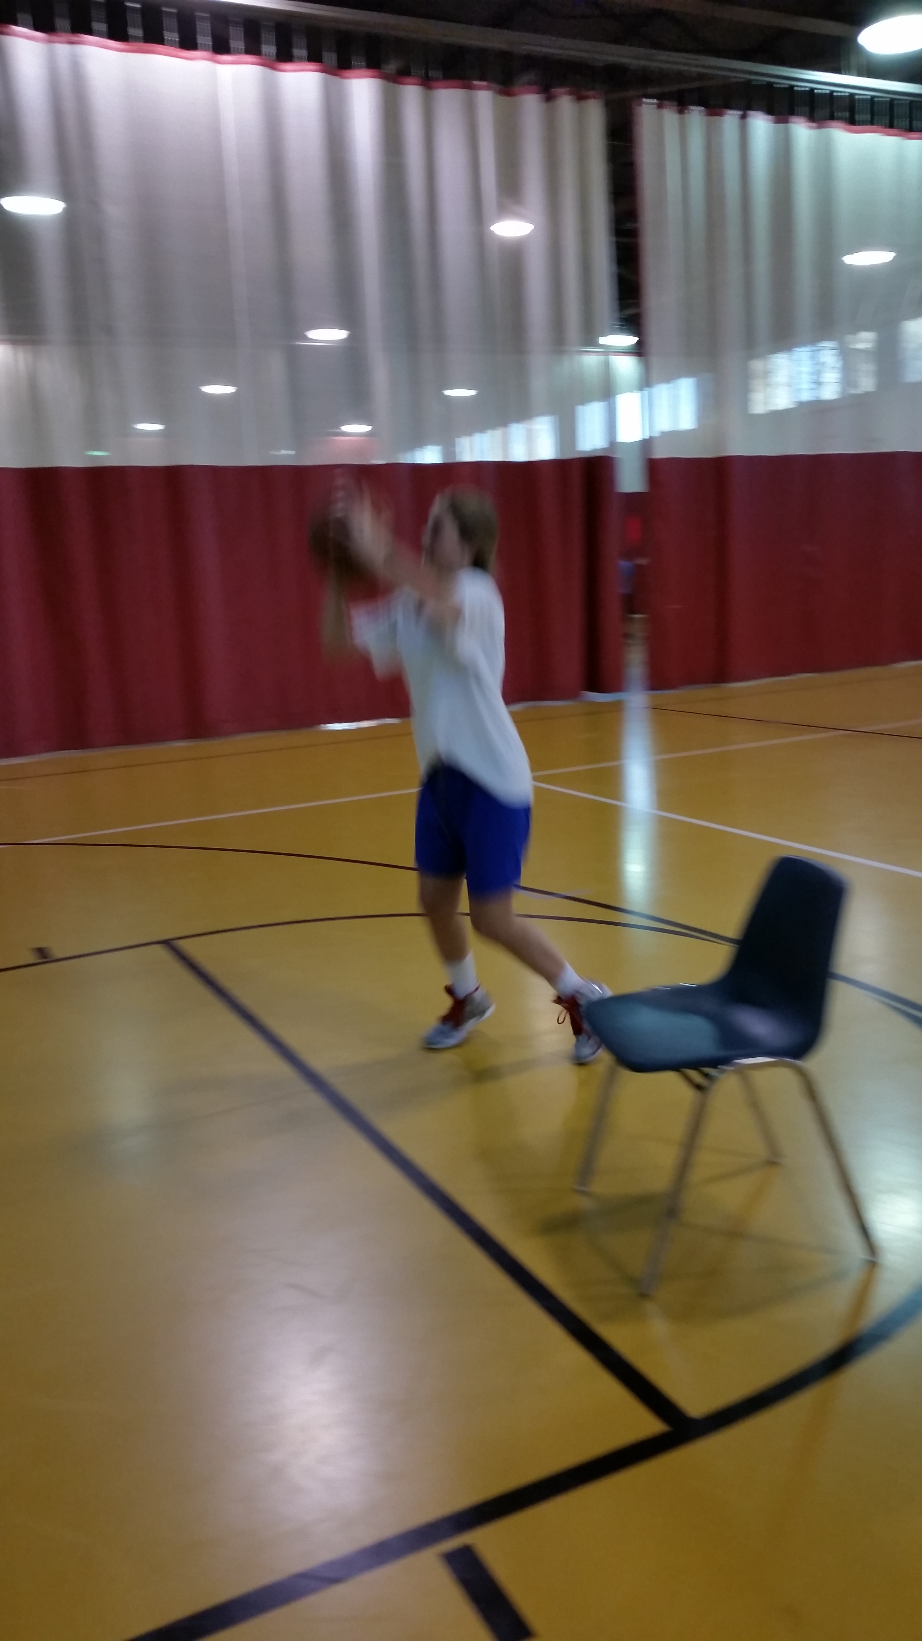
Lightning’s Photo Album

Slide 7

Lightning’s Photo Album

Slide 8

Lightning’s Photo Album

Slide 9
REPLAY

