Slide 1
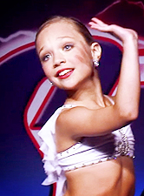
Madison Ziegler

Slide 2
Facts About Maddie!
Birthday: September 30, 2002
10 years old
Has danced since she was two years old
Dancer at the Abby Lee Dance Company
Has a younger sister Mackenzie and two half brothers Tyler and Ryan
Wants to be a professional dancer on Broadway when she grows up
Her nickname is Maddog

Slide 4
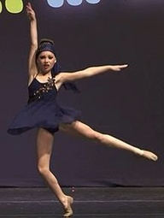
My Favorite Maddie Solo
Uphill Battle

Slide 5
Maddie Ziegler with her mother Melissa and younger sister Mackenzie.

Slide 6
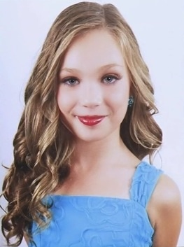
Maddie’s headshot picture for Season 3 of Dance Moms.

Slide 7
Maddie’s Solos
Cry
Beautiful
Angel
Universe
Disappear
Manhattan
Jubilation Bells
Light’s, Camera, Action!
The Girl I Wanna Be
Maestro Man
Every Little Step
I’m Already There
All Of My Life
Reflections
Quiet Voices
In My Heart
Helen Keller
Looking For A Place Called Home
Mom, It’ll Never Be The Same
I Can’t Find the Words
This is Me Over You
Piece in My Heart
Telling Myself
Don’t Leave Me
Quick Sand
You Don’t Know Me
Lifeline
Uphill Battle
Breaking Down Walls

Slide 8
