Slide 1
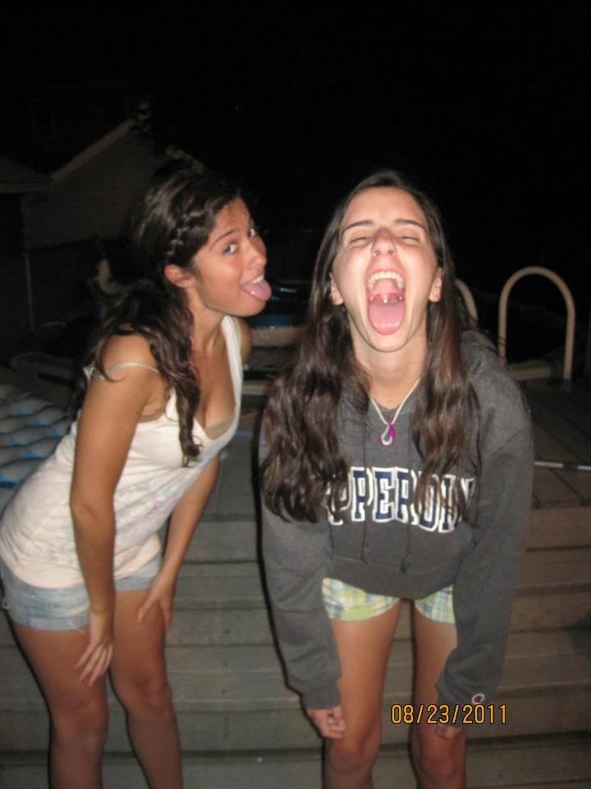
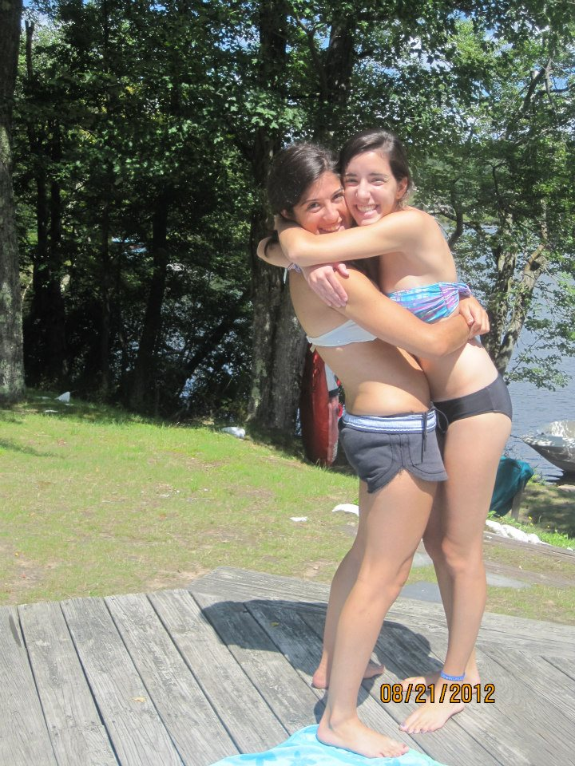
Maria and I
Maria and I have been best friends since we were babies! She’s been there for me
through everything.

Slide 2
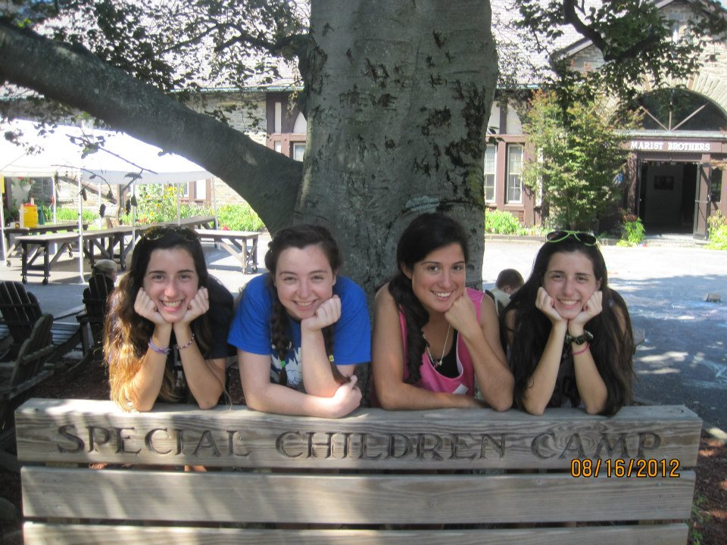
Fun Facts about Maria
Maria studies
nursing at MSMC in
Newburgh.
Here is a link to MSMC
page about Nursing.
http://www.msmc.edu/Academics/Undergraduate/Academic_Programs/nursing
Maria volunteers
at camps for
People with
special needs,
along with me,
Jamie, and our
friend Christine.
Maria loves to eat, especially candy.

Slide 3
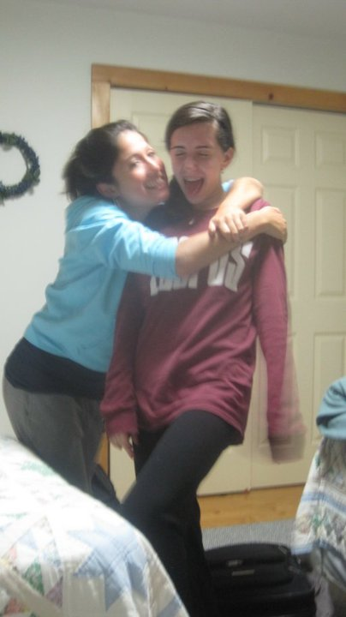
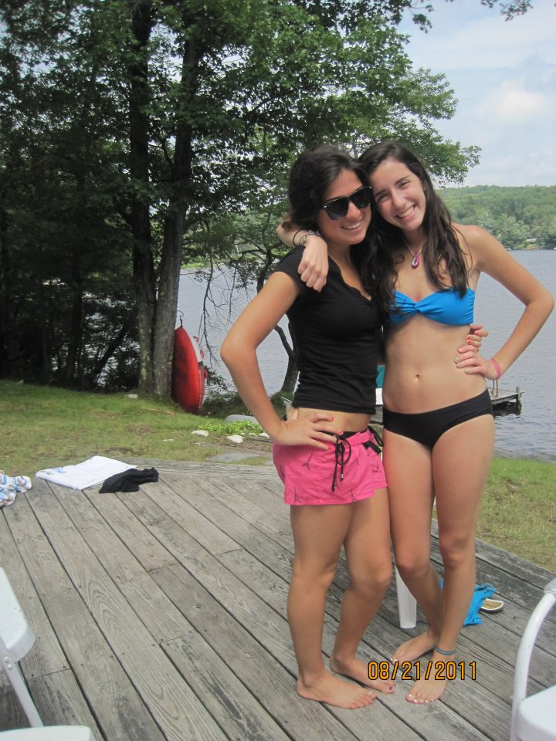
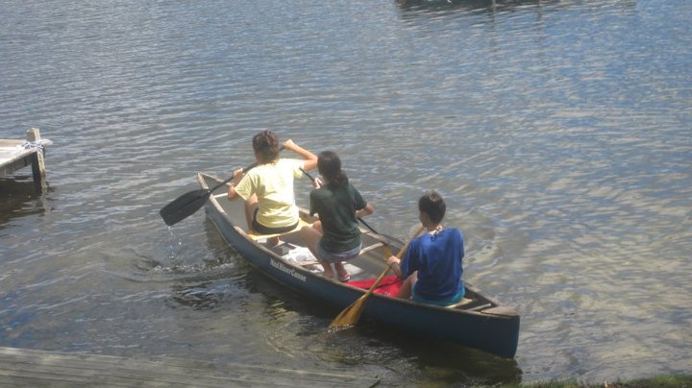
Upstate
My sister and I go upstate with Maria every summer for two days.

Slide 4
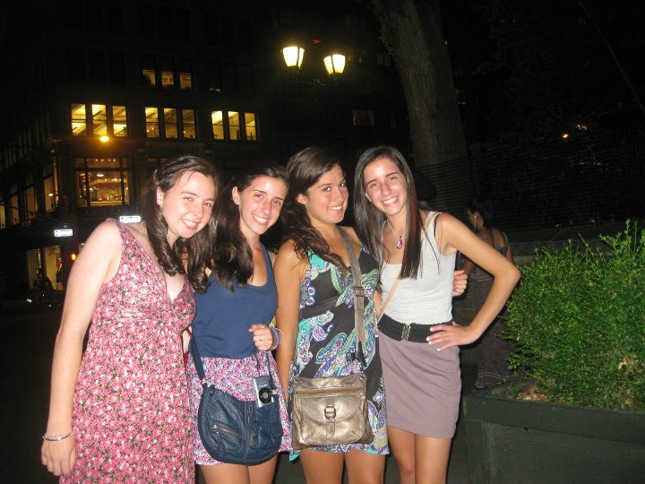
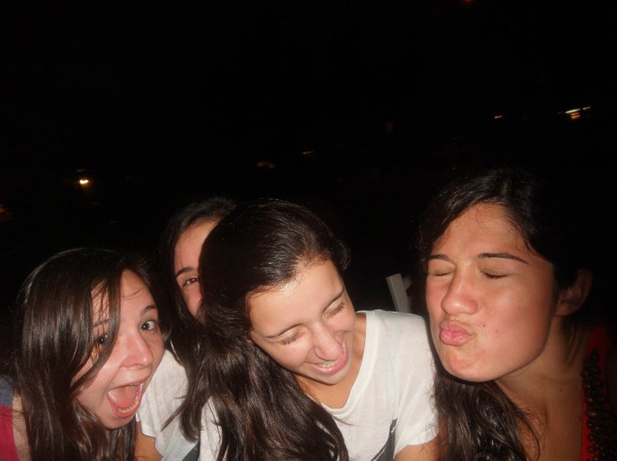
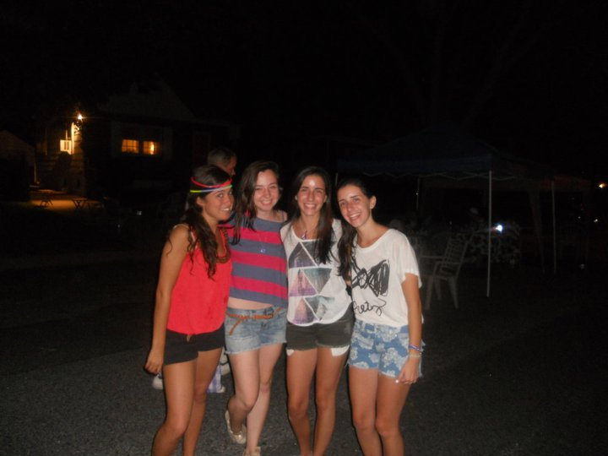
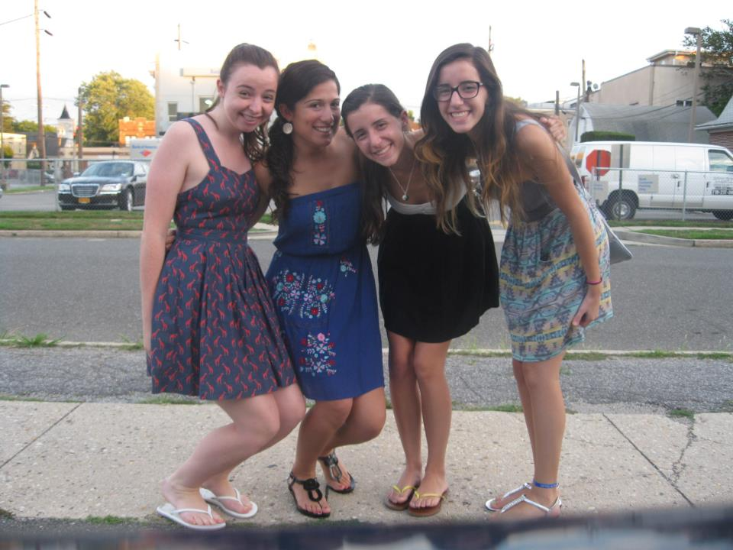
The GROUP
Jamie, Maria, and I always hang out with our friend Christine. The four
of us are constantly together during the summer.

Slide 5
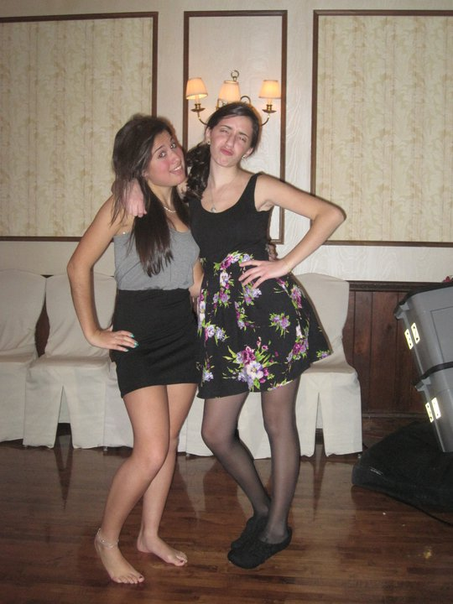
Best Friends forever

