Slide 1
A Comprehensive Approach to Physical Therapy
By: Jenice and Tiller Jessica Tonery
Date: March 12th , 2008
Adelphi University

Slide 2
Contents
What is Physical Therapy?
Qualifications for Physical Therapist
Different avenues within Physical Therapy
Common Cases
Treatments
A day in the life of a patient

Slide 3
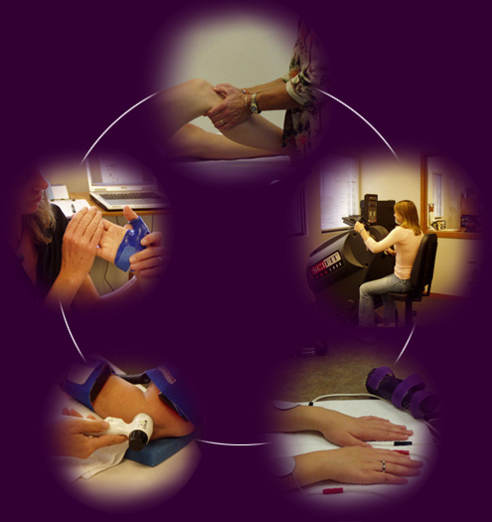
Physical therapy is…
Physical Therapy is a skilled intervention that focus primarily , but not solely , on relieving pain, promoting healing, resorting function and movement, and puts facilitation and adaption associated with injury and disability.

Slide 4
Qualifications for physical therapist
Physical therapists must earn a master's degree or receive a doctoral degree in physical therapy (a DPT) from an accredited college program.
Physical therapists must pass a state-administered national exam.
States also may impose their own regulations for practicing PT.

Slide 5
Different avenues within physical therapy
Hospitals
Nursing Homes
Physicians Offices
Adult Day Care
Children’s Day Care
Private Practice
Agencies
Rehabilitation Hospitals
Speech Pathology

Slide 6
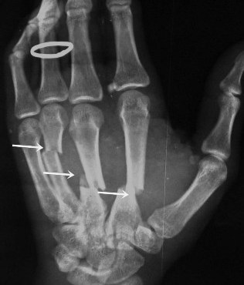
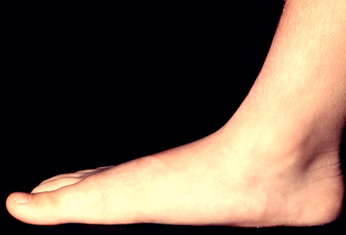
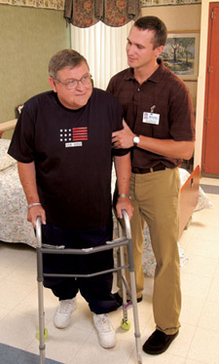
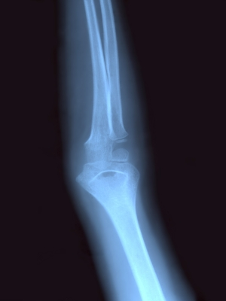
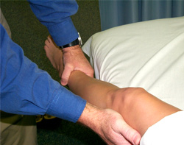
Common cases
Fractures
Flat Foot
Gait Abnormality
Sprains
Strains
Post-Orthopedic surgeries

Slide 7
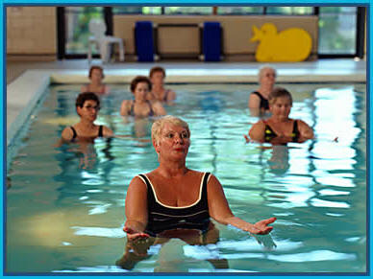
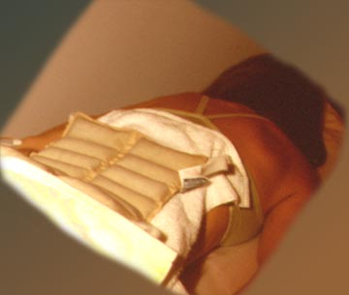
Treatment methods
Electric Stim
Heat
Cold Packs
Deep Tissue Massage
Aquatic therapy
Hippo Therapy
Dance Therapy
Biofeedback
Exercise Machinery

Slide 8
A day in the life of a patient
http://www.youtube.com/watch?v=XGsWFly7kJc&feature=related

Slide 9
A day in the life of a patient (cont….)
During a visit, a physical therapist may:
Measure the patients flexibility and strength
Analyze the way the patient walks
Identify potential and existing problems
Consult with other medical psychiatric and school personal
Provide instructions for home exercise programs
Recommend when returning to sport or daily activity is safe

Slide 10
Works cited
http://kidscando.org/physical.html
http://physicaltherapy.about.com
http://www.americanquettrian.com
http://www.aquaticpt.org
http://www.dance-two-health-help-your-special-needs-child.com

