Slide 1
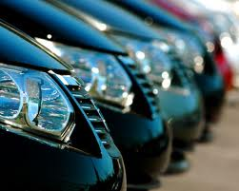
Rent cars today!

Slide 2
For more information, click on the link below
Rental Cars

Slide 3
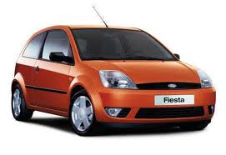
Fiesta
Only $100 per day!

Slide 4
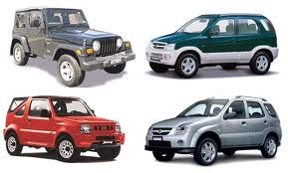
JEEPS
$159 Per day!

Slide 5
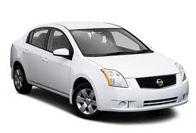
NISSAN
$129 per day!

