Slide 1
Castelli Family Trips
Jacqueline Castelli

Slide 2
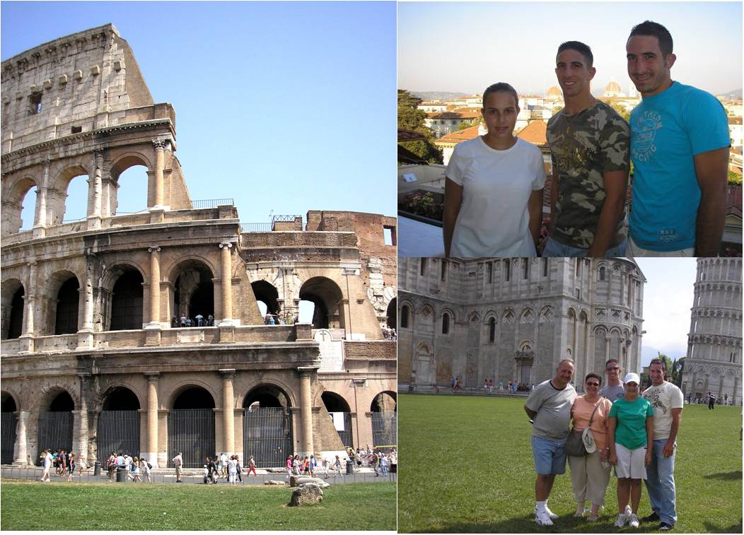
Italy
Italian Tourism
Go to Home Page

Slide 3
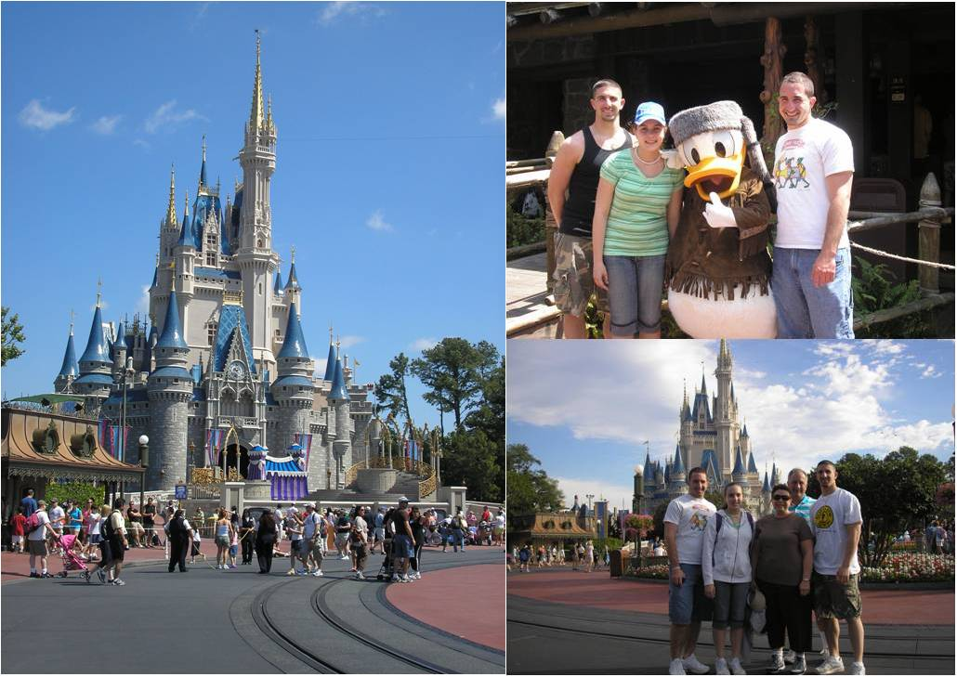
Florida
My Florida
Go to Home Page

Slide 4
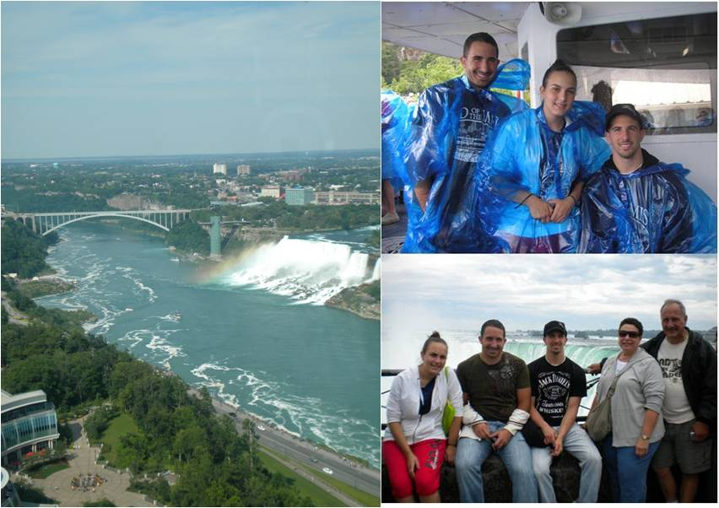
Niagara Falls
Niagara Falls Tourism
Go to Home Page

Slide 5
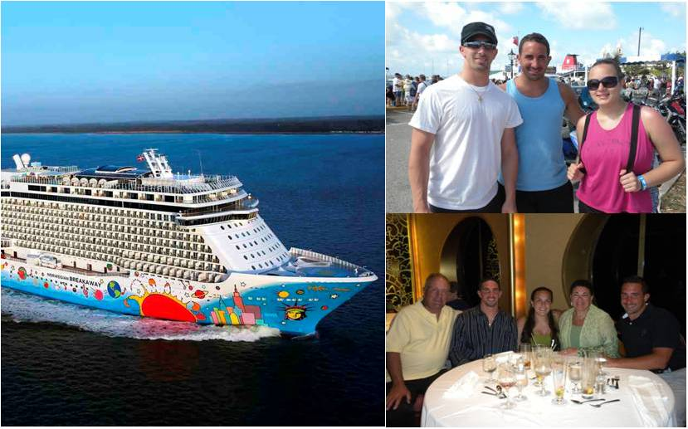
Bermuda
Bermuda Tourism
Go to Home Page

Slide 6
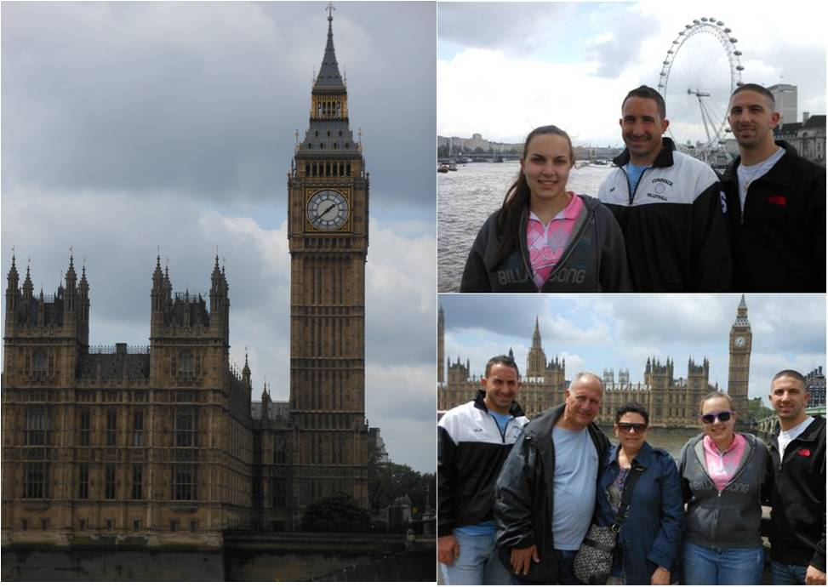
London
Visit London
Go to Home Page

Slide 7
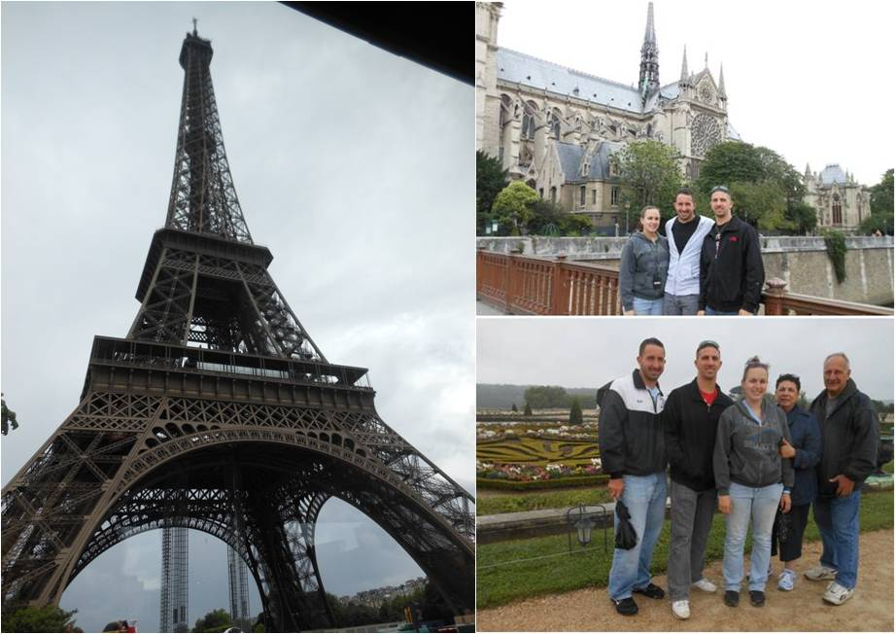
Paris
Paris Info
Go to Home Page

