Slide 1
Andrew & Jamie
Best
Friends
Forever

Slide 2
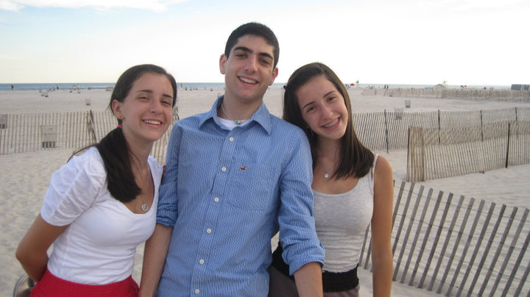
The Awkward Years

Slide 3
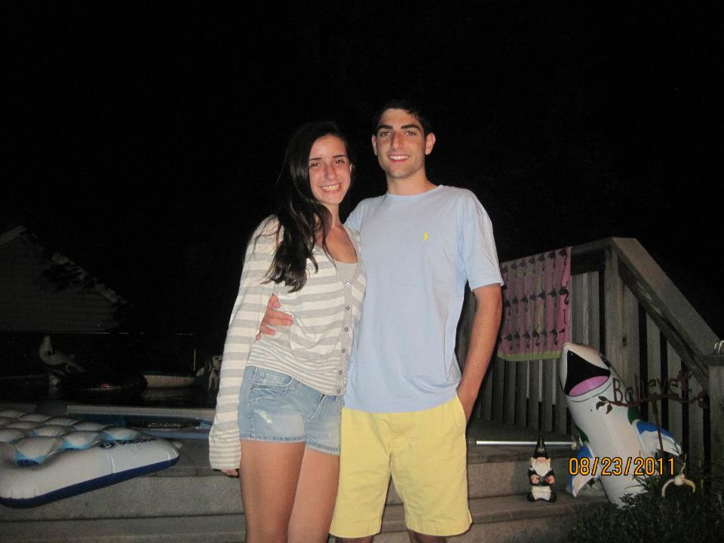
My Seventeenth Birthday

Slide 4
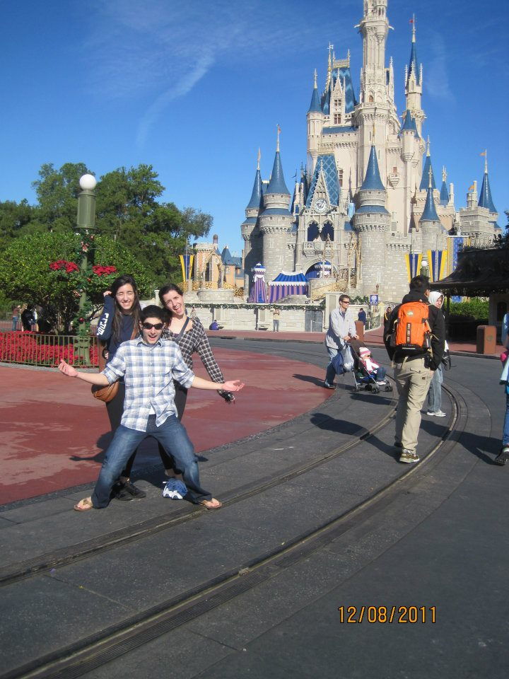
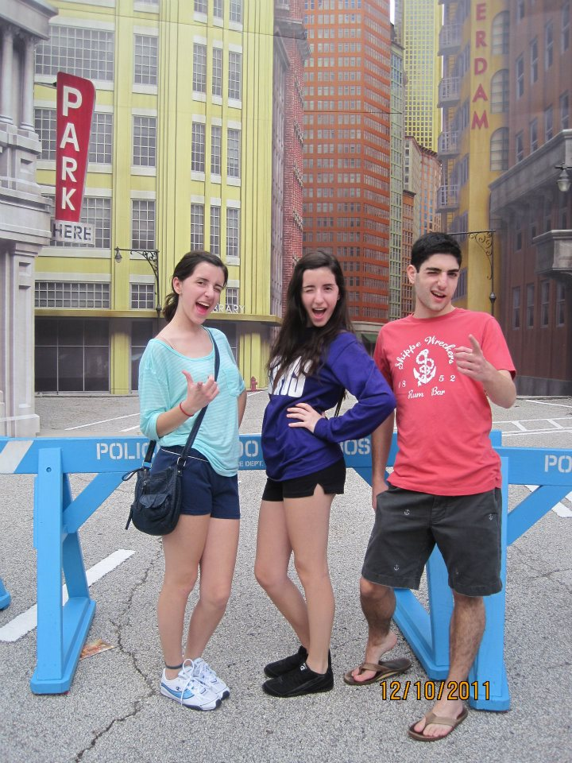
Senior Trip to Disney World

Slide 5
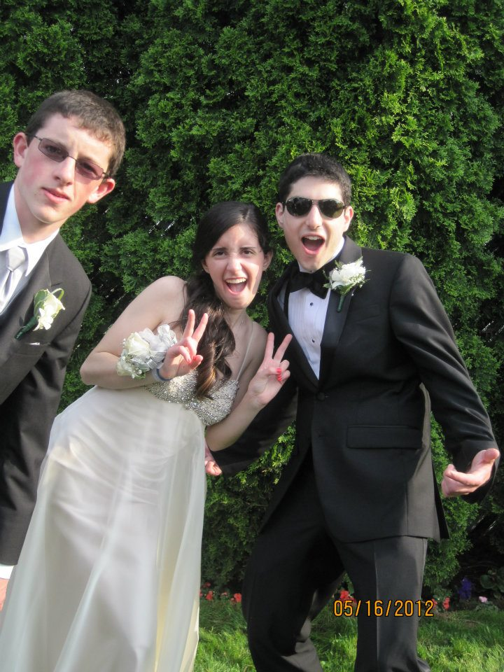
Prom

Slide 6
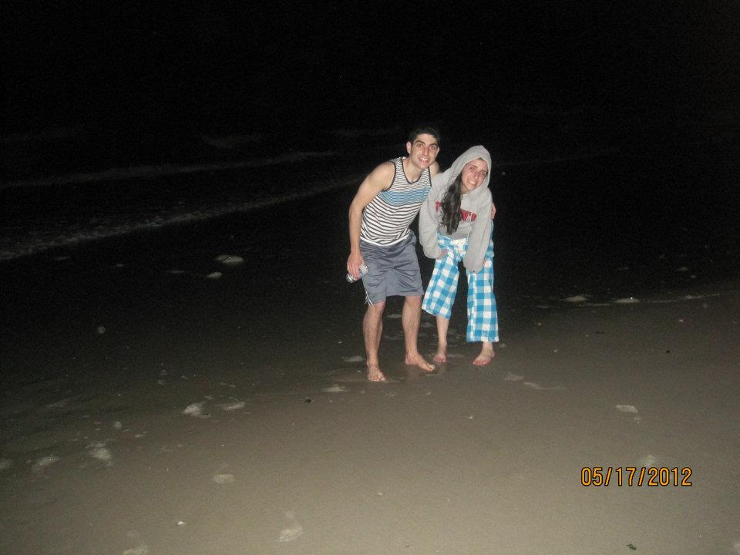
Afterprom Shenanigans

Slide 7
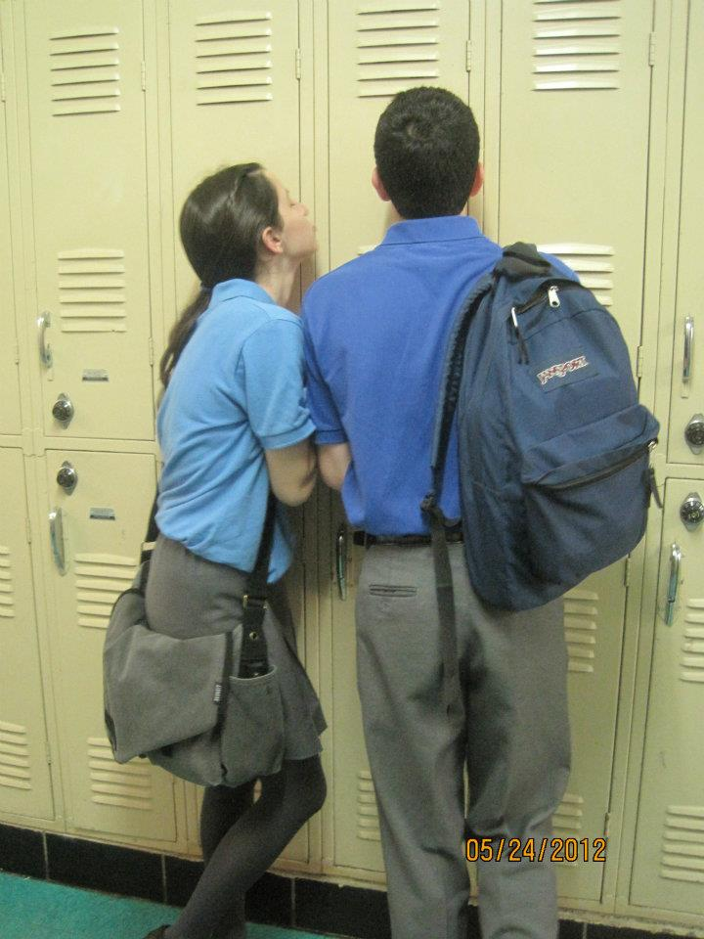
Last day of Senior Year

Slide 8
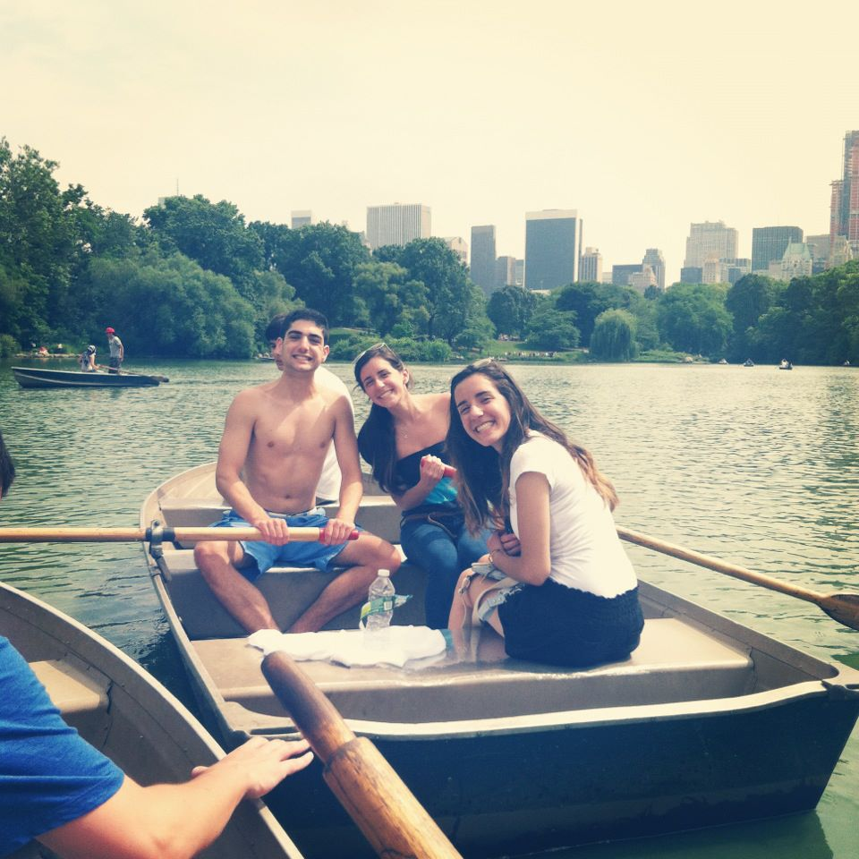
Our day in Central Park

Slide 9
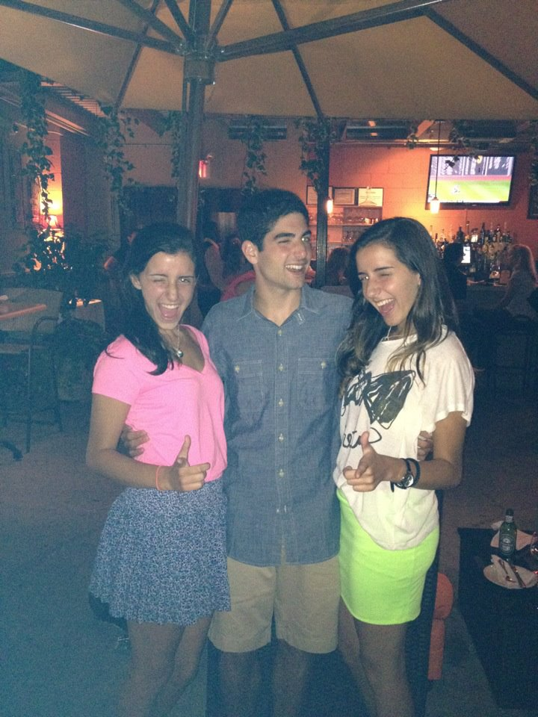
Katherine’s Birthday Dinner

