Slide 1
Andrew & Jamie
Best
Friends
Forever

Slide 2
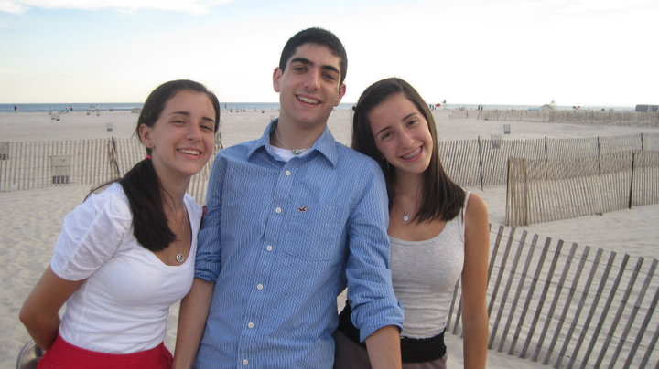
The Awkward Years

Slide 3
My Seventeenth Birthday

Slide 4
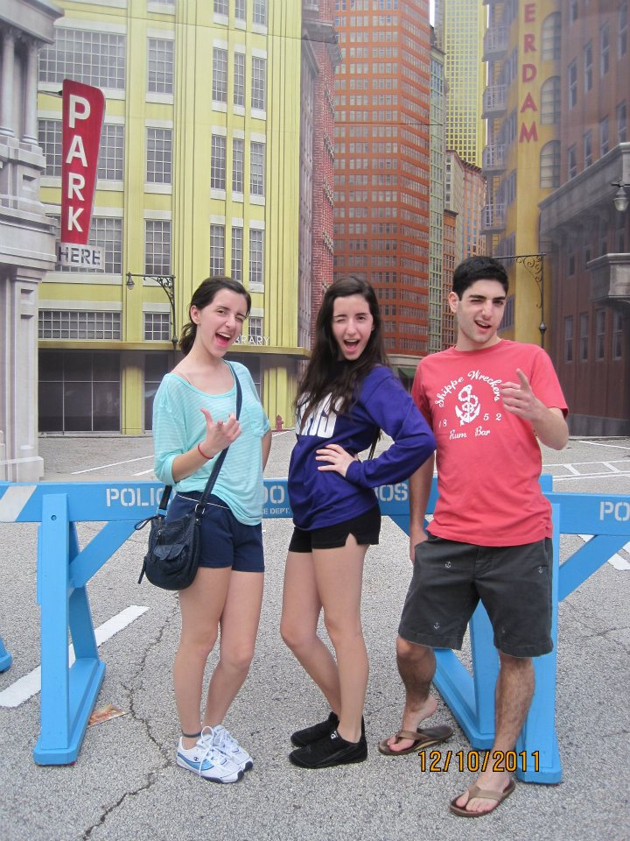
Senior Trip to Disney World

Slide 5
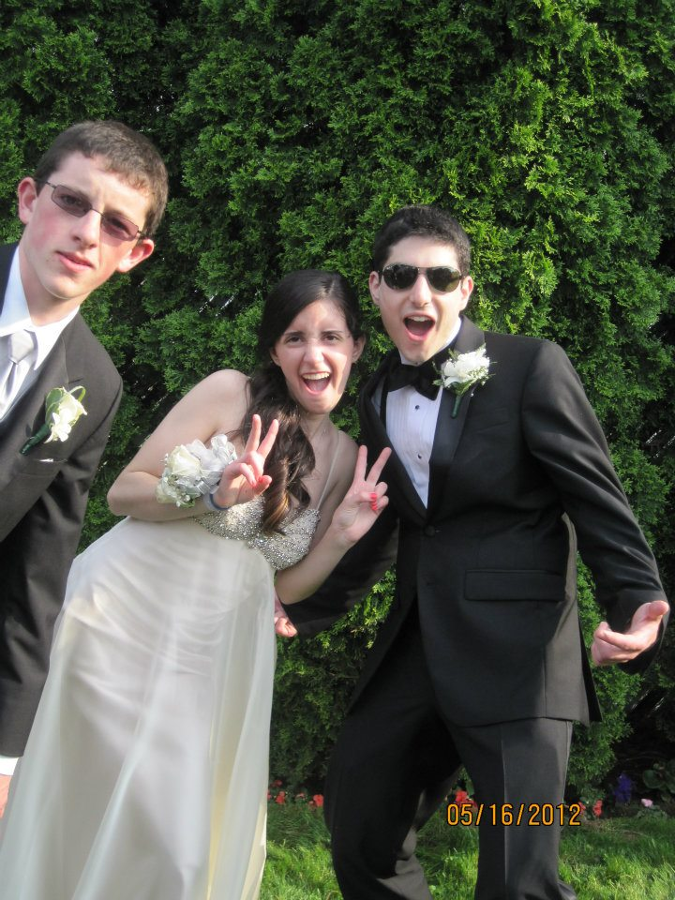
Prom

Slide 6
Afterprom Shenanigans

Slide 7
Last day of Senior Year

Slide 8
Our day in Central Park

Slide 9
Katherine’s Birthday Dinner

