Slide 1
Delta Phi Epsilon Philanthropies
Janine Quintino

Slide 2
Cystic Fibrosis
Cystic Fibrosis (CF) is an inherited disease that causes thick, sticky mucus to form in the lungs, pancreas and other organs. In the lungs, this mucus blocks the airways, causing lung damage and making it hard to breathe. In the pancreas, it clogs the pathways leading to the digestive system, interfering with proper digestion.

Slide 3
How do we help
Delta Phi Epsilon is constantly raising awarnes for CF for it is not a very known disease.
Since 1967, Dphie has also raised over 1.5million dollars for CF.
Two events that DphiE holds nation wide is the 65 rosses gala and tates totes.

Slide 4
65 Roses Gala and Tates totes
The 65 roses gala is called that because, children with Cf can not pronounce it so they call it “65 roses.” We host a gala to raise money and awareness fro the disease.
Tates totes are care packages DPhiE makes for children in hospitals with CF.

Slide 5
DPhiE Adelphi
Last year DphiE at Adelphi Hosted a 65 Roses Gala, we had a guest speaker with CF and a great turn out. We were able to raise over $1000.
This year we had a bowling for breath event, where friends and family came to bowl for CF, this time we raised over $1,200

Slide 6
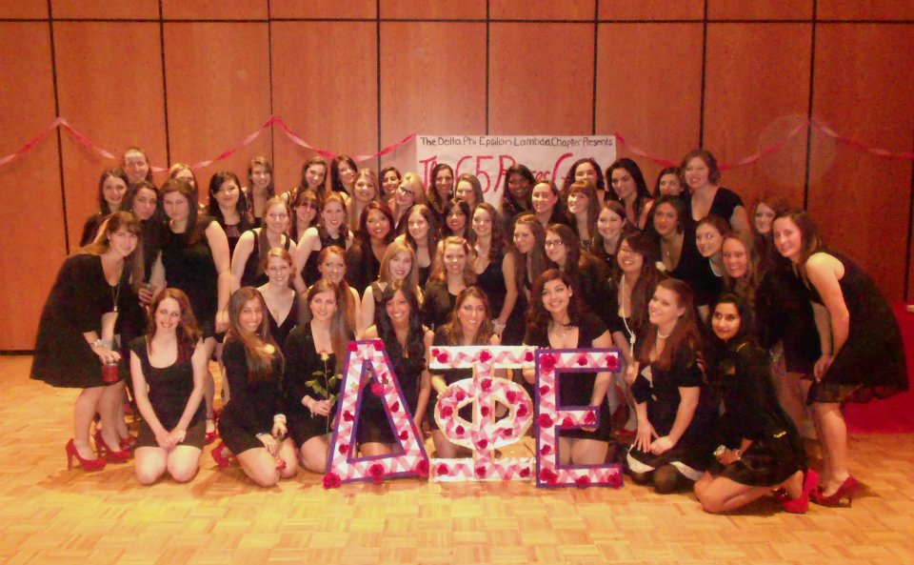
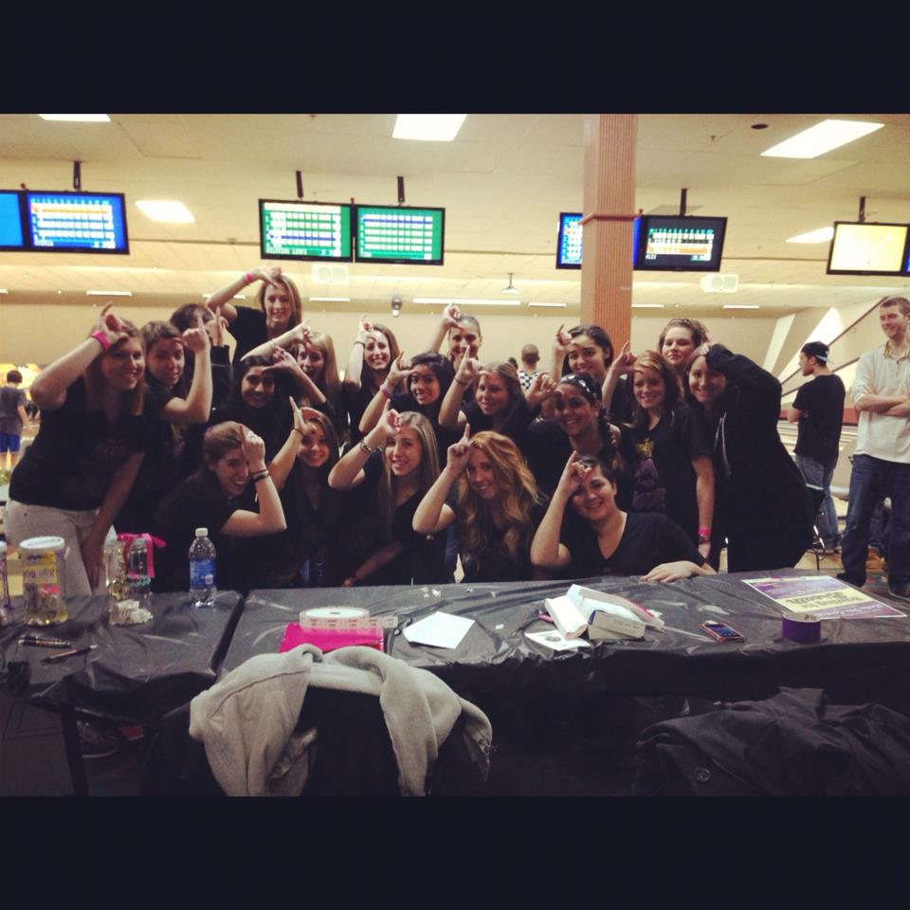
A picture of us at both CF events

Slide 7
ANAD
The National Association of Anorexia Nervosa and Associated Disorders (ANAD) was created to help alleviate problems of anorexia and other eating disorders. Each Delta Phi Epsilon chapter sponsors an annual candlelight vigil on their campus to increase awareness of eating disorders and provide information to family and friends of sufferers. Delta Phi Epsilon is the first national sorority to pledge their regular support to ANAD

Slide 8
ANAD at Adelphi
Our ANAD week will be help next semester in the spring! We will have a table outside the UC everyday raising money and awareness, we are also having one large event (TBA) and ending the week with a Candle light vigil.

Slide 9
Educational Foundation
The Delta Phi Epsilon Educational Foundation, established in 1967, helps to give members and their children the opportunity to further their education through scholarships, grants, and loans. The foundation also supports sorority education and volunteer training. The Harriette Hirsch Sisterhood Fund helps give financial support to sisters during time of family financial crisis and allows them to continue their education.

Slide 10
Useful Links
To Find out more about each philanthropy check out these links.
Educational foundation = http://www.dphie.org/philanthropy
Cystic Fibrosis = http://www.dphie.org/philanthropy/philanthropicpartners/thecysticfibrosisfoundation
ANAD= http://www.dphie.org/philanthropy/philanthropicpartners/anorexianervosaassociateddisorders%28anad%29/anorexianervosaassociateddisorders

