Slide 1
Lots of Random
All over this page

Slide 2
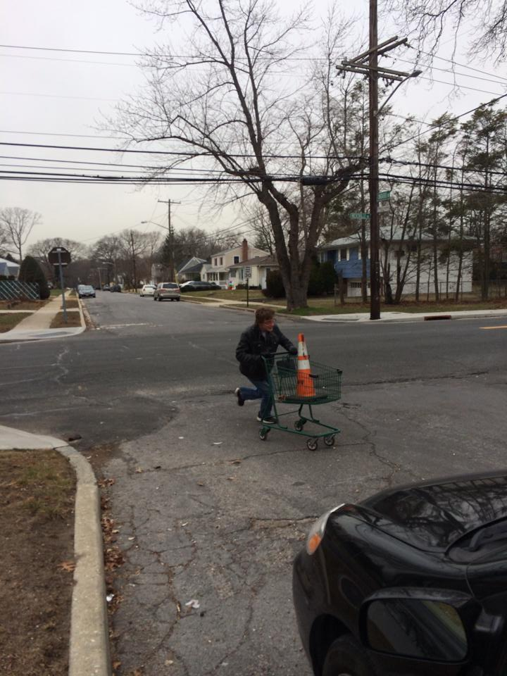
Me and a Traffic Cone

Slide 3
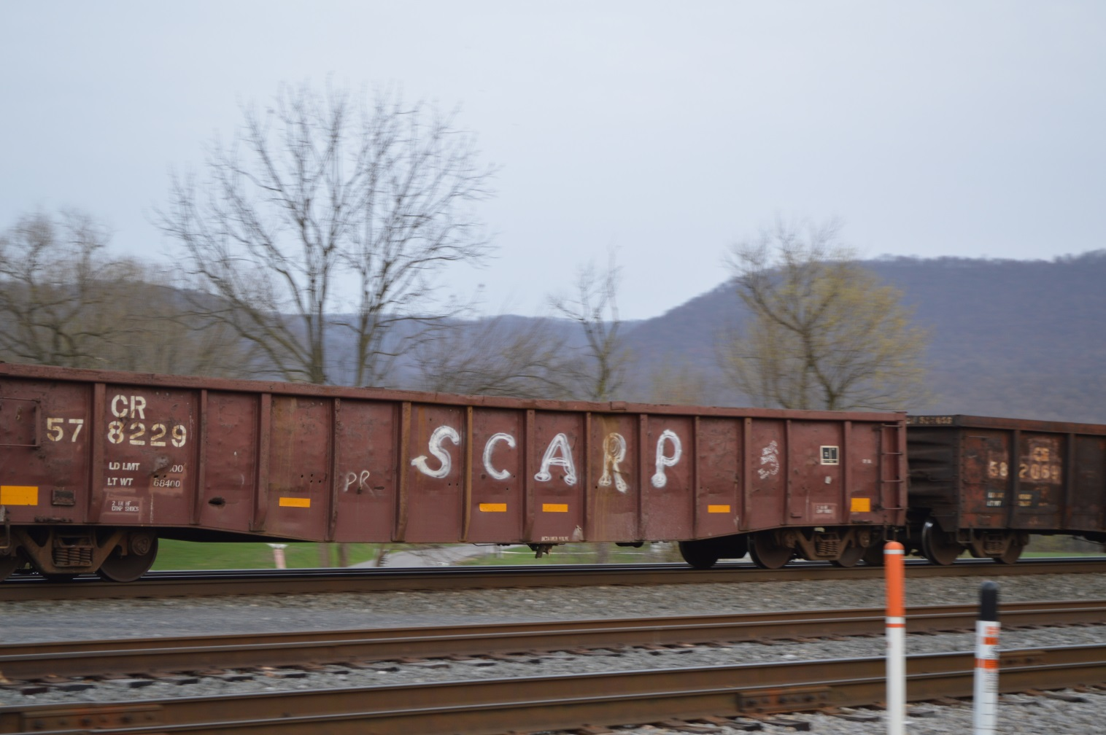
Someone needs more school

Slide 4
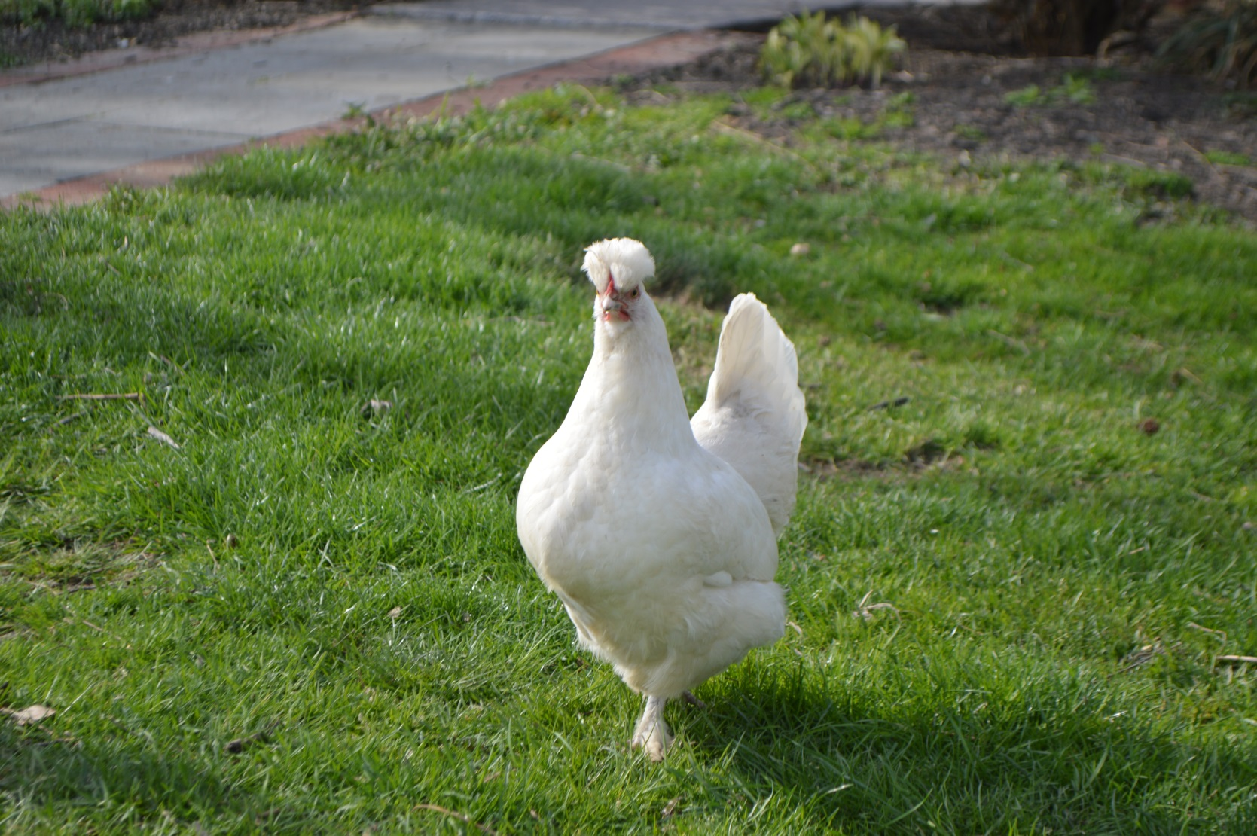
Buck Buck Buck Buck

Slide 5
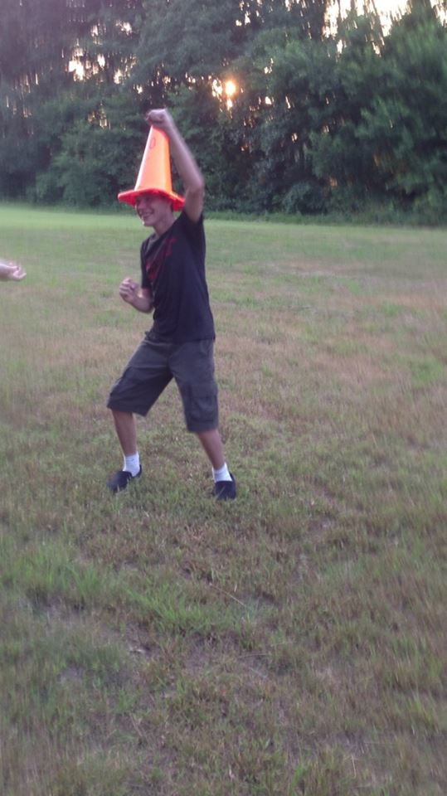
I like Traffic Cones

Slide 6
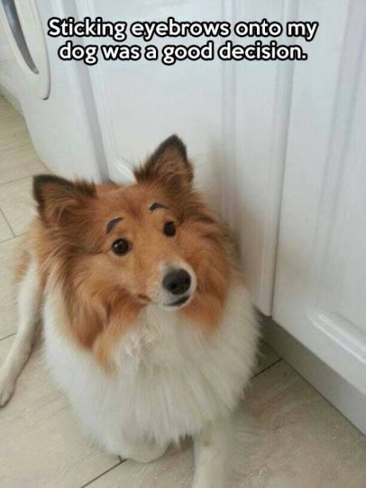
One day I’m gonna do this to my dog

Slide 7
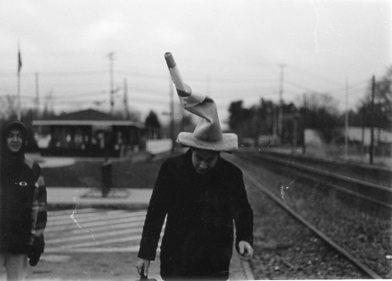
We had to… Return

