Slide 1
Featured Artists
EDC NY 2013

Slide 2
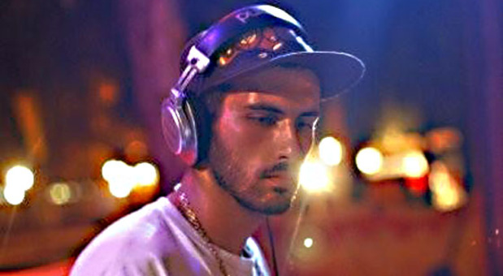
BORGORE

Slide 3
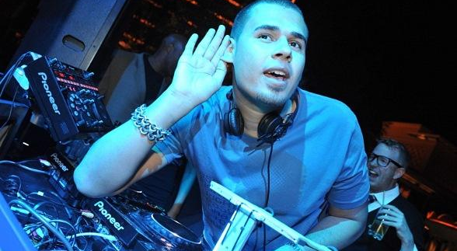
AFROJACK

Slide 4
NERVO

Slide 5
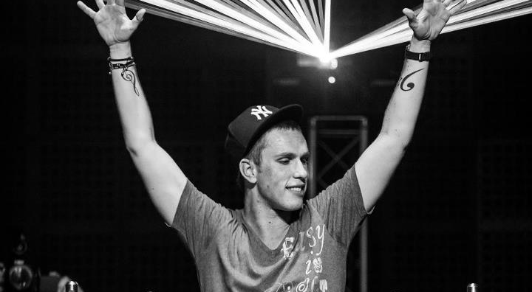
NICKY ROMERO

Slide 6
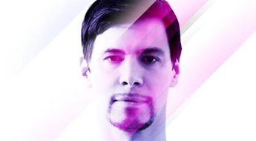
THOMAS GOLD

Slide 7
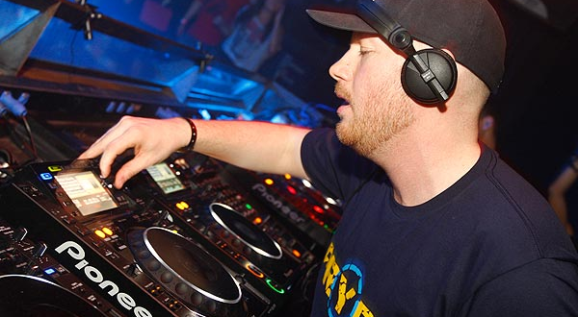
ERIC PRYDZ

