Slide 1
Spoken = expressed speech in specific tone

Slide 2
WORD
=
A sound Representing in writing, communicating a meaning

Slide 4
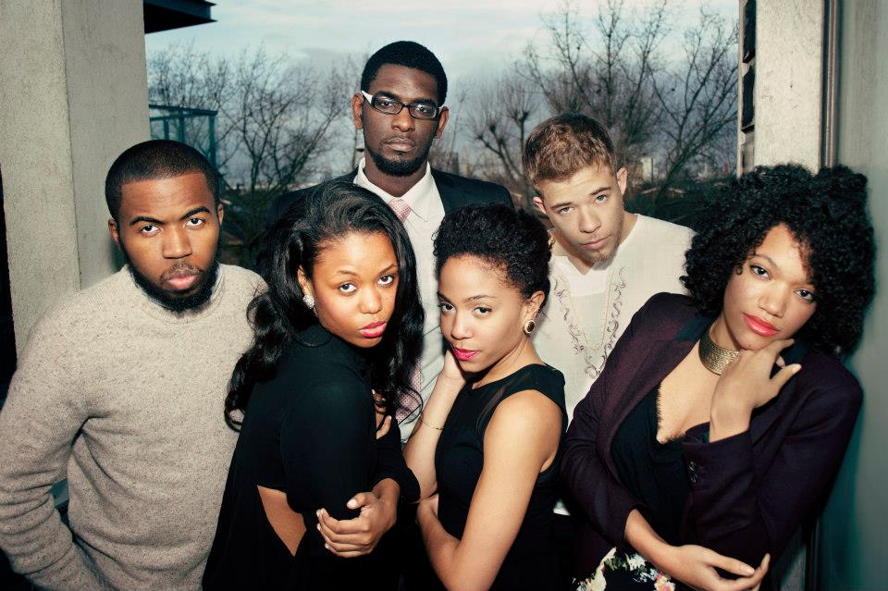
The Artists

