Slide 1
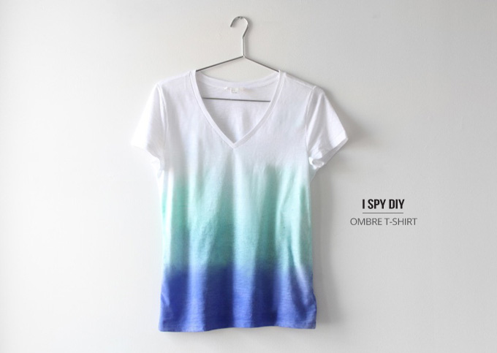
Shirts T-shirts

