Slide 1
The Stony Brook Prep School Photo Album
2009-2011

Slide 2
My Dormitory : Simons Hall
39 dorm mates
1 roommate
5 dorm moms
Community kitchen, lounge, and bathroom

Slide 3
Daily Schedule Monday-Friday
7:50am-3:15pm classes
3:30pm-5/5:30pm sports (required 2 per year)
6:15pm-mandatory dinner
7:45pm-9:45 study hours
11pm- bedtime

Slide 4
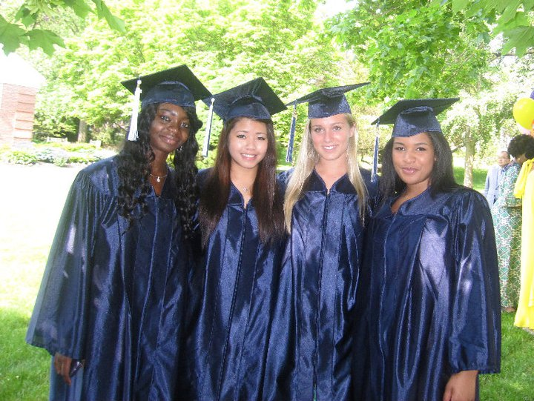
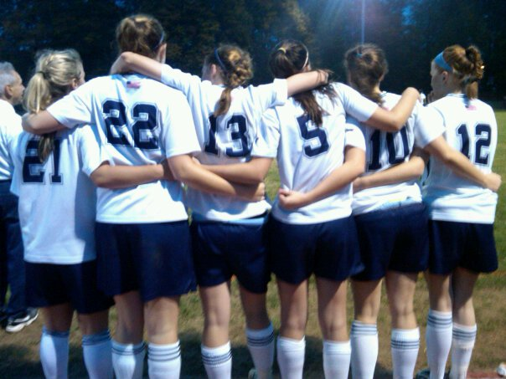
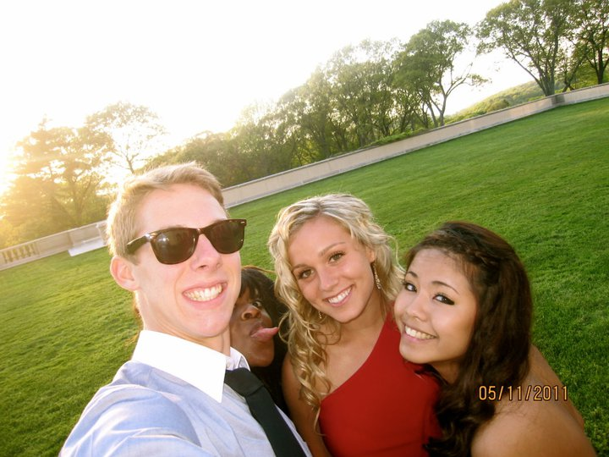
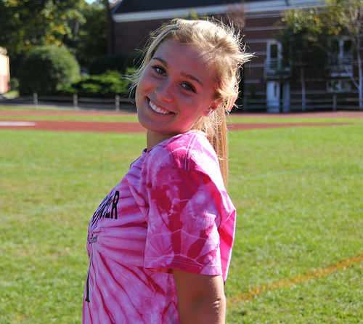
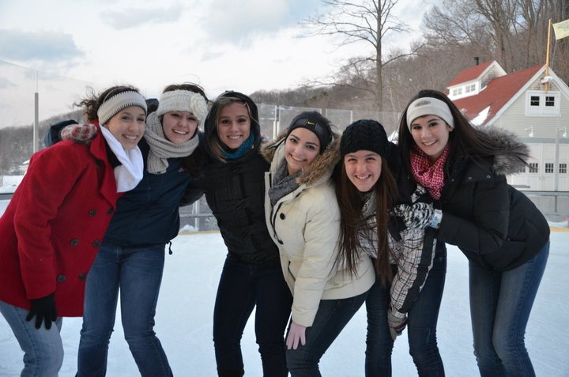
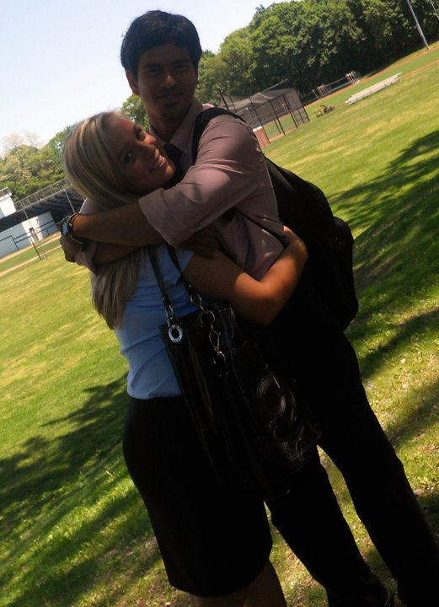
Soccer
Basketball
Graduation
G
R
A
d P
A
R
T
y
Kicks for Cancer Game
Dorm Mates
High school Sweetheart
Roommate: Jetaime

Slide 5
New York State Champions 2009
During my first season of soccer at the stony brook school, I led the team to a state championship and was named new york state player of the year.
This was the first state championship the school had ever won.
It is one of the most precious memories I have and will always remember.
#1 play of the year.

