Slide 1
Cardiovascular Exercise
The Different Types

Slide 2
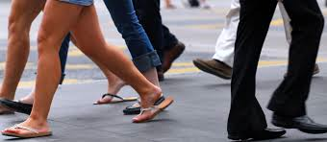
Walking

Slide 3
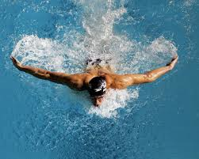
Swimming

Slide 4
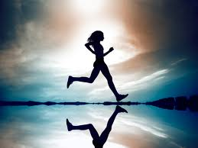
Jogging

Slide 5
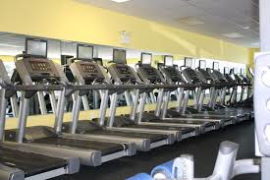
Treadmill

Slide 6
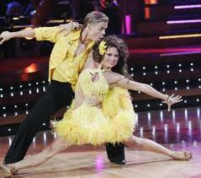
Dancing

Slide 7
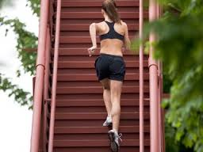
Stair Climbing

Slide 8
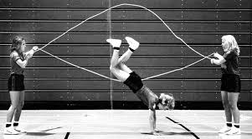
Jumping Rope

Slide 9
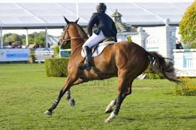
Horseback Riding

Slide 10
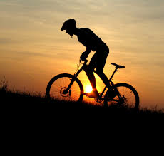
Biking

Slide 11
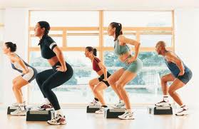
Step Aerobics

Slide 12
More Ideas!
Click here for more cardio ideas!

