Slide 1
D2 Women's LACROSSE
2012

Slide 2
Adelphi Women's lacrosse

Slide 3
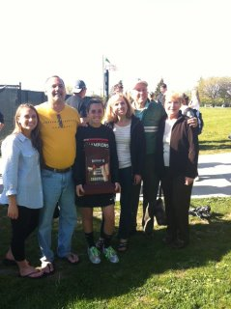
Ne 10 Conference CHAMPS!

