Slide 1
AU Women’s Lax Sophomores
By Camille Rosellini

Slide 2
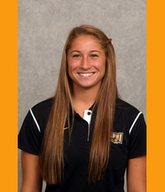
#33 Camille Rosellini
Sophomore Defender
Height: 5’ 7”
Hometown: Rockaway, NJ
Hobbies: Soccer, Running, and the beach
Major: Accounting

Slide 3
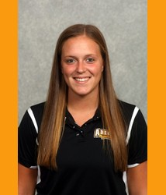
#22 Danielle Montano
Sophomore Attacker
Height: 5’ 5”
Hometown: Oceanside, NY
Hobbies: Swimming, going to the beach, and getting Dunkin Donuts
Major: Physical Education

Slide 4
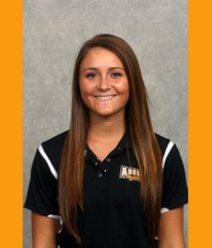
#19 Emily Keesling
Sophomore Midfielder
Height: 5’ 3”
Hometown: Bel Air, Md
Hobbies: Field hockey, going to the beach, watching the Ravens
Major: speech pathology

Slide 5
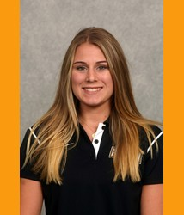
# 27 Gianna Galo
Sophomore defender
Height 5’ 5”
Hometown: Port Washington, NY
Hobbies: Shopping, Going to the zoo, hanging with Rachel
Major: Accounting

Slide 6
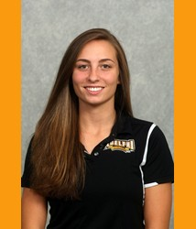
#28 Rachel Aitkens
Sophomore Midfielder
Height: 5’ 5”
Hometown: Flemington, NJ
Hobbies: Playing video games, playing with Brutus (her dog), flying helicopters
Major: Nursing

Slide 7
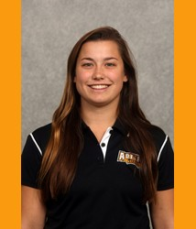
#12 Rachel O’Brien
Sophomore Attacker
Height: 5’ 4”
Hometown: Bayport, NY
Hobbies: Going to the beach, longboarding, painting, watching Spongebob, hanging out at Spa Rachel
Major: Art

Slide 8
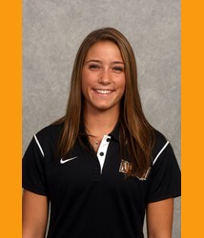
#36 Taylor Hayes
Sophomore Goalie
Height: 5’ 6”
Hometown: Rockville Centre, NY
Hobbies: Going to the beach, hanging out with Danielle Jaycox, Running
Major: Communications

