Slide 1
Empanada Mama
Photo gallery

Slide 2
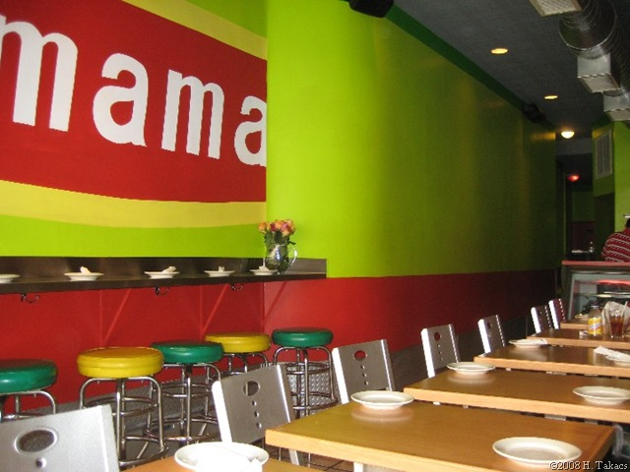

Slide 3
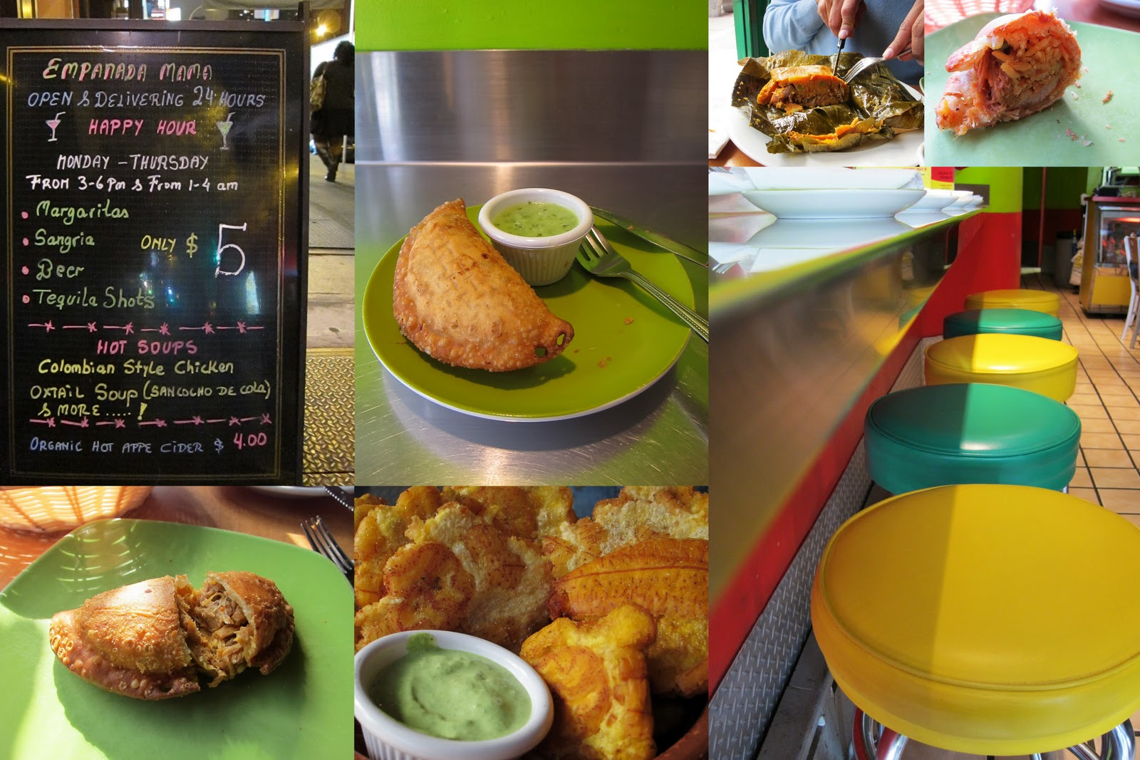

Slide 4
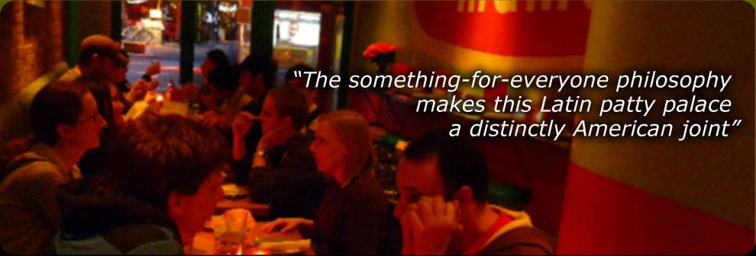
About us
A Critique of Empanada Mama: "Socrates Nanas, who founded this restaurant with the owner of the Mama's Empanadas chain in Queens, has a foolproof plan to feed the masses: big flavors in small packages. The menu of more than forty empanadas stuffed and sealed with wheat- or corn-based shells is designed to hit a nostalgic nerve. Whatever flavors you like, you can expect them here, wrapped in a warm, yielding pocket: Greek (spinach pie), Cuban (ham, pork, and cheese), Polish (kielbasa and sauerkraut), Hawaiian (ham, cheese, and pineapple), Italian (sausage, peppers, and onions), [and] American (cheeseburger). Other small offerings include arepas, tamales, and veal and rice balls with Greek avgolemono, fork-tender meatballs in a lemon-based gravy. Dessert empanadas are worthy of a fancier establishment; the fig, caramel, and cheese patty mingles salty cheese with sweet figs and gooey caramel. The bright, industrial interior is as quirky and varied as the menu...Empanadas aside; the something-for-everyone philosophy makes this Latin patty palace a distinctly American joint." _Timothy Cooper Courtesy of New York Magazine's Restaurant Guide.

Slide 5
Visit our website at http://www.empmamanyc.com/index.php

