Slide 1
Fashion
Brittany Hagan

Slide 2
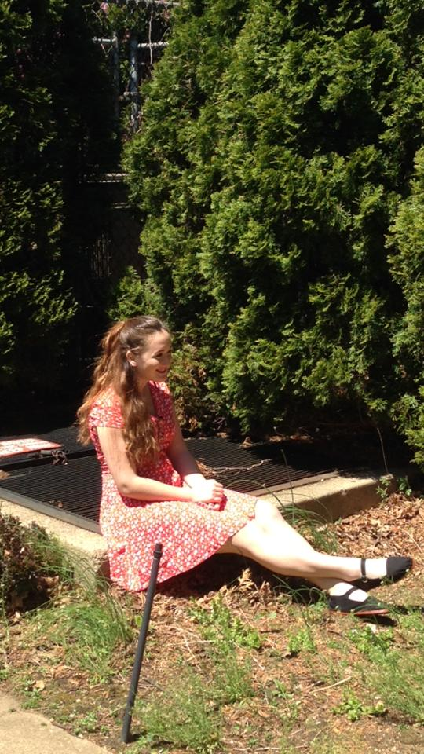
Vintage
Go back to beginning

