Slide 1
My Future Plan
By: Brittany Piazza

Slide 2
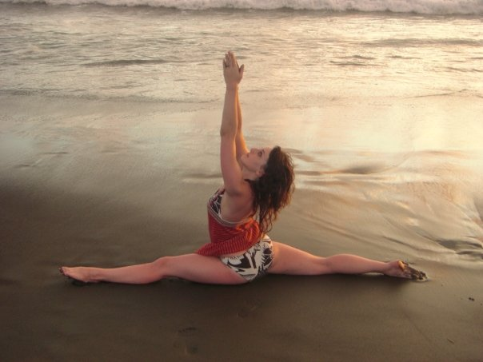
Professional Dancer
First and foremost, I aspire to be a professional dancer soon after I graduate from Adelphi University.
I will be graduating with a B.F.A. in dance and a minor in psychology.

Slide 3
Dream Companies
Parsons Dance Company
Amy Marshall Dance Company
Paul Taylor Dance Company
Pilobolus Dance Theater
Hubbard Street Dance
Mark Morris Dance Group
Lar Lubovitch Dance Company
And more…

Slide 4
What’s Next?
Dancing in a company is all I want in life, however that only lasts until your 30s.
What do I do after my professional career is over?

Slide 5
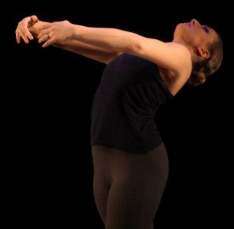
Dance Therapy
I am looking into getting my Master Degree in Dance Therapy.
I wanted to go into dance therapy because I have an immense background as a dancer and great interest in psychology.
Online or on-campus classes.
This is a program I will look into.

Slide 6
That is the Plan for Now
The End

