Slide 1
Transferring to Mount Saint Mary College
By: Brittany Thomas
http://msmc.edu/

Slide 2
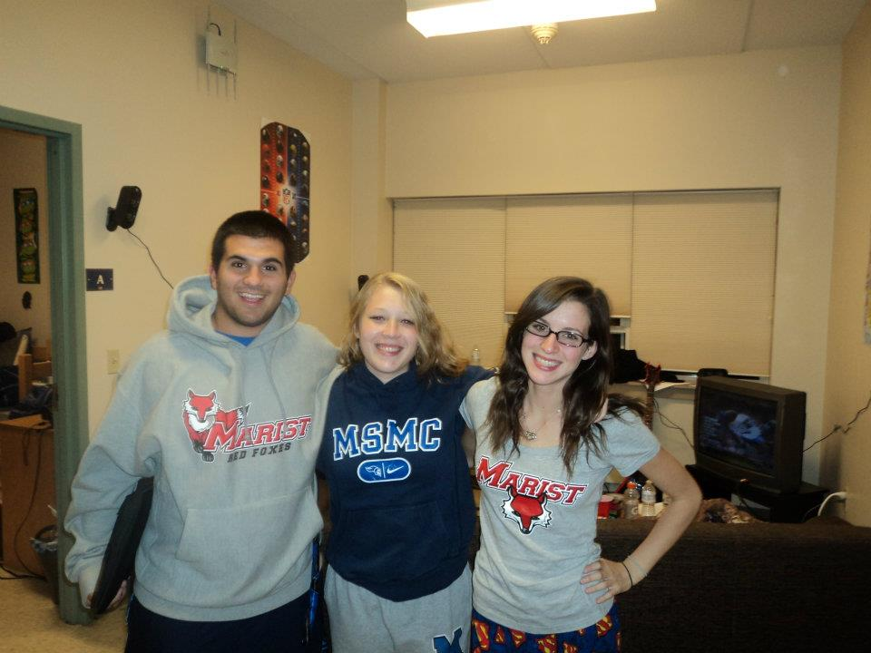
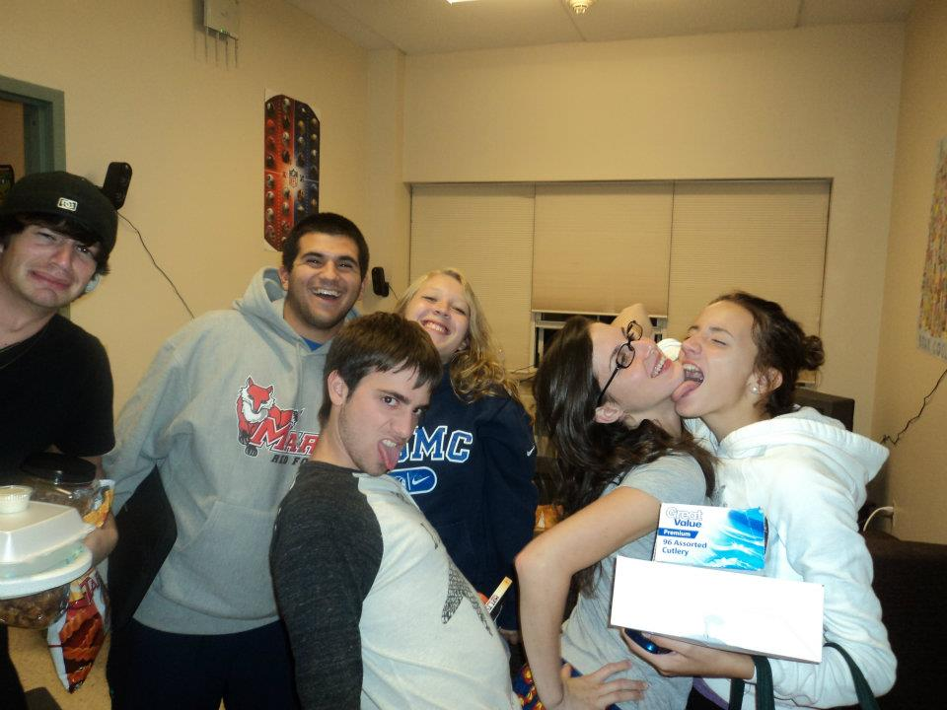
Christina, Matt, Bobby, Emily, Justin & a group of friends
PRO

Slide 3
Great Education Program!

Slide 4
Cheaper than Marist
PRO

Slide 5
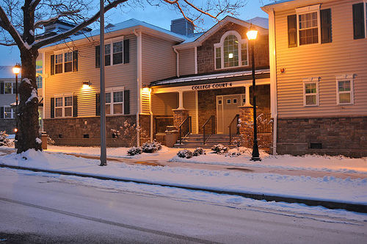
Honors housing with Christina next year!
PRO

Slide 6
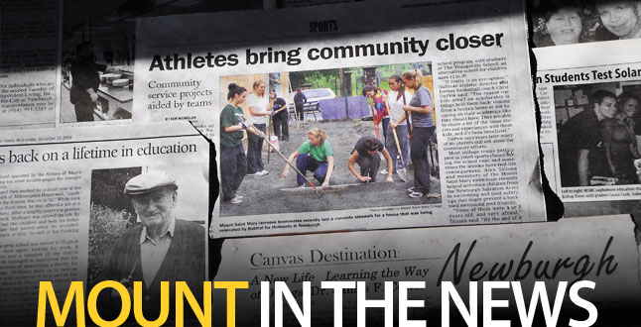
Track and Field
PRO

Slide 7
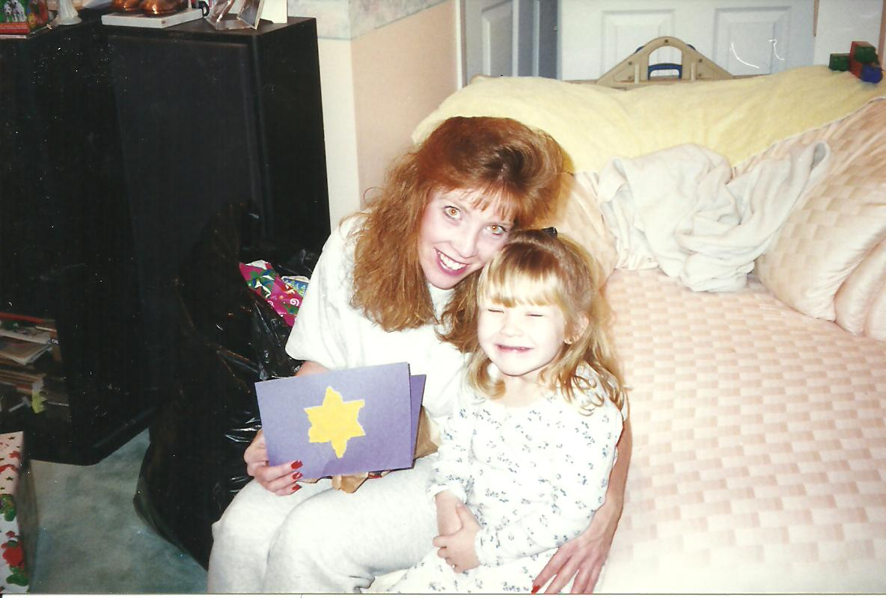
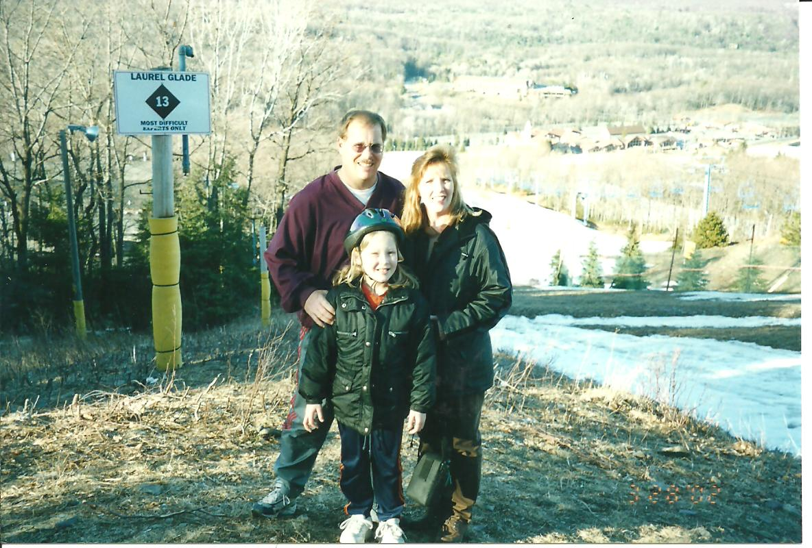
Closer to home
PRO

Slide 8
Carpool
PRO

Slide 9
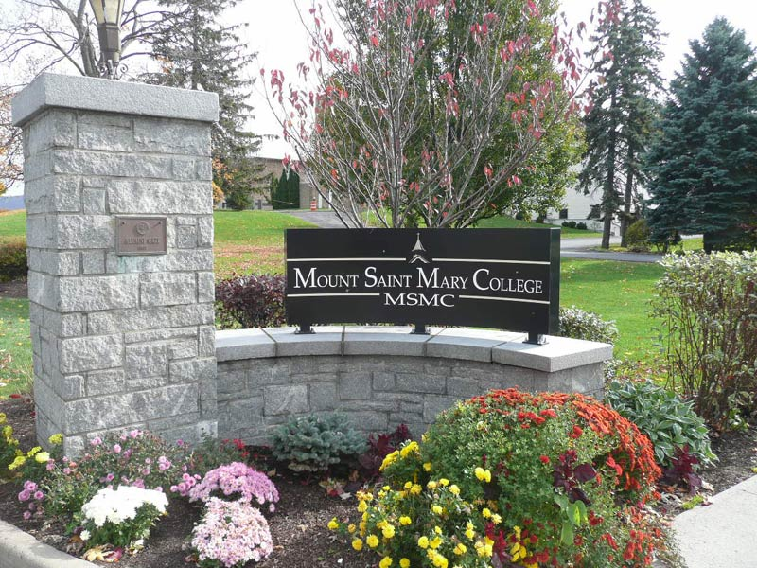
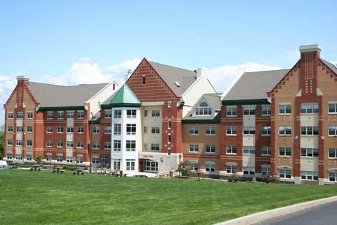
Beautiful Campus
PRO

Slide 10
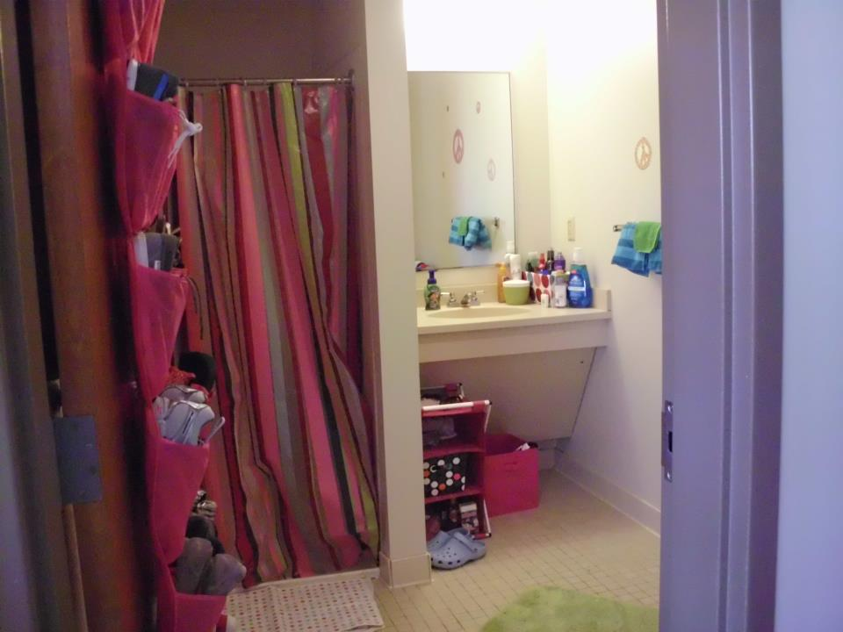
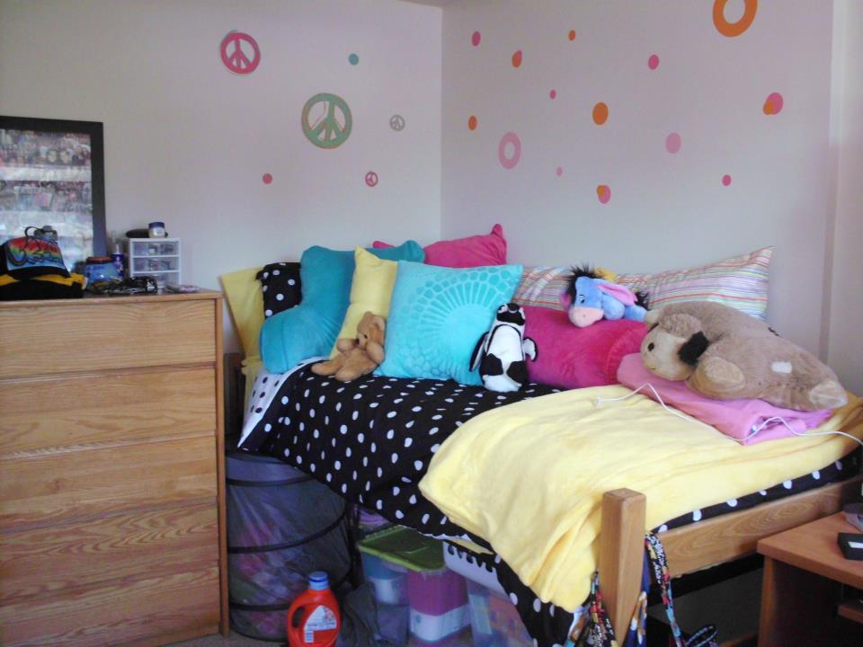
MUCH nicer dorms/personal bathrooms
PRO

Slide 11
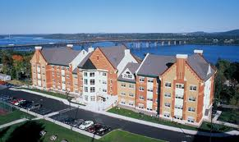
Smaller/Easier to get to class
PRO

Slide 12
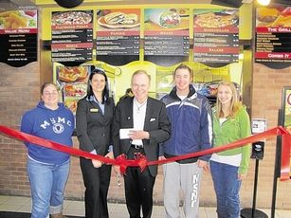
Beautiful Dining hall and Hudson
PRO

Slide 13
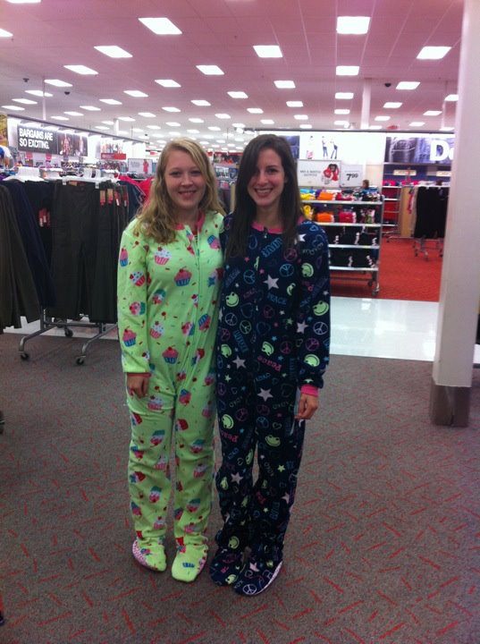
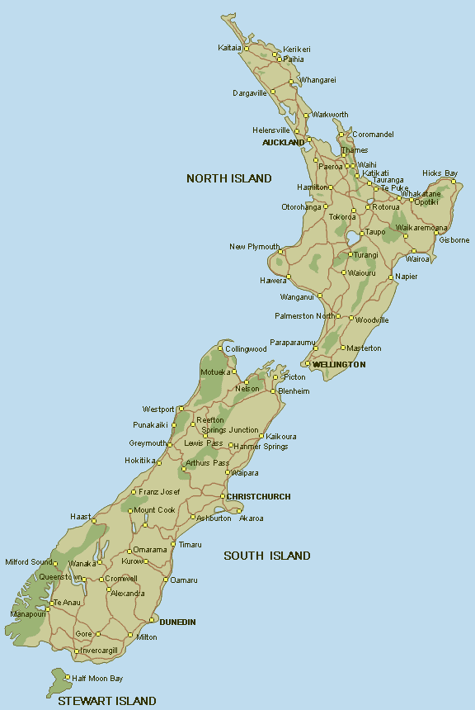
Bestie trip to New Zealand!
PRO

Slide 14
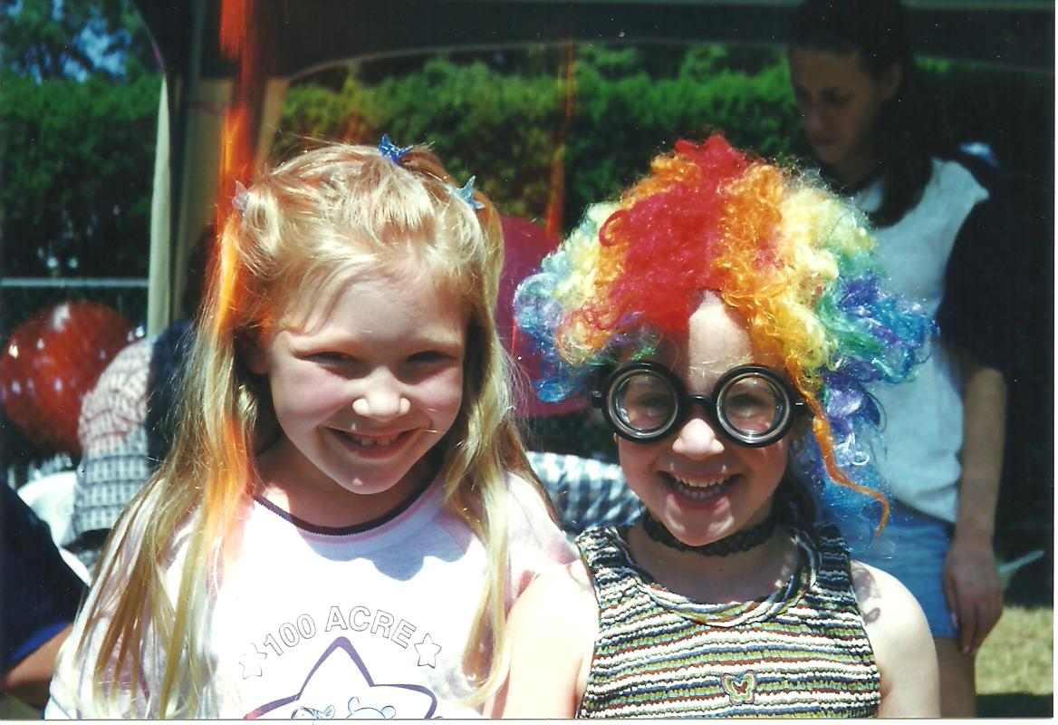
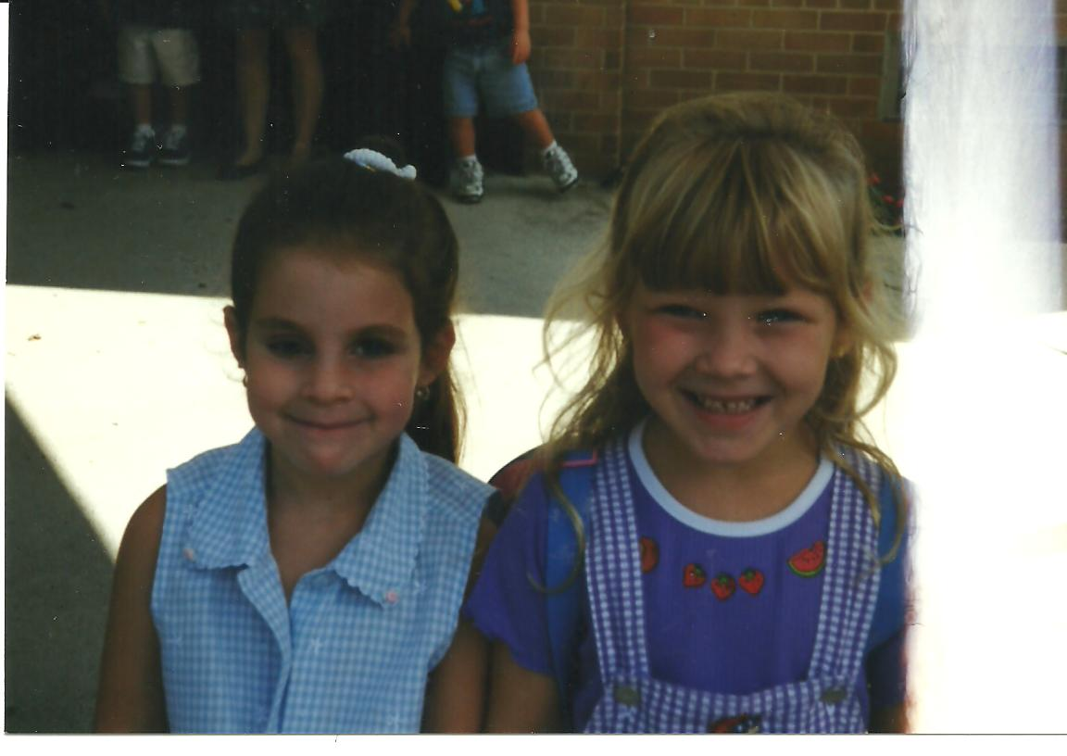
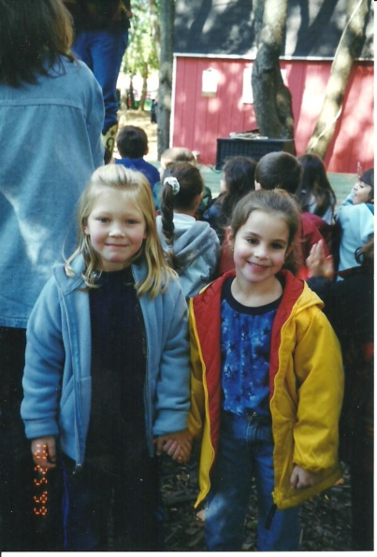
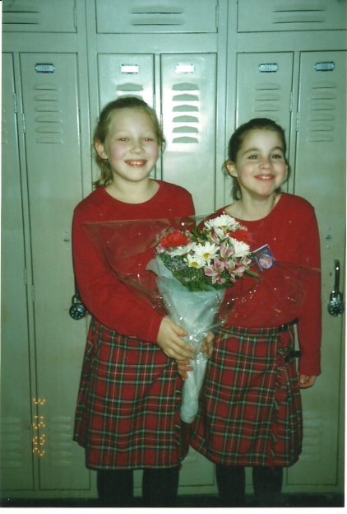
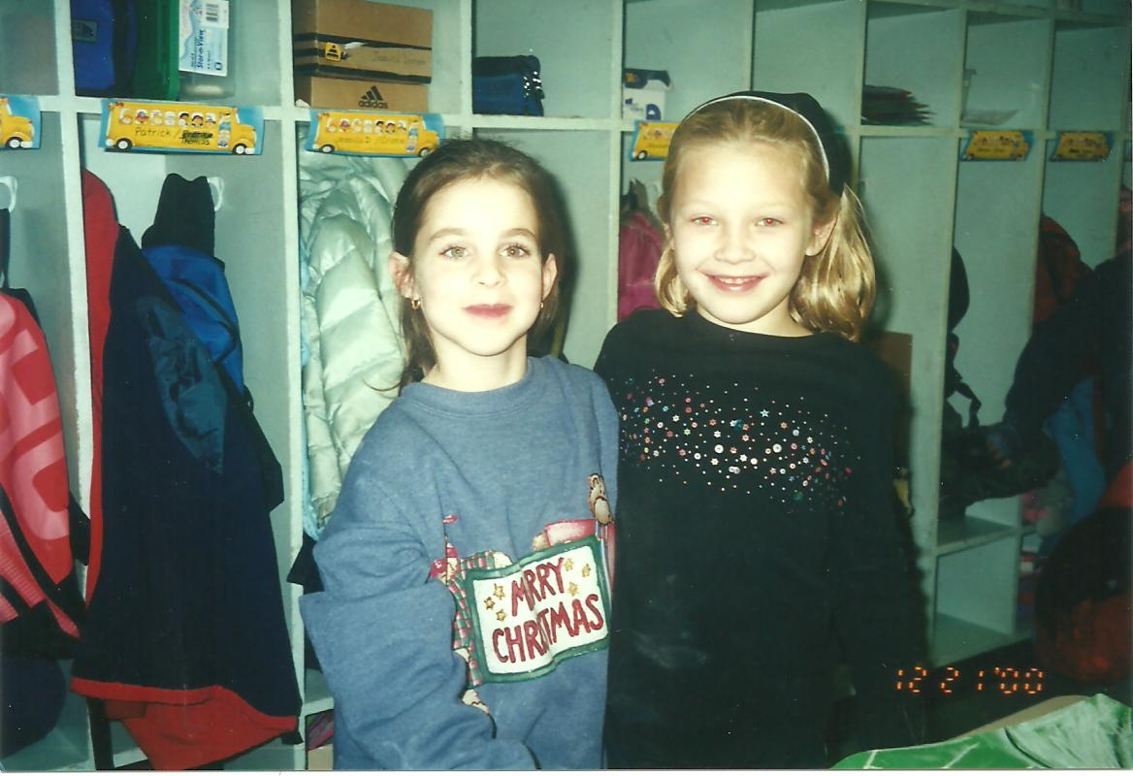
Happier
PRO

