Slide 1
What Camera Do I Use?
By: Brittany Bonasia

Slide 2
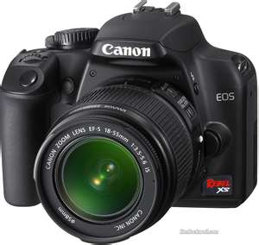
Canon rebel xs
This camera takes great quality pictures and is a good entry level DSLR camera.
To learn more about this camera click here for a link to Canon’s official site.

