Slide 1
Our Members
Quick Match

Slide 2
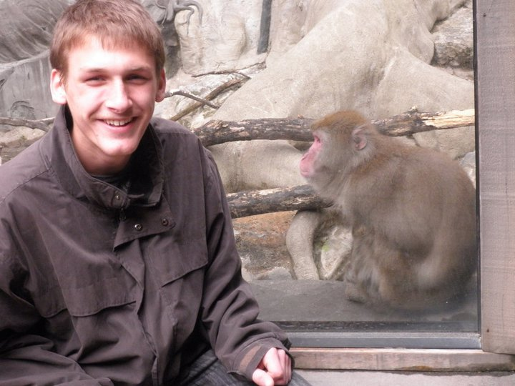
Steven
My self-summary I'm a CERN physicist and college senior. I like explaining science to people, I'm really good at it. I'm a rapper, ex-professional opera singer, Higgs Boson discoverer, prolific toilet-tweeter and humor magazine writer. I was raised between the beach and the city and I really like exploring and generally being outside. I love everyone and thrive on the energy of others.
What I’m doing with my life I aspire to becoming the Notorious BIG of physics. and getting lots and lots of tattoos.
I’m really good at tweeting, laughing, rapping, exploring, eating, explaining, diffusing, snuggling, singing, coding, listening, helping, reminiscing, youtubing
Favorite books, movies, shows, music, and food Someone once asked me what my 'non-negotiables' were Must like dogs. must have an original, inclusive, well-informed music taste. must like cheap food. must have a desire to learn. My original, inclusive, well-informed music taste includes, but is not limited to: Interpol, The Notorious B.I.G., Joy Division, Frank Ocean, Kraftwerk, Hieroglyphics, Girls, The KLF, Pavement, The Backstreet Boys, Pantera, Zomby, The Pixies, The Shins, The Yeah Yeah Yeahs, TNGHT, A$AP Rocky, and anything with a beat i can twerk to.
The six things I could never do without a subwoofer comfy sweaters pizza an equation sheet humor other people
I spend a lot of time thinking about What to order for dinner.
On a typical Friday night I am I gather my friends, find the highest point of the room I'm in, stand on top of it and sing along with whatever the DJ is playing.
The most private thing I’m willing to admit i'm an over-thinker.
I’m looking for Girls who like guys
Ages 18–22
Near me
Who are single
For new friends, long-term dating, short-term dating, activity partners

Slide 3
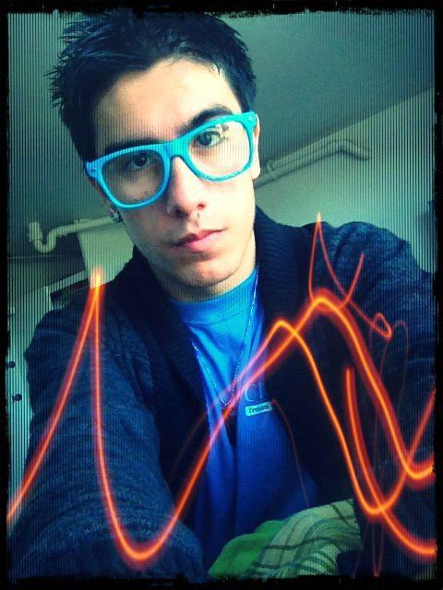
Samuel
His Details
Last Online Online now! Ethnicity White Height 5′ 8″ (1.73m). Body Type Average Diet Mostly anything Smokes No Drinks Socially Drugs Never Religion Catholicism but not too serious about it Sign Scorpio and it’s fun to think about Education Graduated from college/university Job Military Income — Offspring Doesn’t have kids Pets — Speaks English
Similar Users
My self-summary I'm Ryan, born and raised Bronx boy. FUN FACT: I share a last name with a popular country (debatable about the country part) musician. If you can guess it, you win a prize. Moved back to the City from college in the midst of the cornfields of Pennsylvania. I'm a simple, down to earth guy who has been described as a perfect gentleman and good conversationalist. I'm a pretty decent cook, and I have a knack for not taking serious situations seriously. Anything else you'd care to know, shoot me a message!
What I’m doing with my life Infantry officer in the Army reserves, in the works of becoming a police officer for my full time career, but it's such a lengthy process :(
I’m looking for Girls who like girls
Ages 20–24
Near me
Who are single
For new friends, long-term dating, short-term dating

Slide 4
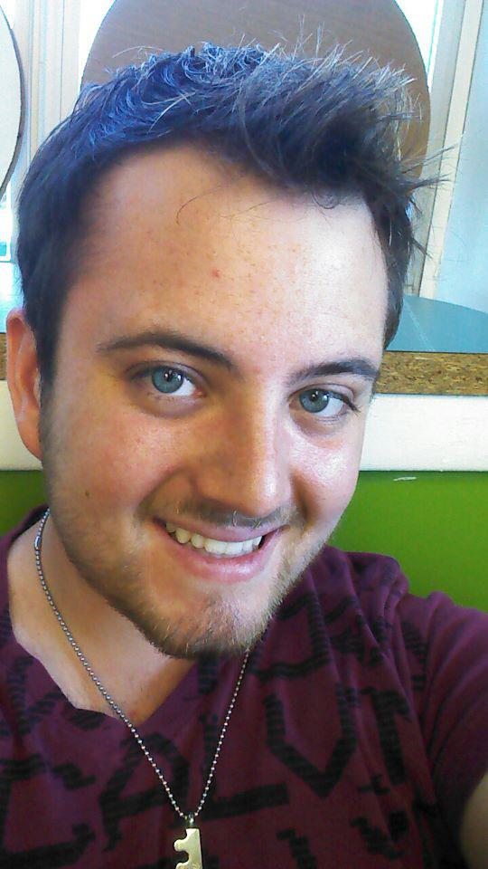
Brian
I’m looking for Girls who like guys
Ages 18–22
Near me
Who are single
For new friends
You should message me if If you're looking for a ruggedly masculine gentleman to squire about town for an evening, if you're a goof who doesn't take herself too seriously, and thirdly (perhaps most importantly) You would have no problem spending a day inside watching movies from the couch fort that you and I built together.

Slide 5
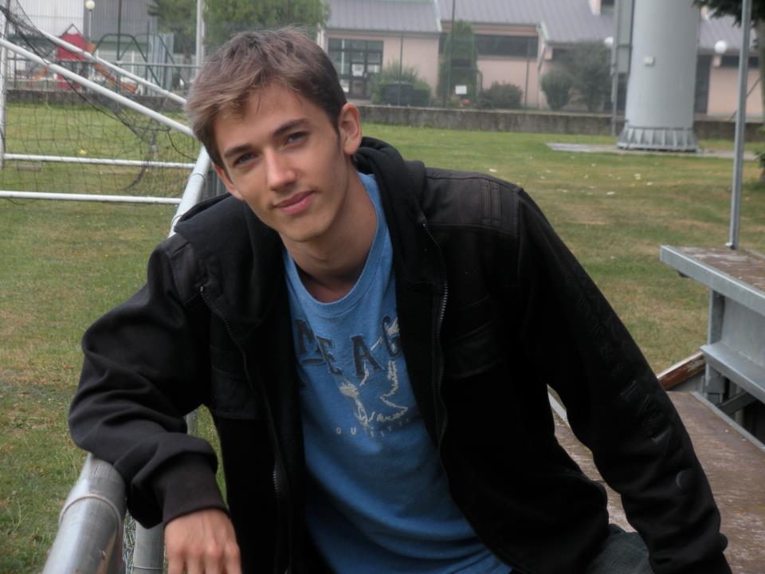
Elliot
My self-summary I'm easy going and open minded. I moved to the city about a year ago. I love to try new things, whether it's trying a new restaurant or discovering a part of town I'm unfamiliar with. Growing up, I moved all across the country and realized that I'm a city dweller. I like to cook when I get the chance, but I keep a bottle of hot sauce handy just in case!
What I’m doing with my life Working at a law firm as a consultant. The plan's to go to law school.
I’m looking for Straight girls only
Ages 21–24
Near me
Who are single
For new friends, long-term dating, short-term dating

Slide 6
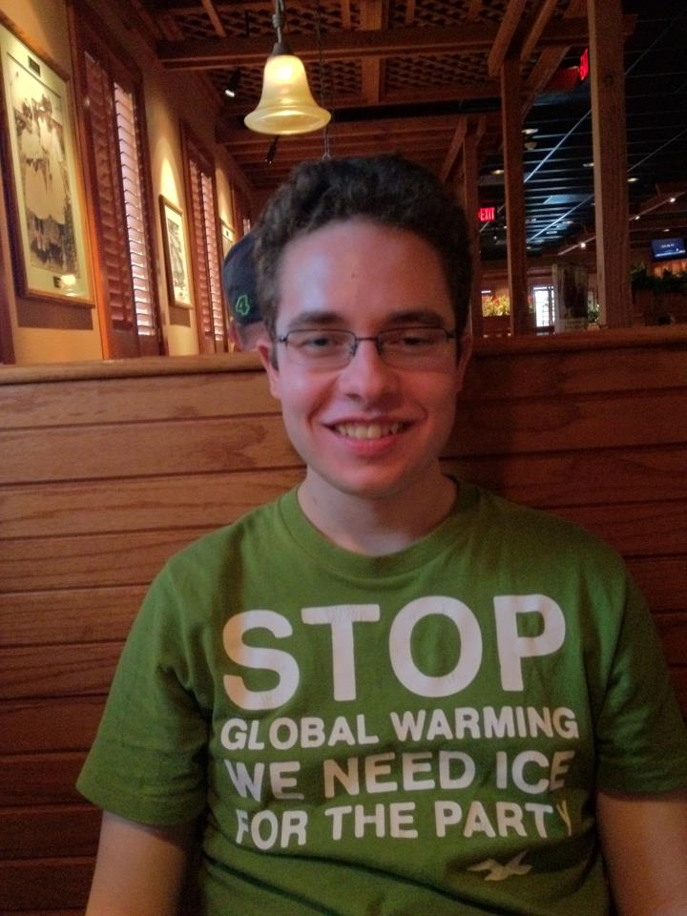
Joseph
My self-summary Started my own social media company a couple of months back. To say that I've been loving it would still be an understatement. Before I got the business going, I graduated from Vanderbilt University, and then spent a year advertising tampons at big agency. Things have been interesting, to say the least. I'm a New Yorker, born and raised in Manhattan (although, people tell me I strike them as a Brooklynite). I love it here and it'd be great to find someone who'd like to continue exploring it with me.
What I’m doing with my life Working hard, but really enjoying things. Checking out concerts, running around the city, going for drinks and hanging out with friends... just taking it all in.

Slide 7
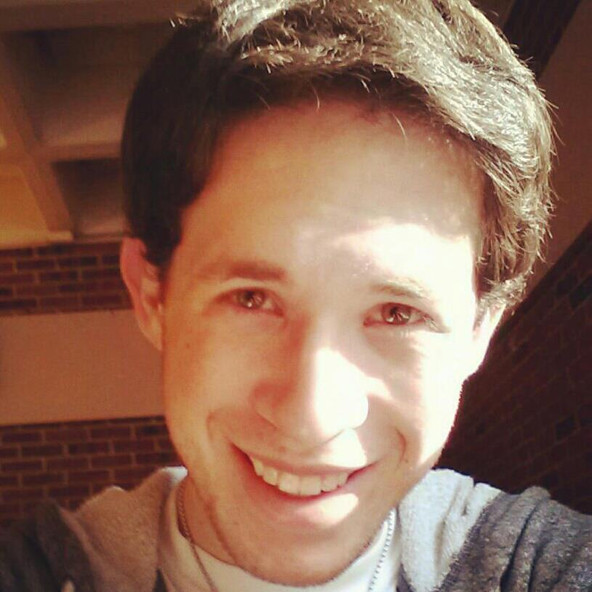
Andrew
Advertisement A-List users don’t see ads
His Details
Ethnicity White Height 5′ 11″ (1.80m). Body Type Athletic Diet Mostly anything Smokes No Drinks Often Drugs — Religion Catholicism but not too serious about it Sign Pisces but it doesn’t matter Education Graduated from college/university Job Banking / Financial / Real Estate Income Rather not say Offspring Doesn’t have kids Pets Likes dogs Speaks English
My self-summary I'm a driven career focused guy, but also easy going and very open minded. I never take myself too seriously and can almost always find a way to have a good time in any situation. I grew up in Massachusetts, went to school in Boston, and have lived in Manhattan for the last 4 years. I enjoy being active, working out, and doing anything outside in the city or by the ocean.
What I’m doing with my life I work in the Finance industry at a large firm in midtown Manhattan. I finally found a great, challenging job that gives me the chance to work with people all around the world.
I’m really good at Anything outdoors, skiing, soccer, trivia, math, debating random things, and taking all my stress out at the gym lifting heavy things up.
I’m looking for Girls who like guys
Ages 18–29
Located anywhere
Who are single

