Slide 2
HELLO (:
Ana Chavez
I’m a sophomore
Psychology Major
Yellow
Brisk
Jeans

Slide 3
What is it?
In 34 countries around the world MNT exists.
MNT kills one baby every nine minutes.
These tiny newborns suffer repeated, painful convulsions and extreme sensitivity to light and touch. There is little hope of survival.
Tetanus kills mothers too.

Slide 4
Why it happens.
MNT is caused when tetanus spores, found in soil everywhere, come into contact with open cuts during childbirth.
The disease strikes the poorest of the poor, the geographically hard to reach and those without health care.

Slide 5
Is It Preventable?
Yesss!
Just three doses of a 60-cent immunization protects mothers, who then pass on the immunity to their future babies.
A total of $1.80 can save a life

Slide 6
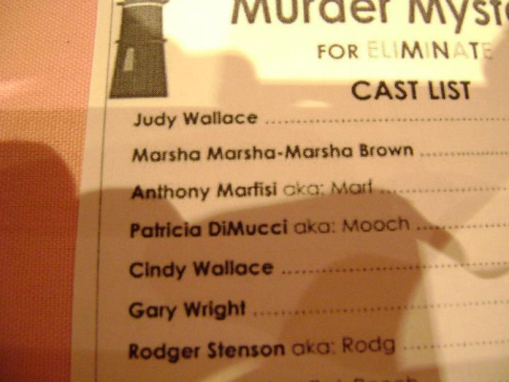
What have we done here?
Murder Mystery 2011
Mother’s Day Tea Party
Super Successful Bake Sales
The Giver-Upper Jar(:

Slide 7
Video
http://www.youtube.com/watch?v=0FY_sBrN3pk&feature=youtu.be

