Slide 1
Alex
test

Slide 2
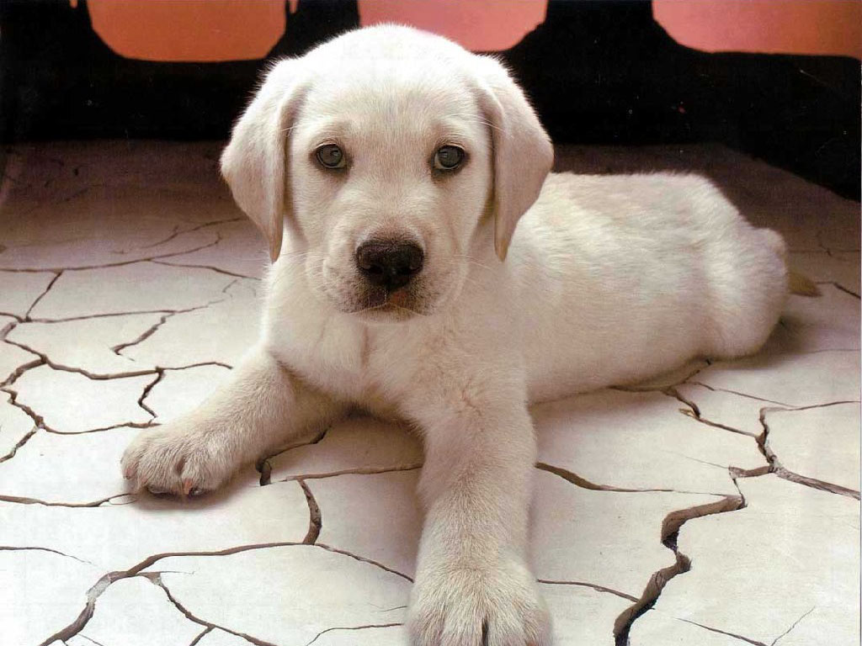
Yo Dawg Wussup?

