Slide 1
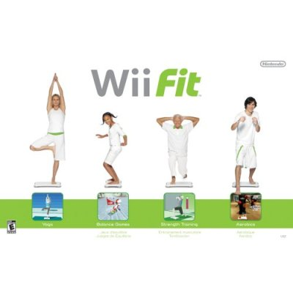
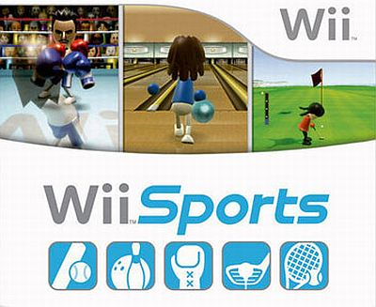
Wii Fit & Wii Sports
Adelphi University
Robby Brown & Andrew Huber

Slide 2
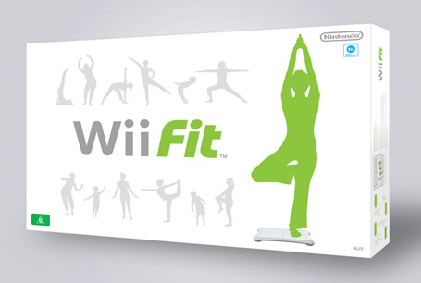
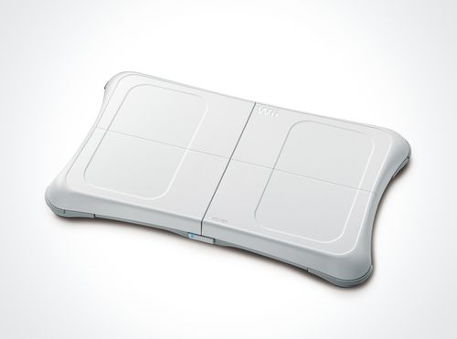
Wii Fit
Wii Fit lets your physically in cooperate yourself within the games to make you feel as if your actually getting involved in a physical activity.
For Wii Fit, the game focuses on aerobics, yoga, balance games, and strength training.
Wii Fit has been proven to increase focus while working out, as it keeps a routine schedule for you to follow.
Your weight, as well as your BMI ( Body Mass Index ) is measured at the start of each exercise, to monitor your progress from start to finish.

Slide 3
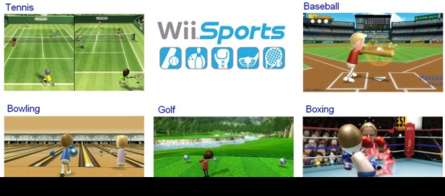
Wii Sports
Wii Sports, similar to Wii Fit, allows you to use a controller that acts on physical movement, that gives you that “in the game” experience.
Within the game, one can play Bowling, Baseball, Boxing, Golf, and Tennis, all which is done by using your upper body as your swing the controller in the motion you would as if you were actually competing in the game.
Wii Sports, along with Wii Fit, allows you to get off the couch and into the game as you burn calories while you play.

Slide 4
Wii Sports Statistics
 | Tennis | Boxing | Bowling | Baseball
Real Sport (Calories Burnt Per Minute) | 8.1 | 10.2 | 7.2 | 7.3
Wii Sport (Calories Burnt Per Minute) | 5.3 | 7.2 | 3.5 | 4.5

Slide 5
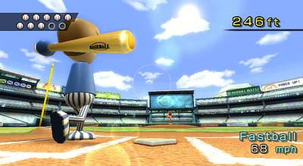
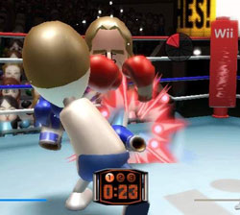
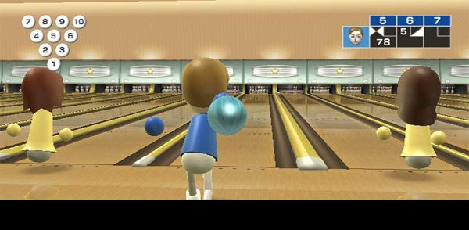
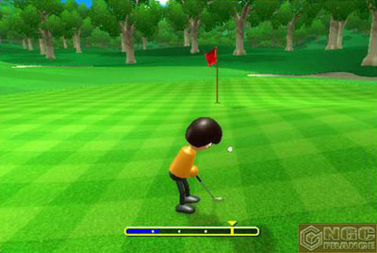
Wii Sports
Baseball
Boxing
Bowling
Golf

Slide 6
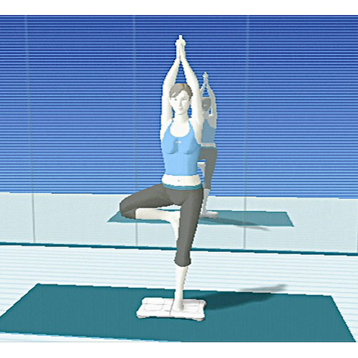
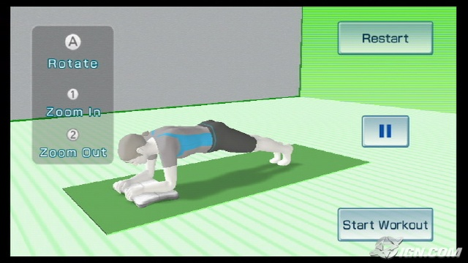
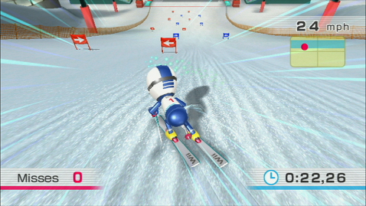
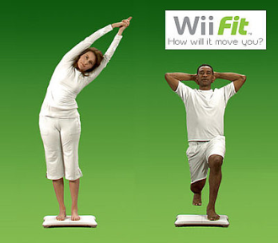
Wii Fit

