Slide 1
AU SOFTBALL
2013 ROSTER & SCHEDULE

Slide 2
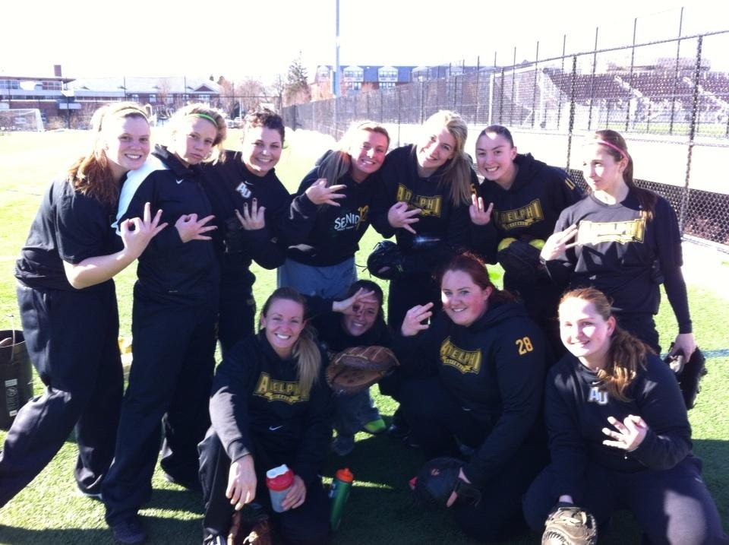
FROM THE FIRST PRACTICE…

Slide 3
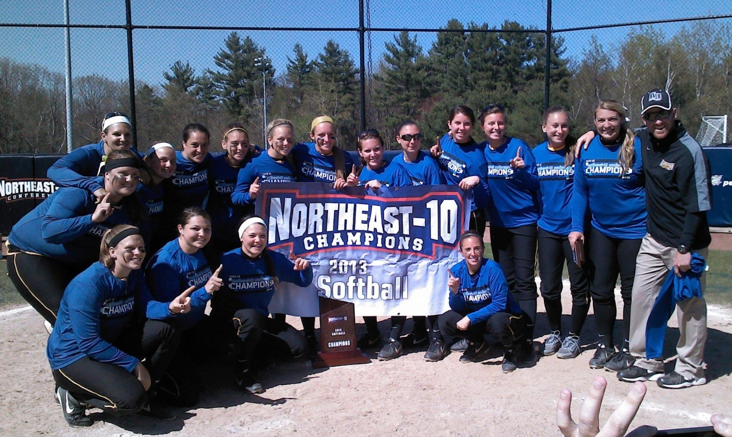
TO THE CHAMPIONSHIP

Slide 4
ROSTER
Click to view 2013 Roster

Slide 5
SCHEDULE
Click to view 2013 Schedule

