Slide 1
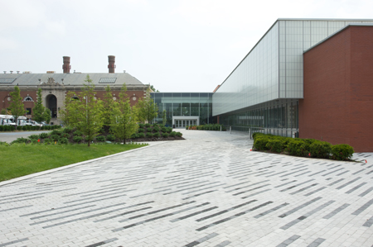
Adelphi University Equipment Room
Mission Statement:
The mission of Adelphi University’s Equipment Room is to promote the growth and wellbeing of its student-athletes by providing cutting edge athletic apparel while administering professional care of equipment.
Located in room 140 of the Center for Recreation and Sport
Equipment Manager- LaSheena Brown
Services Provided:
Laundry
Lockers
Cubbies
Lost & Found
Care of Equipment
Sizing
Equipment Distribution
Towels

Slide 2
