Slide 1
Version Control overview
Let’s learn a few Version Control Basics!
Donald Hanson II - 3/3/2016
Revised by Brian Seidl – 5/8/2017

Slide 2
What is Version Control?
Version Control is the process of being able to track how projects change over time. When working on large projects with many members working on the same project, change management can drastically improve the productivity of project.
Version control systems are used heavily computer science areas, spanning from personal research to large scale projects.

Slide 3
What kind of systems are there?

Slide 4
Today, we’ll focus on using the most popular system:

Slide 5
How does git work?
Git manages code using folders called repositories.
The meaning of repository is: (When referring to Computing)
“A central location in which data is stored and managed”
Repositories are usually maintained in a folder based hierarchy for simplicity.

Slide 6
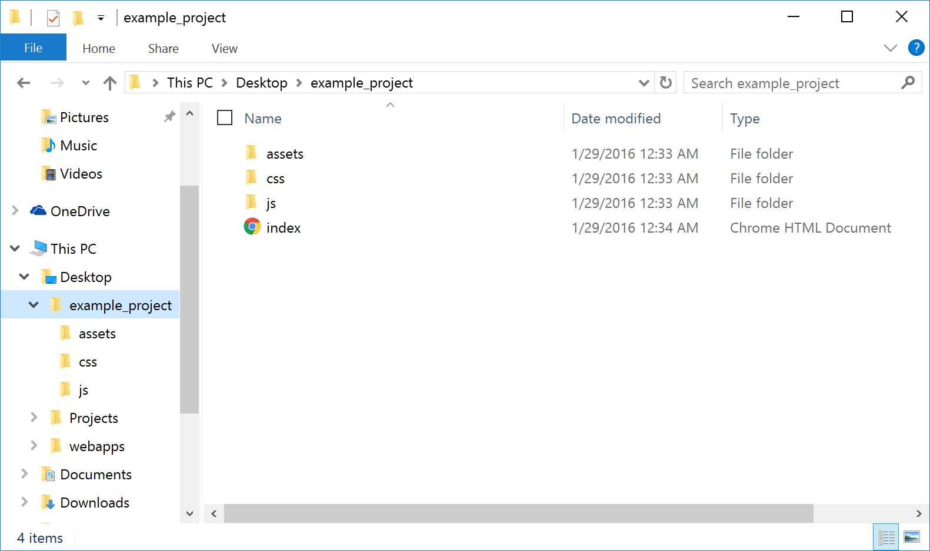
Example repository structure: Basic Website

Slide 7
What now?
Once the repository is hosted online, git services can be utilized to make the most out of the hosted project.
git has created numerous commands for users to access, utilize, and manipulate repositories on their own machines.

Slide 8
Git setup: Repository Hosting
To start using git, one would need to create an account in an online repository hosting service, such as Github, or BitBucket.

Slide 9
Github and Bitbucket
Github
Based towards public repositories
Good for showcasing work
Helpful for open sourcing
Limited private repositories
Bitbucket
Based towards private repositories
Good for personal and internal projects
Unlimited private repositories

Slide 10
Git setup: Let’s set up Github!
Go to github.com and login/create an account.
Create a new repository.
Clone the repository to your local machine.
Add some files.
Save changes to the server.

Slide 11
Git setup: Let’s set up Bitbucket!
Go to bitbucket.org and login/create an account.
Create a new repository.
Clone the repository to your local machine.
Add some files.
Save changes to the server.

Slide 12
Let’s setup git!
You can use many programs that can access git commands.
You can either use a git in the command line, or in a GUI.
Let’s use the command line to start. (It’s a good idea to learn the basic commands first, before moving on to a GUI!)

Slide 13
Let’s setup git!
Today, we’ll be using the Git BASH terminal to access commands.

Slide 14
Let’s setup git!
First, we need to tell git system who we are:
git config --global user.name “First Last”
git config --global user.email “yourEmail@coolmail.com”

Slide 15
Let’s setup git!
Now, let’s navigate to a folder where you want to download the source repository:
Navigation review:
To navigate to a folder: cd folderName
To navigate up a folder: cd ..
To list the files in the current folder: ls

Slide 16
Let’s setup git!: Clone repository!
We can clone the repository to use it.
Now that you are in the folder that you would like to download the files, type:
git clone httpslinkhere
When prompted, enter your username and password for the account under which the files are located.
This will place a copy of the repository on your machine.
Make sure to place a copy of your project into the directory that was just cloned

Slide 17
Let’s setup git!: Learn git commands!
Now that we have the repository cloned, let’s learn a few commands to use!
Add - git add filename ( adds the specified file to the local staging )
To add multiple files - git add .
Commit - git commit -m “Name, changes in this version” (Stage your changes)
Push - git push -u origin master (Push your changes to the server)
Pull - git pull origin master (Pull latest changes from the server)

Slide 18
Let’s setup git!: Learn git commands!
Now that we have the repository cloned, let’s learn a few commands to use!
Status - git status (Checks the current status of the repository)

Slide 19
Branching
Branching is an important tool that version control offers.
Branching allows the user to access previous versions of the project at any time.
git checkout - allows the user to ‘checkout’ a version of the project at any time

Slide 20
Thanks!

