Slide 1
Yankees PowerPoint
By Andrew Brunton
Yankees

Slide 2
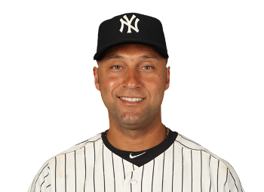
Derek Jeter (#2, ShortStop)

Slide 3
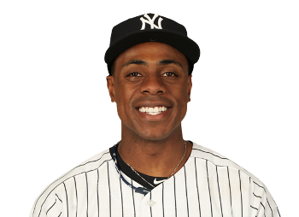
Curtis Granderson (#14, Center Field)

Slide 4
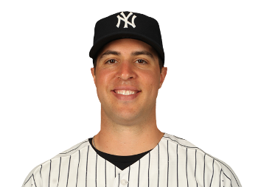
Mark Teixeira (#25, First Base)

Slide 5
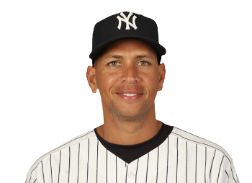
Alex Rodriguez (#13, Third Base)

Slide 6
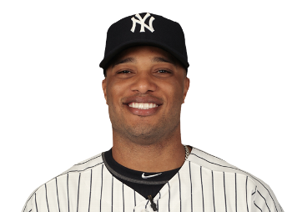
Robinson Cano (#24, Second Base)

Slide 7
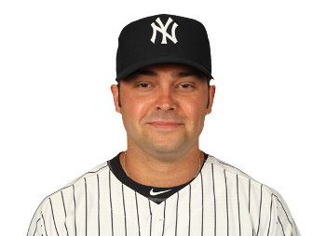
Nick Swisher (#33, Right Field)

Slide 8
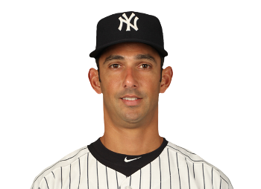
Jorge Posada (#20, Designated Hitter)

Slide 9
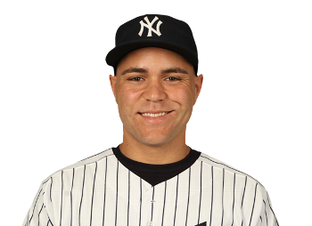
Russell Martin (#55, Catcher)

Slide 10
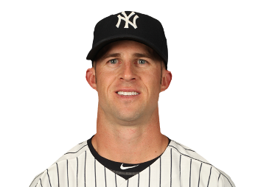
Brett Gardner (#11, Left Field)

